Slide 1

Core Socialist Values
Democracy

Slide 2

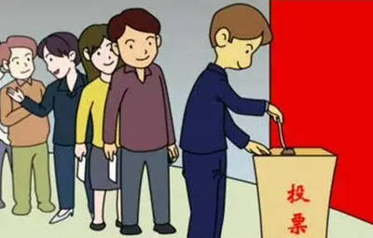
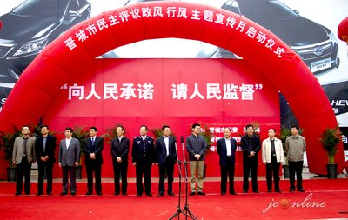
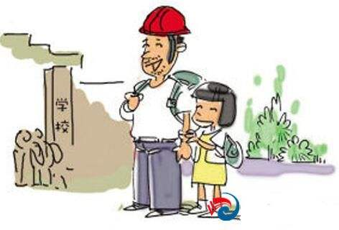
What's China’s socialist democracy?

Slide 3



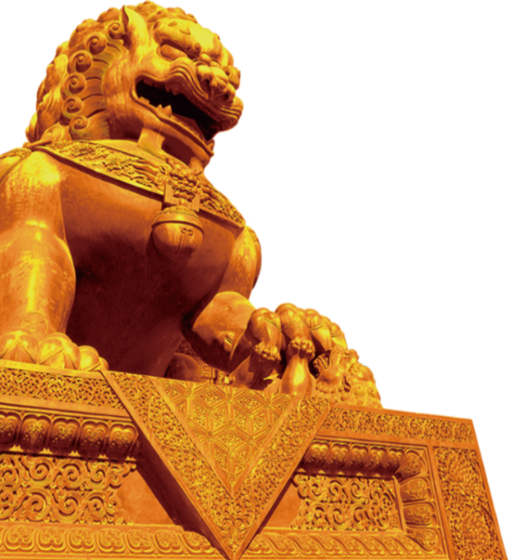

People’s democracy is a banner that the CPC has always held high. On our way forward, we should keep to the socialist path of making democratic political progress with Chinese features.
——Xi Jinping
人民民主是中国共产党始终高举的旗帜。在前进道路上，我们要坚定不移走中国特色社会主义政治发展道路，继续推进社会主义民主政治建设、发展社会主义政治文明。
——习近平

Slide 4
1
Three Elements
Contents
2
Characteristics
3
Summary

Slide 5



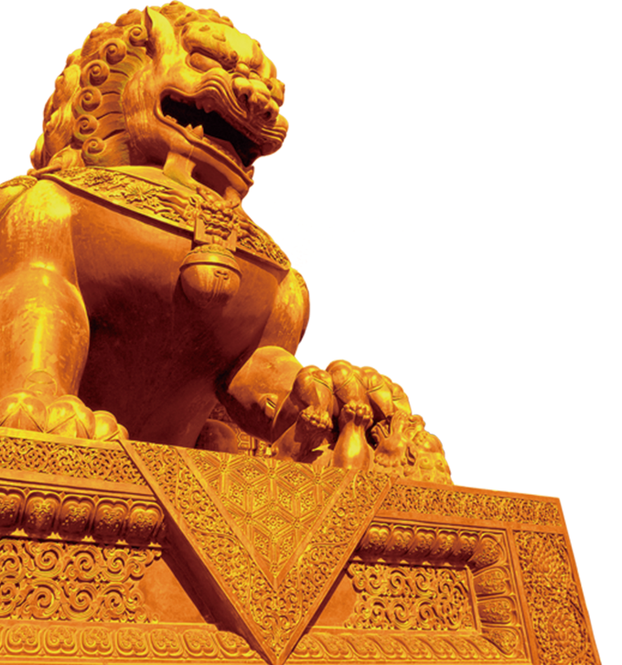
Part I Three Elements
Party leadership
中国共产党的领导
People running the country
人民当家作主
Law-based governance
依法治国

Slide 6

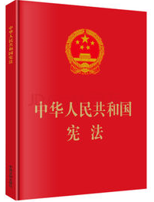
Part II Characteristics
1.One Constitution
2.Three systems
2.1The system of people’s congresses
人民代表大会制度
fundamental political system
2.2 Multi-party cooperation and political consultation under the leadership of the Communist Party of China
中国共产党领导的多党合作和政治协商制度
basic political systems
2.3 Regional ethnic autonomy
民族区域自治制度

Slide 7

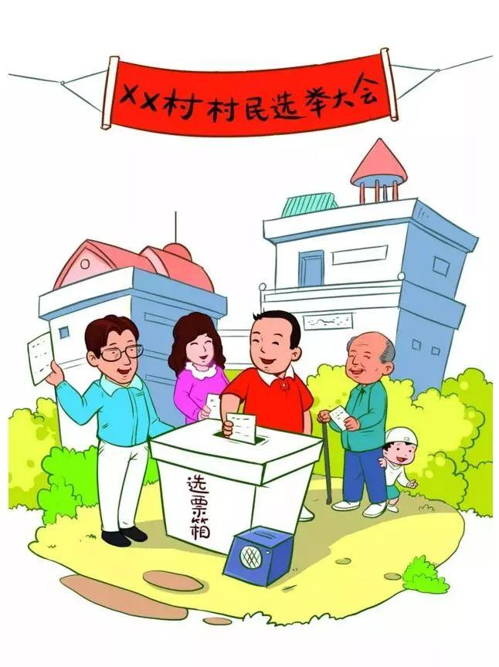




2.1The System of People’s Congresses
indirect election
间接选举
indirect election
间接选举
direct election
直接选举

Slide 8

2.2 Political Party System
West
China
Multiparty cooperation and political consultation under the leadership of the Communist Party of China
One-Party System 一党制
Two-Party System 两党制
中国共产党领导的多党
合作和政治协商制度
Multi-Party System 多党制

Slide 9

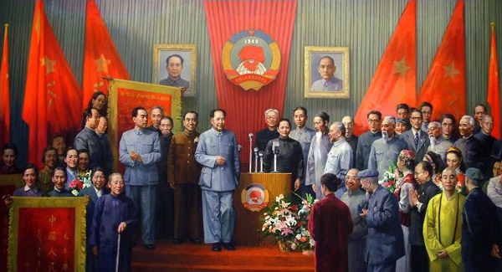
2.2.1 Advantages
1. It avoids political turbulence caused by multi-party competition and mutual strife.
避免多党竞争造成的政治动荡
2. It avoids all kinds of malpractices caused by
one-party dictatorship and lack of supervision.
避免一党专政、缺少监督
3. Parties also supervise each other and ensure
that the people are masters of their own affairs.
相互监督，保障人民当家作主

Slide 10
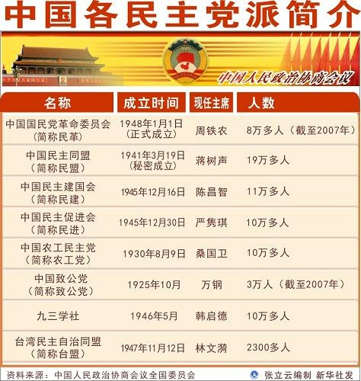
2.2.2 Roles
Communist Party of China
Role:
ruling party
Democratic parties
Role:
participating in the administration and discussion of state affairs

Slide 11

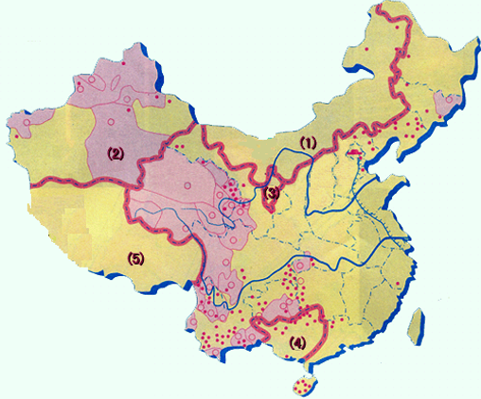
2.3 Regional Ethnic Autonomy
1. Inner Mongolia Autonomous
Region 1947
2. Xinjiang Uygur Autonomous
Region 1955
3. Hui nationality in Ningxia
Autonomous Region 1958
4. Guangxi Zhuang Autonomous
Region 1958
5. Tibet Autonomous Region 1965

Slide 12
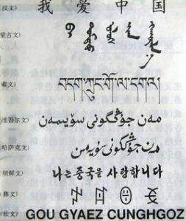
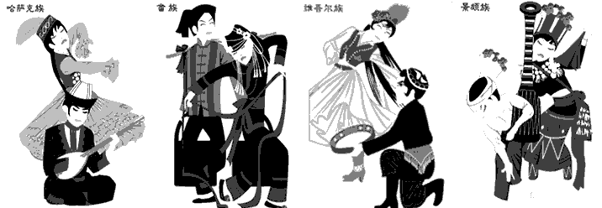
Reasons
1. Ethnic differences and unbalanced development. 民族差异
2. The ethnic distribution in China is dominated by large-scale mixed
and small-scale cohabitation. 大杂居，小聚居
different languages
different culture

Slide 13
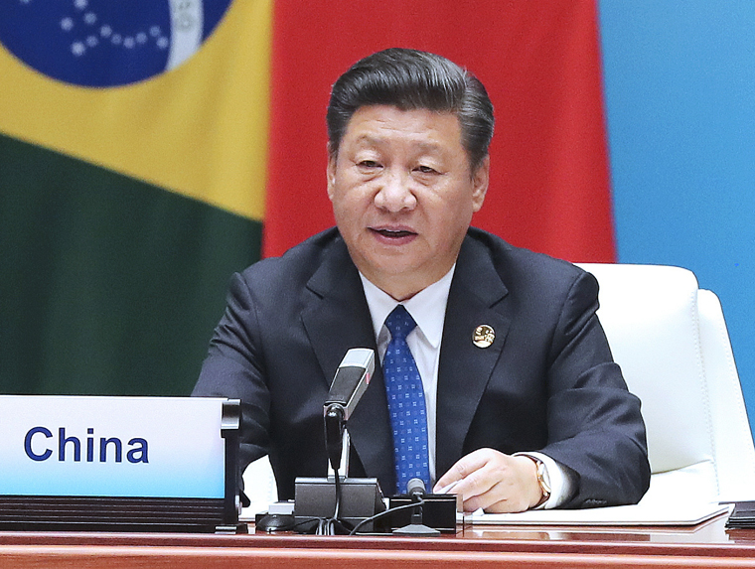
Part III Summary
China’s socialist democracy is the broadest, most genuine, and most effective democracy to safeguard the fundamental interests of the people.
——Xi Jinping

Slide 14

Part III Summary
Discussion:
How should college students participate in the construction of China’s socialist democracy?

