Slide 1



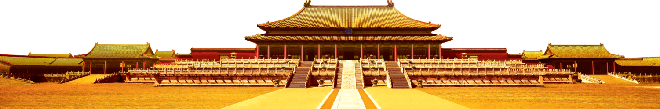
Core Socialist Values
Justice

Slide 2

Contents
Definition of Justice
Problems of Injustice
Related CET-4 Practice
Significance and Solution

Slide 3
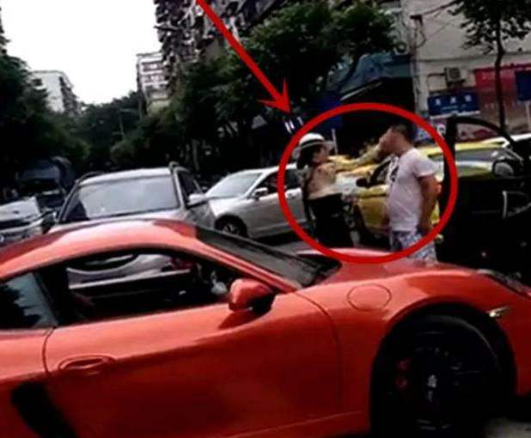
Definition of Justice
?
Chongqing Porsche driver
重庆保时捷姐
On Aug 14, 2019, Chongqing Porsche driver and wife of local police chief disses a guy who didn’t make room for her illegal u-turn on a zebra crossing. She slapped him in the face and the man slapped her back.

Slide 4
Definition of Justice
Her bragging(吹嘘) about always speeding, running red lights and avoiding responsibility for traffic violations(违规) caused heated online discussion about her background and police connections.
Vote
Chongqing police announced on Monday the police officer husband of the face-slapping Porsche driver has been removed from his post for “disciplinary violations”(违纪) and is now under further investigation.

Slide 5

Definition of Justice
Macro
The system of laws in a country that judges and punishes people.

Slide 6
Trolley Problem(电车难题) Definition of Justice
Suppose you are the driver of a trolley. The trolley rounds a bend, and there come into view ahead five track workmen, who have been repairing the track. The track goes through a bit of a valley at that point, and the sides are steep, so you must stop the trolley if you are to avoid running the five men down. You step on the brakes, but alas they don't work. Now you suddenly see a spur of track leading off to the right. You can turn the trolley onto it, and thus save the five men on the straight track ahead. Unfortunately, ... there is one track workman on that spur of track. He can no more get off the track in time than the five can, so you will kill him if you turn the trolley onto him (Thomson 1985, 1395).
假设你是一辆电车司机。 电车绕过一个弯道，你看到前面有五个轨道工人，他们一直在修理轨道。 那条轨道在某一地点经过山谷，两侧都是陡峭的。如果你要避免电车撞向无人，你必须停下电车。 你踩刹车，但刹车失灵。 现在你突然看到一条向右走的轨道，你可以将电车转到该轨道，从而解救在前方直道上的五人。 不幸的是......在这条轨道上有一位轨道工人，他和那五人一样来不及离开轨道。所以如果你将电车驶向他，你就会杀了他（Thomson 1985,1395）。

Slide 7
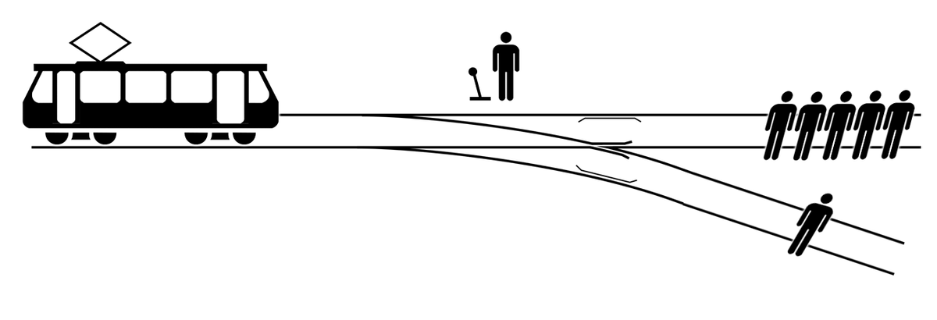
What would you do if you were the trolley driver?
Definition of Justice

Slide 8
Questions
Definition of Justice
★What is the right thing to do?
1. Turn the trolley car onto the side track
2. Go straight ahead
★What is your choice, one or five?
★What if one is a scientist, five are criminals?

Slide 9
Definition of Justice
The trolley problem is a question of human morality, and an example of a philosophical view called consequentialism（结果主义）. This view says that justice is defined by the consequences of an action, and that the consequences are all that matter.
F
Justice is relative.

Slide 10
Definition of Justice
Micro
Fairness in the way people are dealt with

Slide 11
What terms can you think of when talking about justice?
Problems of Injustice
Jobs
Cheating
Laws
Jealous
Salaries
Justices between sexes
Quarrels
Complaints
Business
Phenomenon
Force
Results
Illegal
Tests
Slaves
Reform

Slide 12
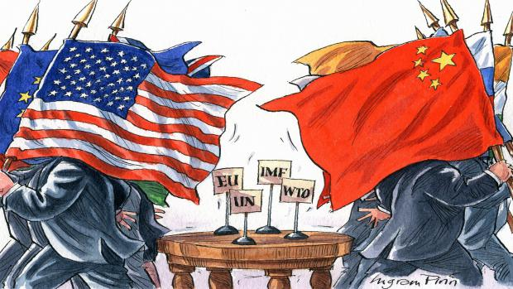
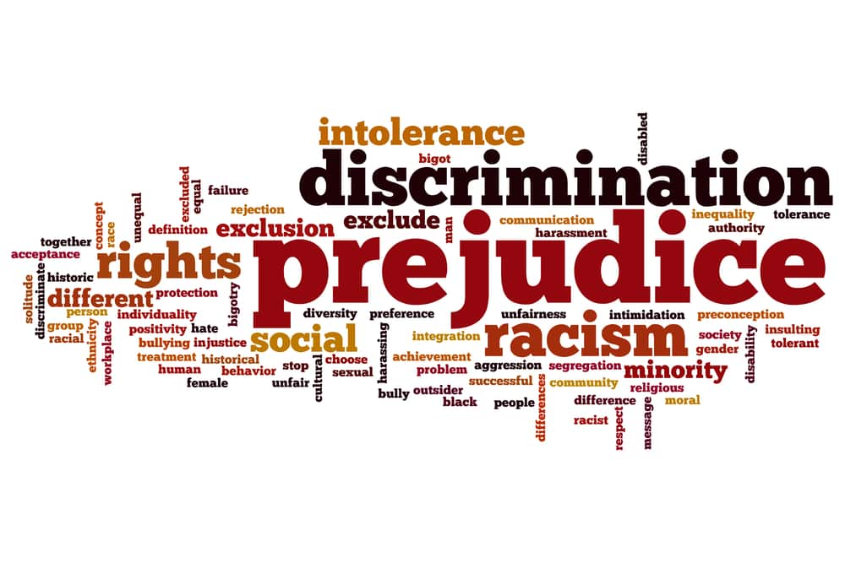
Problems of Injustice
Sino America Trade War---Global economy depression
Social problems---Social disorder
and unstability

Slide 13
Related CET-4 Practice
Core Socialist Values
CET 4 Writing (2019, 6)
Equality of Education Opportunity
Recently the problems which are caused by inequality education opportunities have attracted people’s attention…
What are the causes of these phenomena and what are the consequences?
How to change?

Slide 14

What terms can you think of on this topic ?
Related CET-4 Practice
NCEE
migrant
School district housing
Key
schools
School selection fee
？

Slide 15
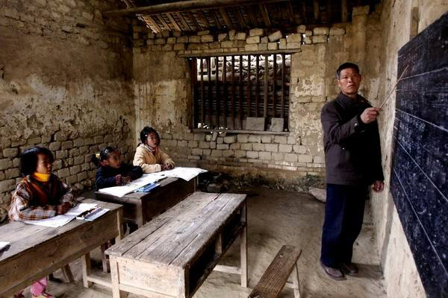
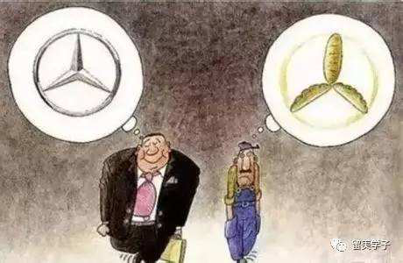
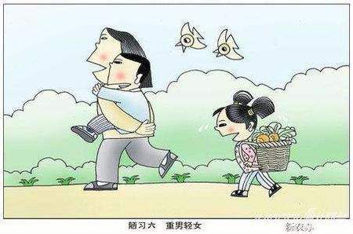
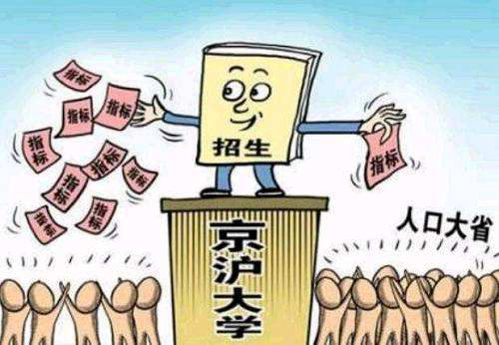
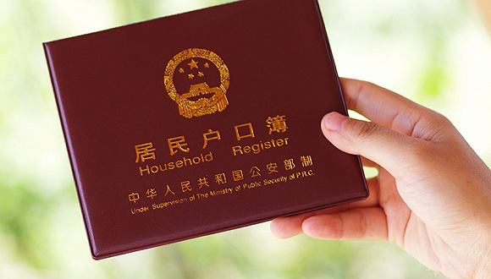
What are the causes of inequality education opportunities?
Related CET-4 Practice
Regional differences
Gap of wealth
Admission
criteria
Household registration system
Gender differences

Slide 16
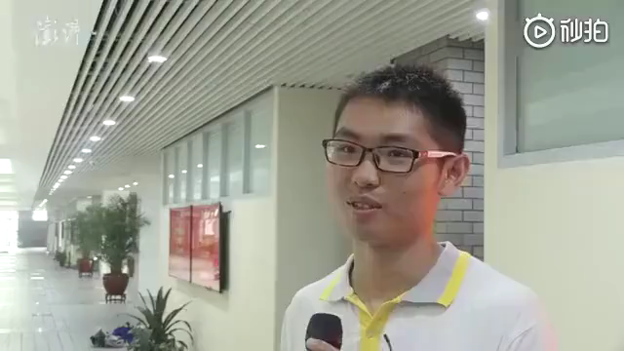
Related CET-4 Practice
Justice?
（Xiong Xuan’ang, 690, the Beijing top scorer of National College Entrance Examination)

Slide 17
Related CET-4 Practice
Justice?
Do you agree with Xiong’s opinion on inequity education opportunities?
The rich can enjoy better education while the poor can’t, do you think the phenomenon is fair?

Slide 18
Significance and Solution
Core Socialist Values
We must safeguard social fairness and justice. Fairness and justice are inherent requirements of socialism with Chinese characteristics. We must, relying on the concerted efforts of all the Chinese people and based on economic and social development, step up efforts to develop institutions that are vital to ensuring social fairness and justice; establish in due course a system for guaranteeing fairness in society featuring, among other things, equal rights, equal opportunities and fair rules for all; and foster a fair social environment and ensure people's equal right to participation in governance and to development.
--Report to the Eighteenth National Congress of the Communist Party of China on Nov 8

Slide 19
Significance and Solution
我们必须维护社会公平和正义。 公平正义是中国特色社会主义的内在要求。 我们必须依靠全体中国人民的共同努力，在经济社会发展的基础上，加强发展对确保社会公平正义至关重要的制度; 在适当的时候建立一个保障社会公平的制度，其中包括平等权利，平等机会和公平规则; 并营造公平的社会环境，确保人民参与治理和发展的平等权利。
11月8日中国共产党第十八次全国代表大会报告

Slide 20
Significance and Solution
Equal rights
Equal Opportunities
Fair rules
1
2
3
Everyone can enjoy basic rights equally, regardless of one’s family background, occupation, wealth, etc.
Belonger. It is given to everyone.
Aims. For example, jobs, education, medical treatment, housing, etc.
Relationships.
It includes all the laws, policies, regulations, etc, which are used to regulate behaviors. There is no exception for anyone to use hidden rules or privilege.

Slide 21
理国要道，在于公平正直。
－－习近平

Slide 22
Thank you!

