Slide 1



Core Socialist Values
The Rule of Law

Slide 2
1.
Definition of the rule of law
2.
Evolution of the rule of law in China
Contents
3.
Significance of the rule of law
4.
Case analysis
5.
Roles and tasks of college students

Slide 3
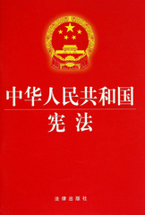
Warm-up
1. Why does our country make the law?
Our country wants to ensure social fairness and carry
out comprehensive reform.
2. What’s the basic law of China? Can you name some laws in our country?
Our basic law is the Constitution of the People’s Republic of China.
Criminal Law; Labor Law; Marriage Law; Education Law; Advertisement Law; Insurance Law; Contract Law; Succession Law; Teachers Law; Lawyers Law…
Notes:
刑法;劳动法;婚姻法;教育法;广告法;保险法;合同法;继承法;教师法;律师法…

Slide 4


Motorcycling robbery
Can people live without law?
Notes:
4

Slide 5
The law is around us everywhere.
Attending school
The Labor Law
Working
Civil Law; Tax Laws
Getting married
Road Traffic Safety Law
Driving
Marriage Law
Dinning outside
Succession Law
Winning a lottery
Education Law; The Compulsory Education Law
Writing a will
Consumer Protection Law
People can’t live without law.
Notes:
Civil Law 民法; Tax Law税法; The Compulsory Education Law义务教育法;Consumer Protection Law消费者权益保护法
5

Slide 6

1. Definition of the rule of law
Notes:
6

Slide 7

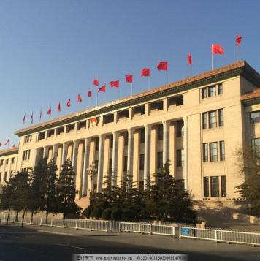
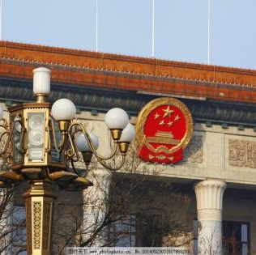
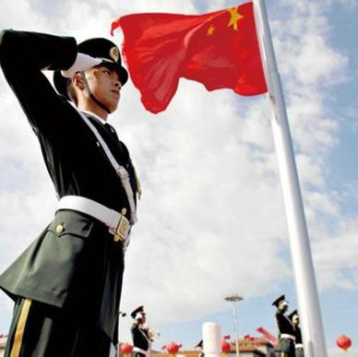
Definition of the rule of law
The rule of law is the legal principle that law should govern a nation, as opposed to being governed by arbitrary decisions of individual government officials.
Notes:
arbitrary: a. 任意的,武断的,专制的
7

Slide 8

Definition of the rule of law
It primarily refers to the influence and authority of law within society, particularly as a constraint upon behavior, including behavior of government officials.
Notes:
constraint: 限制; 限定;约束
8

Slide 9

Definition of the rule of law
That is to say,
Everyone must follow the law
Leaders must obey the law
Government must obey the law
No one is above the law
Notes:
9

Slide 10
2. Evolution of the rule of law in China
Notes:
10

Slide 11

Evolution of the rule of law in China
1978
The third plenary session of the 11th Communist Party of China (CPC) Central Committee proposed the policy “ having laws to go by, laws that must be observed and strictly enforced , and lawbreakers prosecuted ”.
Notes:
1978年，十一届三中全会提出[有法可依、有法必依、执法必严、 违法必究]16字方针。
11

Slide 12
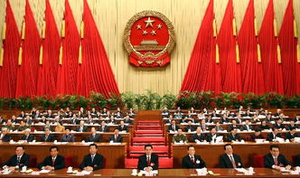
Evolution of the rule of law in China
1997
The 15th National Congress of CPC decided to make “the rule of law” a basic strategy and “building a socialist country under the rule of law ” an important goal for socialist modernization.
Notes:
1997年，十五大确立“依法治国”的基本方略并将“建设社会主义法治国家”列入社会主义现代化建设的重要目标。
12

Slide 13
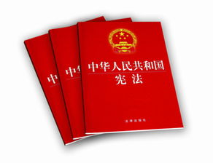
Evolution of the rule of law in China
1999
“The PRC exercises the rule of law, building a socialist country governed according to law” was added to the Constitution.
Notes:
1999年，将”中华人民共和国实行依法治国，建设社会主义法治国家”载入宪法。
13

Slide 14
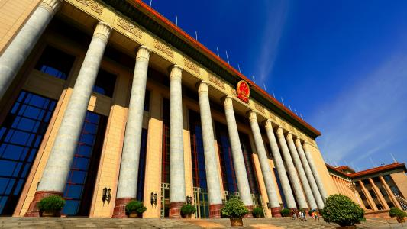
Evolution of the rule of law in China
2007
The 17th CPC National Congress called for speeding up the building of a socialist country under the rule of law.
Notes:
2007年，十七大提出加快建设“社会主义法治国家”。
14

Slide 15

Evolution of the rule of law in China
2014
The Fourth Plenary Session of the 18th CPC Central Committee has taken rule of law as its central theme for the first time.
Notes:
2014年，十八届四中全会第一次将“依法治国”定为会议主题。
15

Slide 16
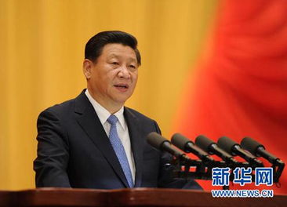
Evolution of the rule of law in China
2017
President Xi delivered the report at the 19th National Congress of CPC.
“… We have taken major steps in developing democracy and the rule of law. We have actively developed socialist democracy and advanced law-based governance….”
Notes:
习主席在十九大报告中说:“民主法治建设迈出重大步伐，积极发展社会主义民主政治，推进全面依法治国.”
16

Slide 17
3. Significance of the rule of law
Notes:
17

Slide 18

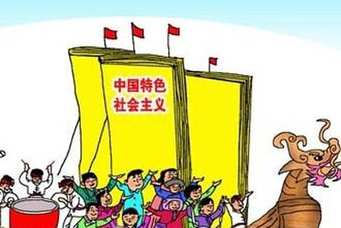
The Significance of the Rule of Law
To be an important guarantee for building a socialist society with Chinese characteristics.
Notes:
18

Slide 19


The Significance of the Rule of Law
To provide people with good living order, so that people can establish basic, stable and sustainable expectations for their lives.
Notes:
19

Slide 20


The Significance of the Rule of Law
To ensure that people enjoy a wide range of rights and freedom in all areas of the society, so that people can live in safety and dignity.
Notes:
20

Slide 21
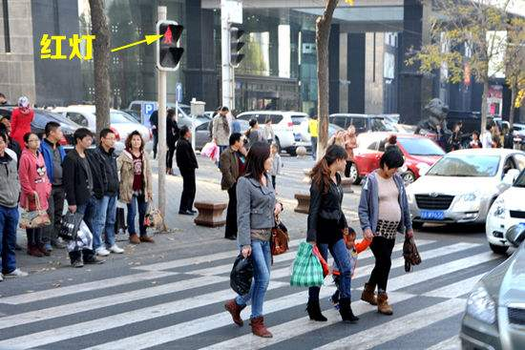
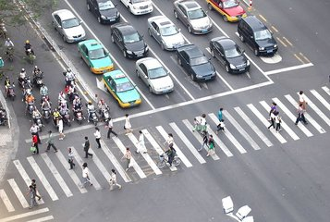
The Significance of the Rule of Law
Chinese Style of Crossing Road
Orderly Traffic at the Crossroad

Slide 22
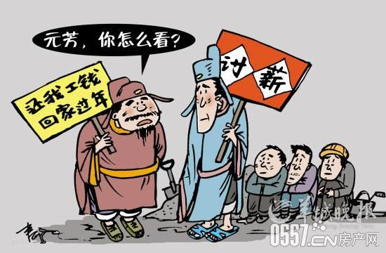

The Significance of the Rule of Law
Wage Arrears of Peasant-workers
Legal Guarantee of Labor Remuneration
Notes:
arrears: 欠款 remuneration:酬金,报酬

Slide 23
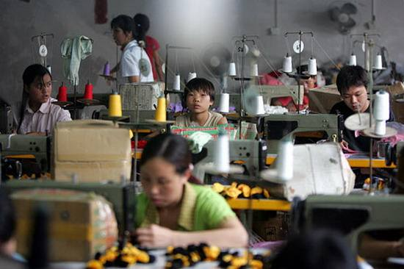
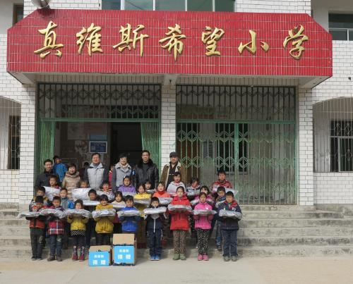
The Significance of the Rule of Law
…
Child Labors
Protection of Minors
Notes:
minor: 未成年人

Slide 24



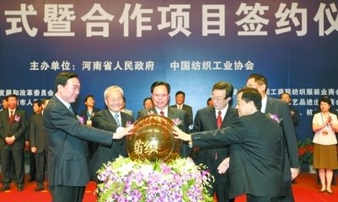
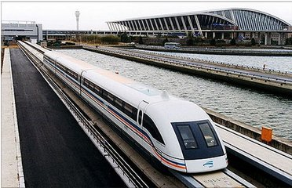

Today’s China under the Rule of Law
Agriculture
Industry
Welfare
Cooperation
Transportation
Space project
Rule of law is “a must” if China wants to carry out comprehensive reform.
Notes:
24

Slide 25
4. Case Analysis

Slide 26
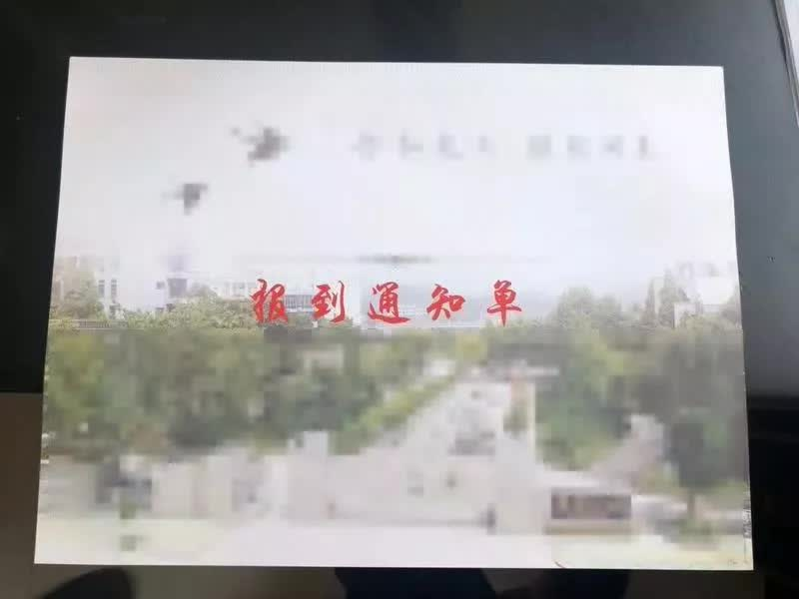
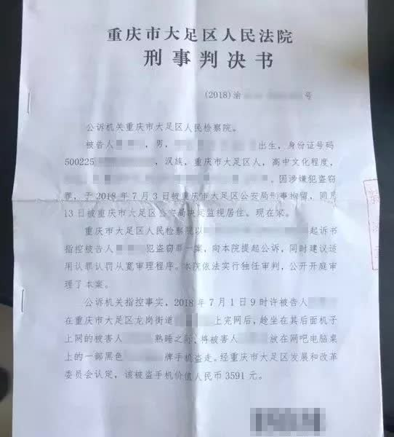

Case Analysis
Case Ⅰ Theft Case
Student gets court verdict, college admission
on the same day
Notes:
verdict: (陪审团的)裁断, 裁决, 裁定
26

Slide 27

Case Analysis
On July 1, one month after Liu finished the college entrance examinations, he stayed overnight playing games at a local internet café. After taking a nap, he woke up the next morning to discover that his phone had disappeared.

Slide 28

Case Analysis
While Liu desperately searched for his phone, he discovered
a man sleeping behind him with his phone by his side.
Feeling upset and mad, Liu impulsively decided to pocket the
stranger’s device as compensation for his own loss.
Liu picked up the phone and dashed out. However, he soon
panicked and regretted his action, realizing he had committed a
crime. He ended up throwing the phone in the trash.
Notes:
impulsively: 冲动地反应,表现 dash:猛冲,突进 panick: (使人或动物)受惊

Slide 29

Case Analysis
Liu was sentenced to four months in detention after stealing a stranger’s phone. He was placed on probation for six months,
and ordered to remain in his hometown, potentially derailing his plans of attending the college in September.
Notes:
detention: 阻止,滞留,拘留(尤)监禁 probation:缓刑(尤对年轻犯人施行的) derail: (使火车等)脱轨
29

Slide 30

Case Analysis
Case Ⅱ Academic Misconduct Case
Persist in a
joint commitment
to rule of law and rule of virtue
Actor Zhai Tianlin
Notes:
academic misconduct: 学术不端

Slide 31
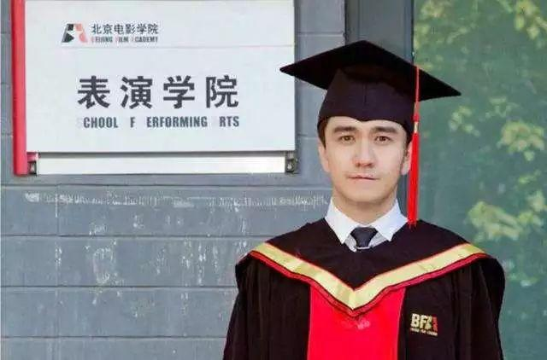
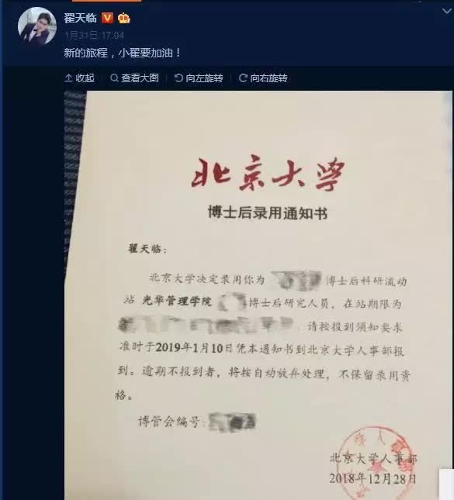
Case Analysis
Persist in a
joint commitment
to rule of law and rule of virtue
PhD from Beijing Film Academy
postdoctoral candidate at Peking University
Notes:
31

Slide 32
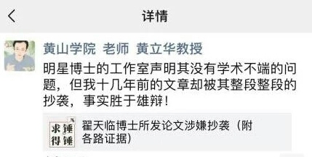
Case Analysis
In a dissertation Zhai published while pursuing his
PhD in the academy, he used the viewpoints of other
experts but didn’t give credit, which showed Zhai didn’t
act normatively and precisely in his academic work.
Persist in a
joint commitment
to rule of law and rule of virtue
Notes:
dissertation: 专题论文,(尤)博士学位之类的论文 normatively: (语言,行为等)标准地，规范地
32

Slide 33
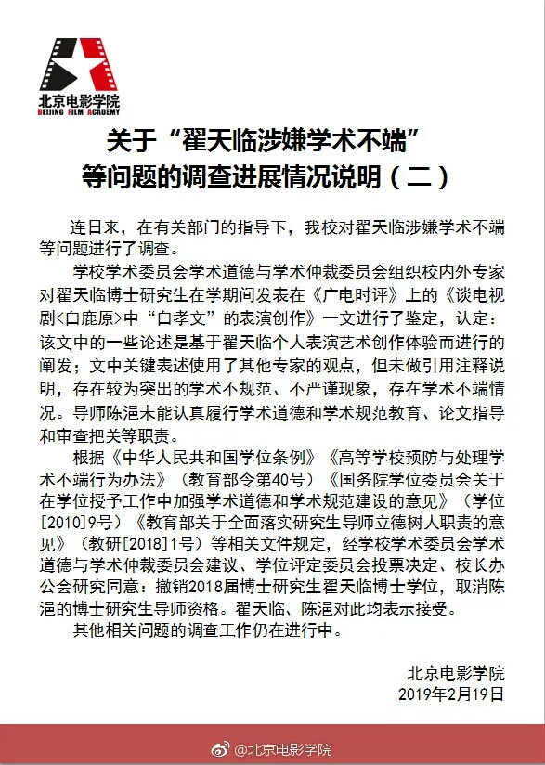
Case Analysis
Be found guilty, Zhai has been stripped of his doctoral degree at Beijing Film Academy. Peking University has also removed Zhai from its postdoctoral research program.
Persist in a
joint commitment
to rule of law and rule of virtue
Notes:
strip:剥夺某人的(财产、荣誉等)
33

Slide 34

Roles and tasks of college students
Discussion: As college students, what is our duty in protecting and developing “the rule of law ” in China?
Notes:
34

Slide 35
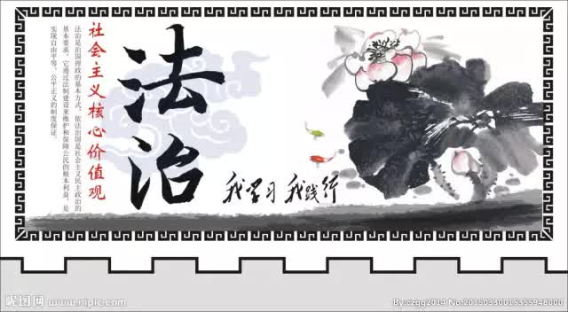
Conclusion
Law is order, and good law is good order.
(Aristole, Ancient Greek Philosopher)
The force of law should follow the citizen, like a shadow along with the body.
(Cesare Bonesana Beccaria, Italian Criminal Jurist)
Notes:
35

Slide 36

Conclusion
法者，天下之程式也，万事之仪表也。
管子(春秋)
家有常业，虽饥不饿 ；国有常法，虽危不乱。
韩非子
法治昌明则国泰民安，法治松懈则国乱民怨
Notes:
36

Slide 37

Conclusion
Notes:
37

