Slide 1
Core Socialist Values
Dedication
prosperity democracy civility harmony
freedom equality justice the rule of law
patriotism dedication integrity friendship

Slide 2
Contents
1
Chapter 1
2
Chapter 2
3
Chapter 3

Slide 3

Chapter 1
What is Dedication?

Slide 4

What is Dedication？
Dedication
It is the value evaluation of citizens’
professional code of conduct, requiring
citizens to be loyal to their duties and serving people and society.

Slide 5
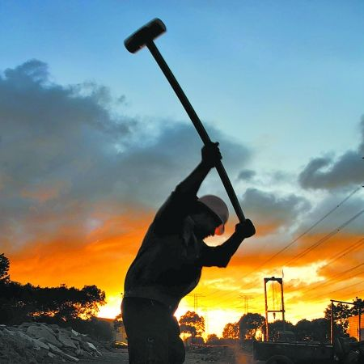
What is Dedication？
Dedication refers to the attitude that people strictly abide by professional ethics in a collective work and study.

Slide 6
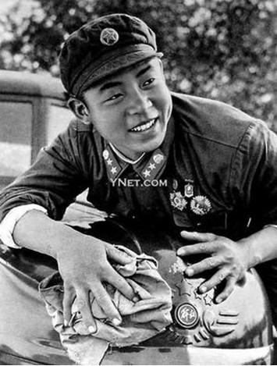
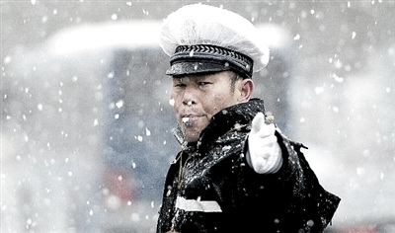
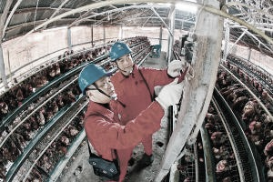
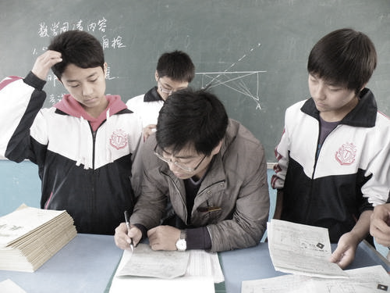
What is Dedication？

Slide 7
What is Dedication？
Study diligently and benefit by the company of friends
(敬业乐群)
--- The book of Rites
《礼记》
People who govern powerful countries should be prudent and abide by their commitments.
(道千乘之国，敬事而信，
节用而爱人，使民以时。)
---The Analects of Confucius《论语》
A dedicated person is serious and diligent in his career.
(敬业者，专心致志，以事其业)
--- Zhu Xi
(朱熹)
“Study”
“State affairs”
“Career”

Slide 8
Chapter 2
Why should the spirit of dedication be carried forward?

Slide 9
Why should the spirit of dedication be carried forward?
dedication
dedication
Necessary conditions for
realizing individual value
Necessary conditions for
avoiding the risk of delinquency

Slide 10
Why should the spirit of dedication be carried forward?
Dedication
achieving the completion of one’s self-level
Dedication
promoting the cause by personal influence
Dedication
having a powerful influence on society

Slide 11
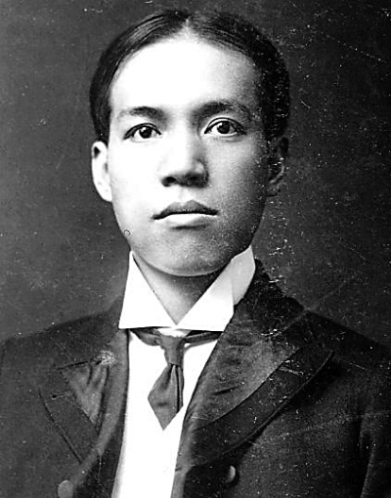
Why should the spirit of dedication be carried forward?
1873年2月23日-1929年1月19日
Dedication focus on one’s attitude toward the profession he is engaged in and the value of his life.
Dedication plays a vital role in the success of team work, the realization of organizational goals, and the development of the country.
敬业主义
于人生最为必要
又于人生最为有利
《敬业与乐业》
Liang Qichao
(1873-1929)

Slide 12
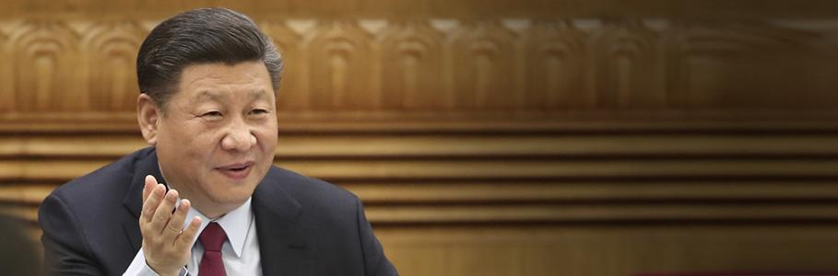
Why should the spirit of dedication be carried forward?
1873年2月23日-1929年1月19日
幸福不会从天而降，梦想不会自动成真。实现我们的奋斗目标，开创我们的美好未来，必须紧紧依靠人民、始终为了人民，必须依靠辛勤劳动、诚实劳动、创造性劳动。

Slide 13

Why should the spirit of dedication be carried forward?
1873年2月23日-1929年1月19日
The realization of the
Chinese dream requires
everyone to serve the
cause through specific
professional activities in
their specific positions,
which requires each of us to work hard, diligently and dedicatedly.

Slide 14
Chapter 3
How can you become a dedicated person?

Slide 15
Discussion
How can you become a dedicated person？

Slide 16
How can you become a dedicated person?
Loving your job
Only by loving their work, will they always maintain a strong sense of responsibility.

Slide 17
How can you become a dedicated person?
Fulfilling your duty
Do your best to do the work at hand

Slide 18
How can you become a dedicated person?
Concentration
Focus on your work

Slide 19
How can you become a dedicated person?
Digging
Through improving one’s professional skill, he can do his job better.

Slide 20
How can you become a dedicated person?
Devotion
It is a necessity for dedication

Slide 21
How can you become a dedicated person?
Loving your job
Concentration
Devotion
Fulfilling your duty
Digging

Slide 22
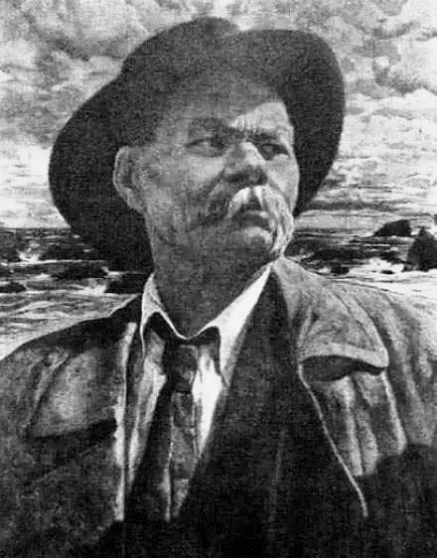
How can you achieve dedication as a student?
Having a long-term vision of development
The higher the goal a person pursues, the faster
his talent develops and the more beneficial to society.
一个人追求的目标越高，他的才力就发展得越快，对社会就越有益
Gorky
(1868-1936)

Slide 23
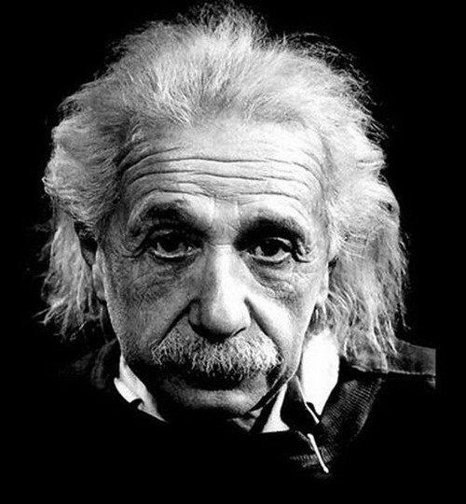
How can you achieve dedication as a student?
Being always diligent and persistent
People attribute my success to my talent, but it is
actually the result of hard work that makes my talent.
人们把我的成功归因于我的天才，其实我的天才只是刻苦罢了
Albert Einstein
(1879-1955)

Slide 24
Thank You

