Slide 1

Core socialist values
Friendship

Slide 2
Contents
1
Sound Interpersonal Relationships
2
Mutual Influence Between Human and Society
3
Harmony Between Human and Nature
4
Summary for Friendship

Slide 3

Friendship is one of the indispensable elements of core socialist values. Moments of friendship between people, mutual influence between human and society, harmony between human and nature deeply interpret the subject.
Friendship

Slide 4

1
Sound Interpersonal Relationships

Slide 5
1.1 What is Friendship ?
Friendship is a kind of human relations. Constructing sound interpersonal relationships can help us deal with social mental conflicts, change unhealthy social morality, and develop social trust.

Slide 6
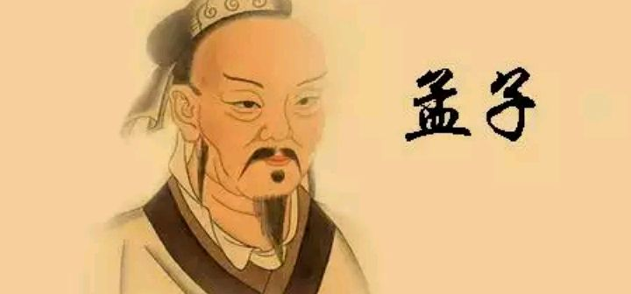
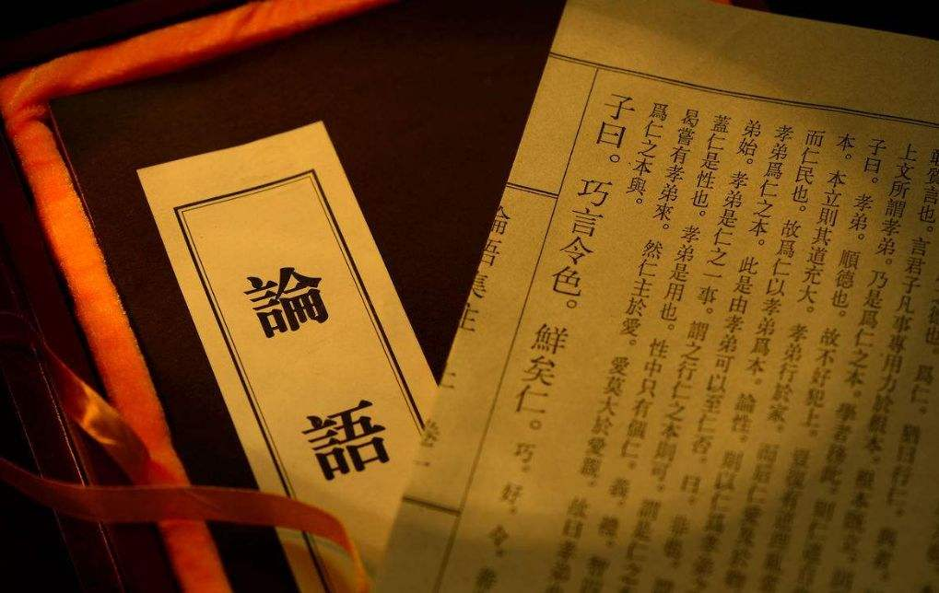
1.2 Excellent Chinese Culture About Friendship
It's great to be kind to others .
---Mencius
You Zi said: "In practicing the rules of propriety, it is harmony that is prized.“
--- 《Confucian Analects》
If you are kind to others, then they will
treat you in the same way.
---Guan Zhong
Notes:
中文翻译：
1.与人为善，善莫大焉。 ---孟子
2. 礼之用，和为贵。---《论语》
3. 善人者，人亦善之。---管子

Slide 7

1.3
Be Kind to the People Around You
Be Kind to
Your Parents
Your Lover
Your Children
Your Friends
Your Teachers
The Strangersrs

Slide 8
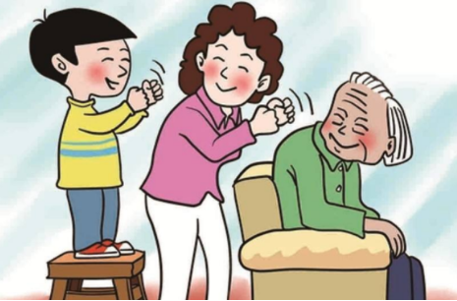


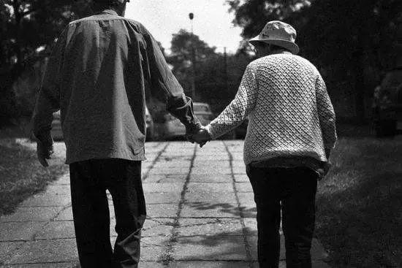
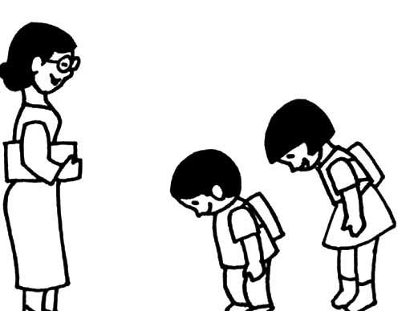
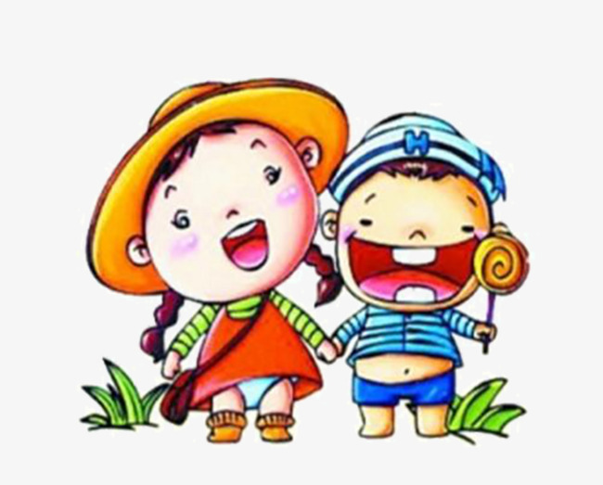
Back
Next

Slide 9
2
Mutual Influence Between Human and Society
Friendship is a moral link to build harmonious interpersonal and social relations, and an ethical basis for maintaining a healthy and good social order.

Slide 10
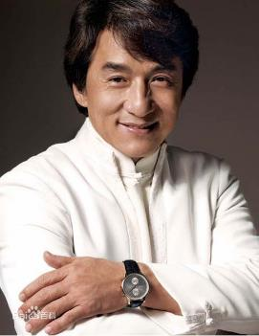
2.1. Action On Friendship
— by Celebrities
Jackie Chan, born in Hong Kong in 1954, spends all his spare time working for children, the elderly, and those in need.
Jackie Chen donated ten million RMB for Wen Chuan Earthquake in 2008.
Jackie Chan

Slide 11
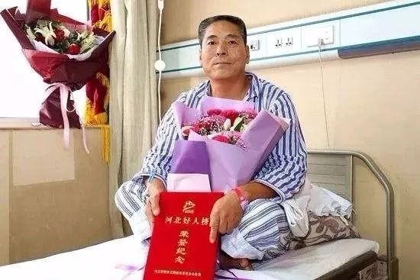
2.2 Action On Friendship
—by Ordinary People
Lv Baomin is a veteran in Wuji County, Hebei Province.
Lv Baomin
On September 8th，2018, Lv Baomin found a man robbing with a knife at Happy North Street Food Market. He stopped the robbery and was stabbed five times by the gangsters and seriously injured. Finally, with the help of the villagers, the gangsters were subdued.

Slide 12
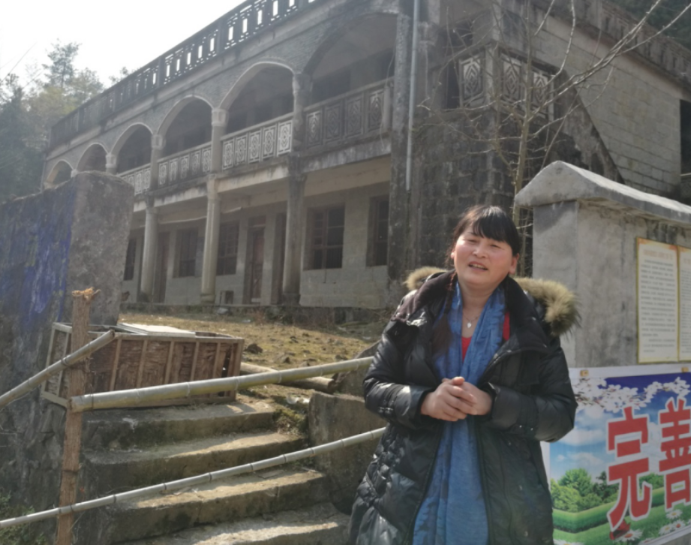
2.3 Action On Friendship
—by those who are dedicated to their jobs
Zhi Yueying is a teacher in Baiyang Teaching Point, Zaoxia Town, Fengxin County, Yichun City, Jiangxi Province.
Zhi Yueying
Zhi Yueying was far away from her hometown Nanchang despite her family’s objection when she was 19 and become a teacher in Niyang Primary School in deep mountains and adhered to the platform for 36 years.

Slide 13

3
Harmony Between Human and Nature
Lucid water and lush mountains are invaluable assets.
Notes:
绿水青山就是金山银山。

Slide 14










3.1 Action On Friendship
—by Garbage Sorting

Slide 15
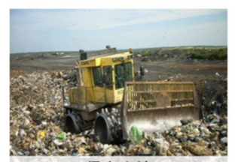
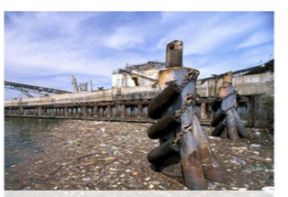


3.1.1. The Harm of Garbage
Occupation of Land
Environmental Pollution
Waste of Resources
Health Hazard
Notes:
中文翻译：
垃圾危害：侵占土地、污染环境、浪费资源、损害健康

Slide 16
3.1.2. The Regulations of Garbage Sorting in China
Kitchen Waste
Harmful Waste
Recyclable
Other Waste

Slide 17
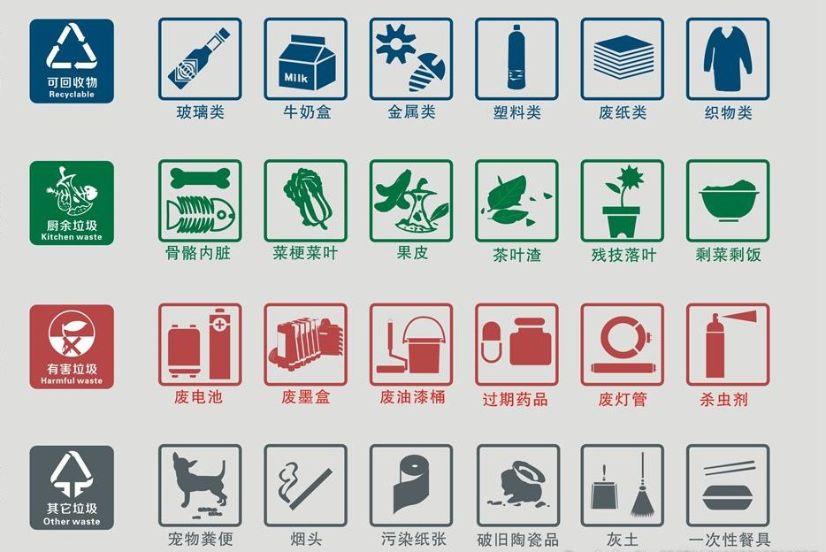
Glass Milk Carton Metal Plastic Waste Paper Fabric
Bone &Viscera Stem&Leave Peel Tea Leave Plant Residue Leftovers
Used batteries Used Cartridge Paint bucket Expired Medicine Used Tube Insecticide
Pet Feces Cigarette End Polluted Paper Broken Ceramics Dust Disposable Tableware
Notes:
中文翻译：
可回收垃圾：玻璃类、牛奶盒、金属类、塑料类、废纸类、织物类
厨余垃圾：骨骼内脏、菜梗菜叶、果皮、茶叶渣、残枝落叶、剩饭剩菜
有害垃圾：废电池、废墨盒、废油漆桶、过期药品、废灯管、杀虫剂
其它垃圾：宠物粪便、烟头、污染纸张、破旧陶瓷品、灰土、一次性餐具

Slide 18

3.2 Action On Friendship
—by riding shared bicycles
Riding a shared bicycle is great for short trips and is an easy, environmentally-friendly and low-cost mode of transport.
Bike sharing is growing in popularity in China. We will continue to support and promote this growth by allowing people to ride in safe, supported environments.

Slide 19
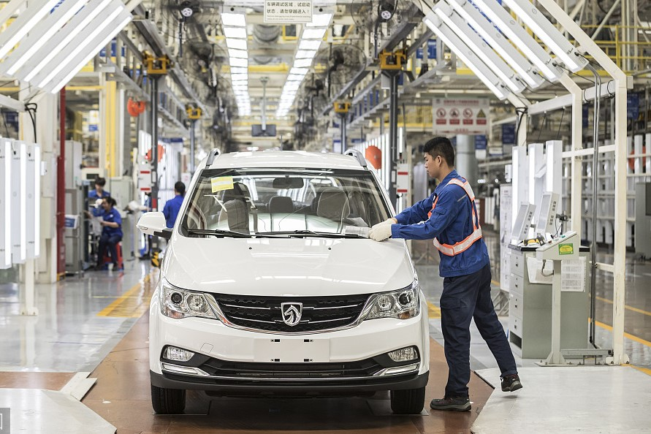
3.3 Action On Friendship
—by driving new energy vehicles
President Xi Jinping has sent a congratulatory letter to the 2019 World New Energy Vehicle Congress held Tuesday in Boao, south China's Hainan province.
With a new round of scientific and technological revolution and industrial transformation in the making and rising, the new energy vehicle industry is entering a new stage of accelerated development.

Slide 20
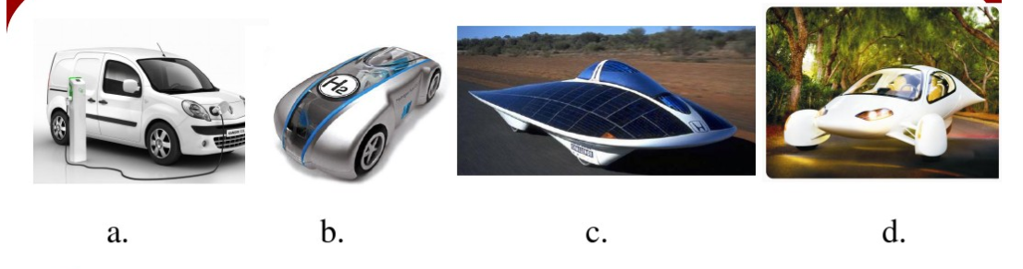
3.3.1 Discussion and Match
Look at the following pictures. Discuss with your partner and match them with the types of vehicles.
( ) 1. Hybrid car
( ) 2. Pure electric vehicle
( ) 3. Hydrogen-powered vehicle
( ) 4. Solar car
d
a
b
c
Notes:
答案备注：d 混合动力车 a 纯电动汽车 b 氢动力汽车 c 太阳能汽车

Slide 21
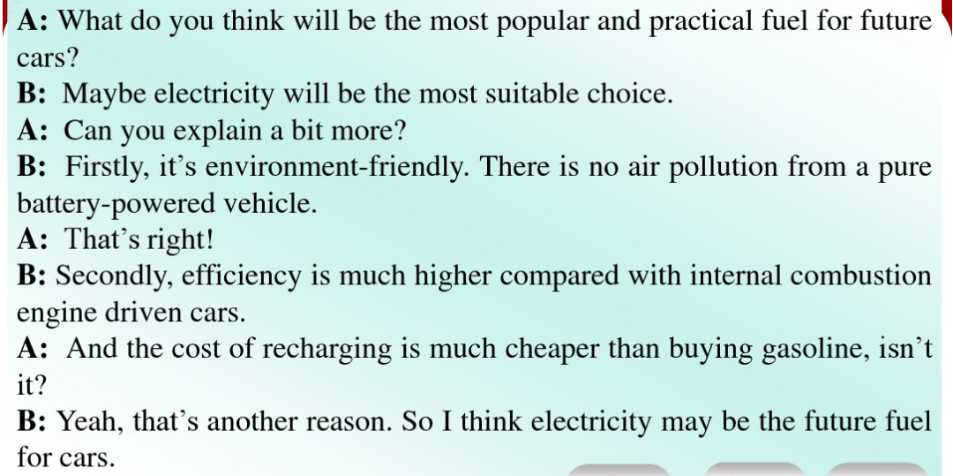
3.3.2 Fuel for Future Cars
By 2020, China is aiming to reduce energy consumption by 50 percent. By then, it's hoped new energy vehicles will replace 20 percent of traditional cars in China, and electricity will become the main substitute for gasoline.

Slide 22
4
Summary for Friendship
Cultivating socialist friendliness values is beneficial for constructing sound interpersonal relationship, dealing with the social mental conflict, changing unhealthy social morality, developing the social trust and enhancing the harmony between human and nature.

