Slide 1

CHINA STORY
中国故事
Tells the story of a real China
讲述一个真实的中国

Slide 2
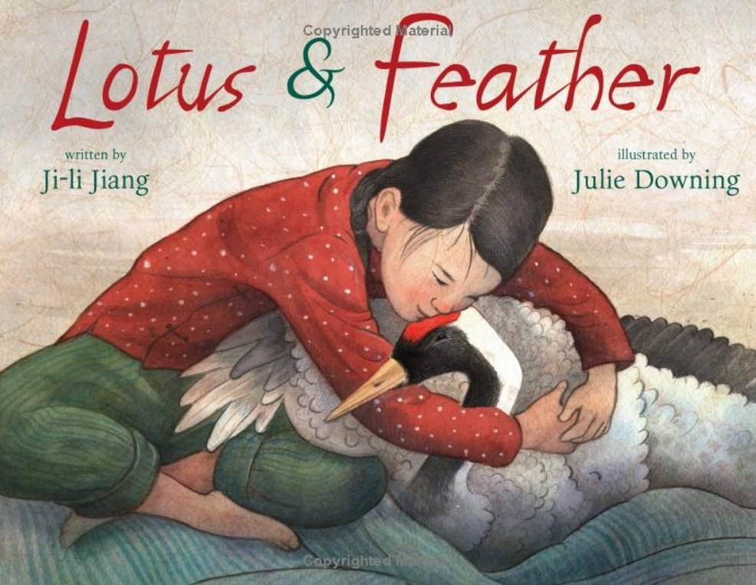

Slide 3
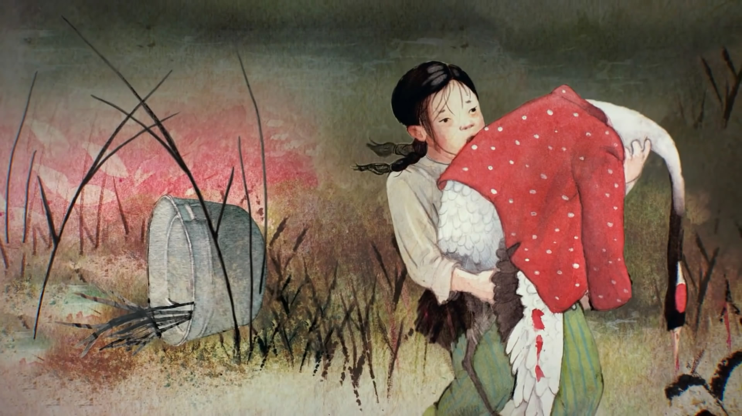
One morning, Lotus went to collect reeds for her Grandpa. Suddenly, she saw a bleeding crane.
Lotus hurriedly waded across the wetland toward it.
She gathered up the heavy bird. “Hold on, please!” She pleaded.

Slide 4
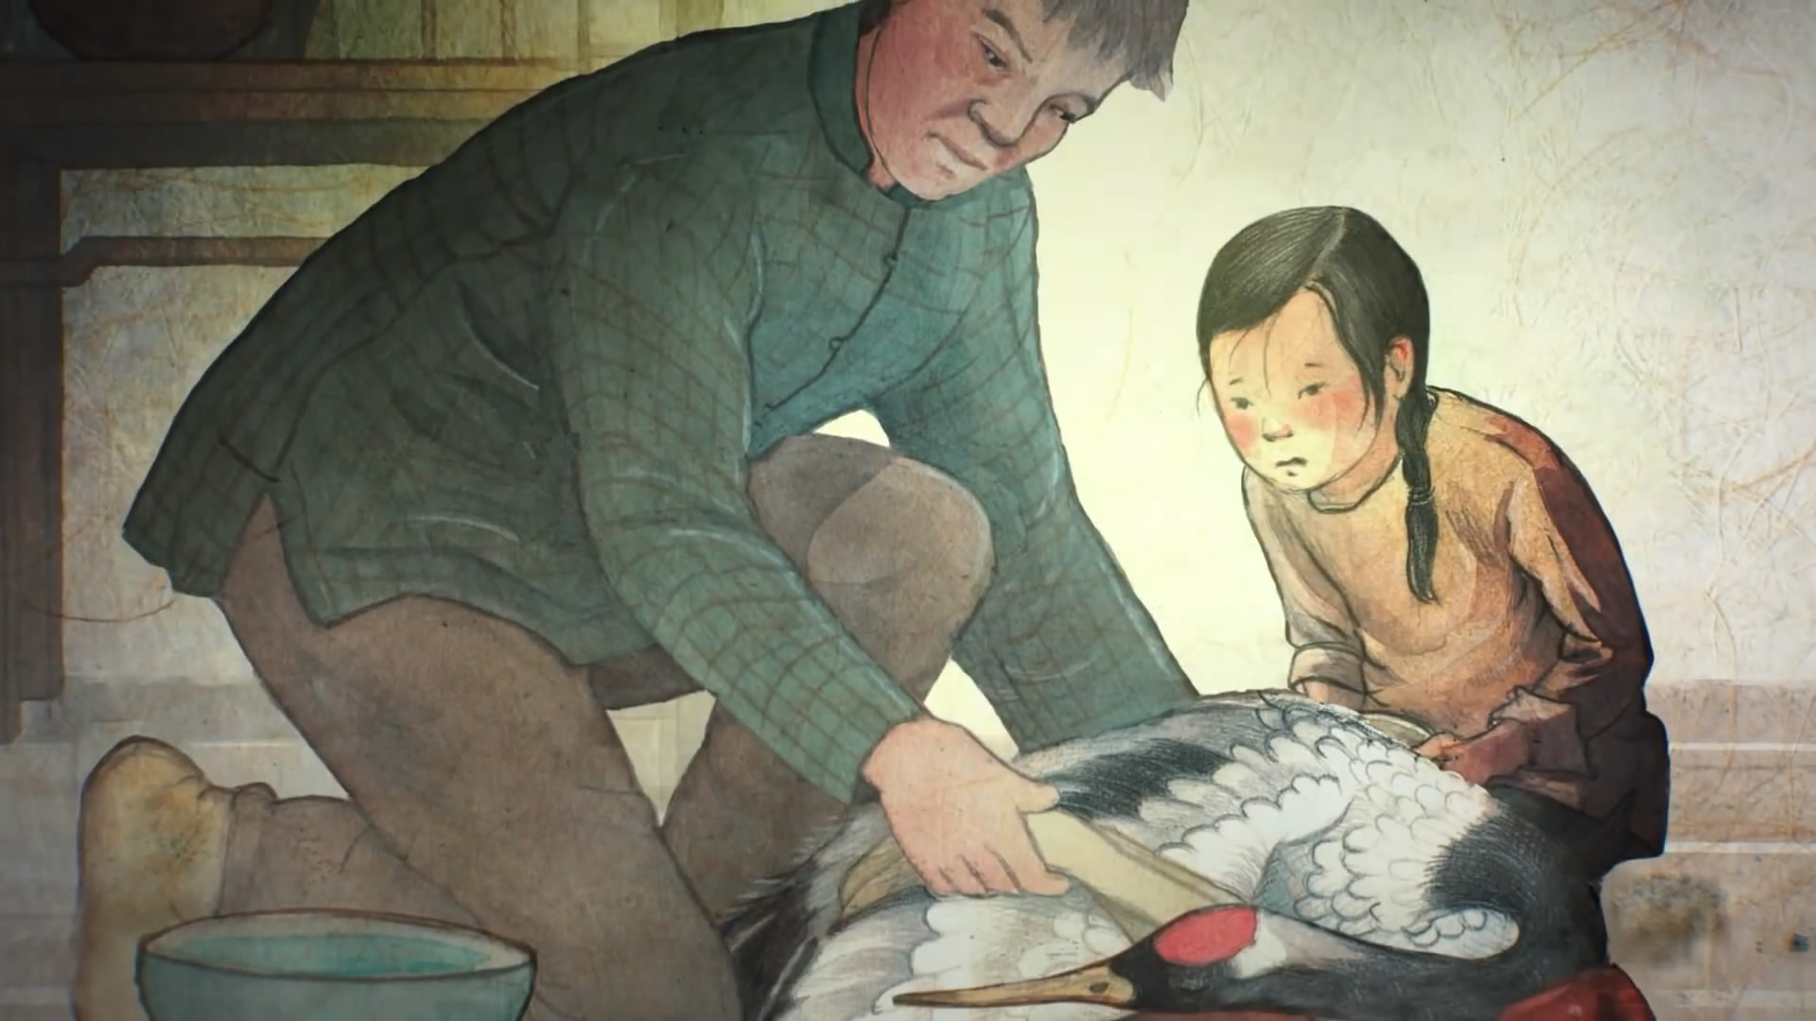
Lotus tottered home to Grandpa, who had rescued other animals before. Carefully, Grandpa wrapped the bird’s wound. “He’s lost a lot of blood, but he will survive,” he said.

Slide 5
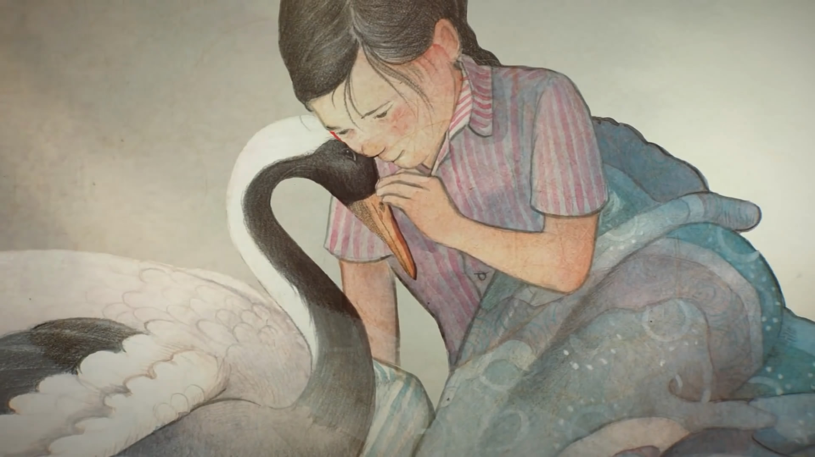
On the third day, the crane lifted his head for the first time. Gently, Lotus put her small fingers on his head. The bird stretched his neck, and rubbed her cheek gently. Lotus’s heart pounded, and tears sprang to her eyes.
Filled with happiness, Lotus chose the name “Feather” for her new friend.

Slide 6
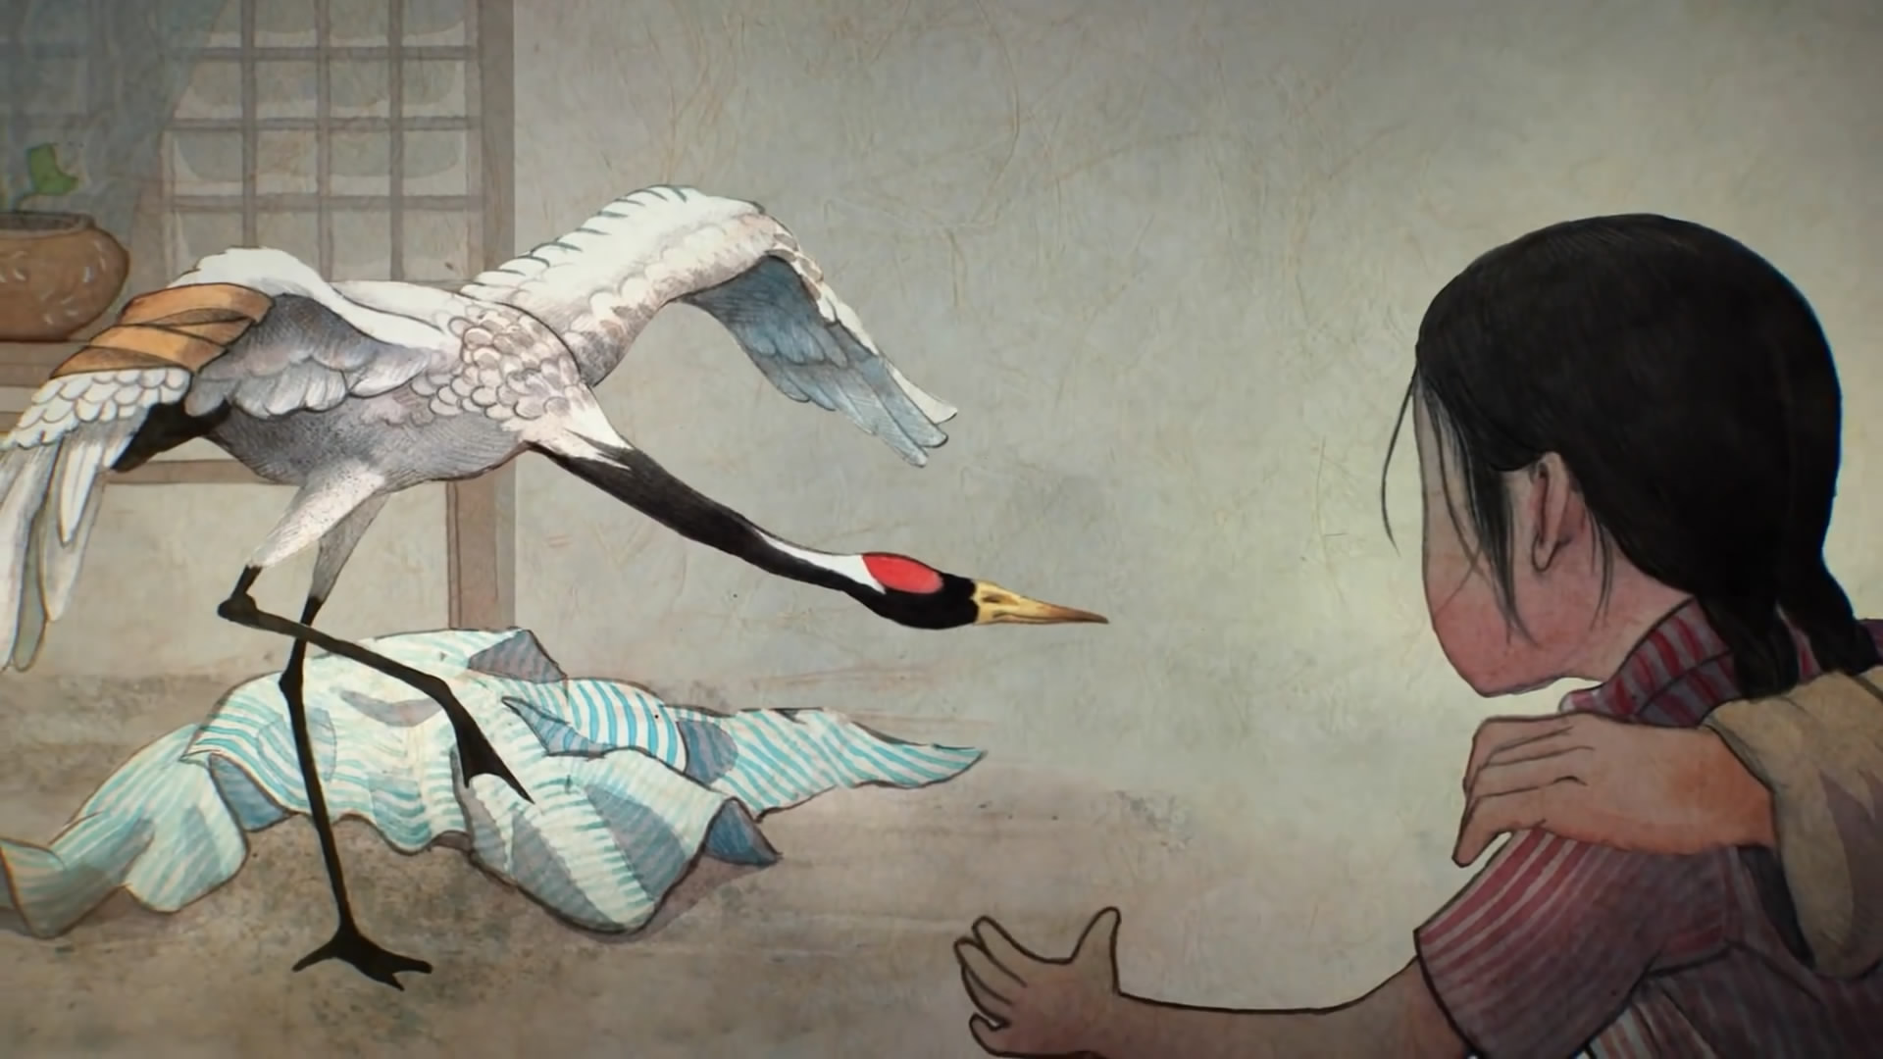
One day, slowly and cautiously, Feather took his first step. Lotus jumped and swirled and hugged Grandpa blissfully.

Slide 7
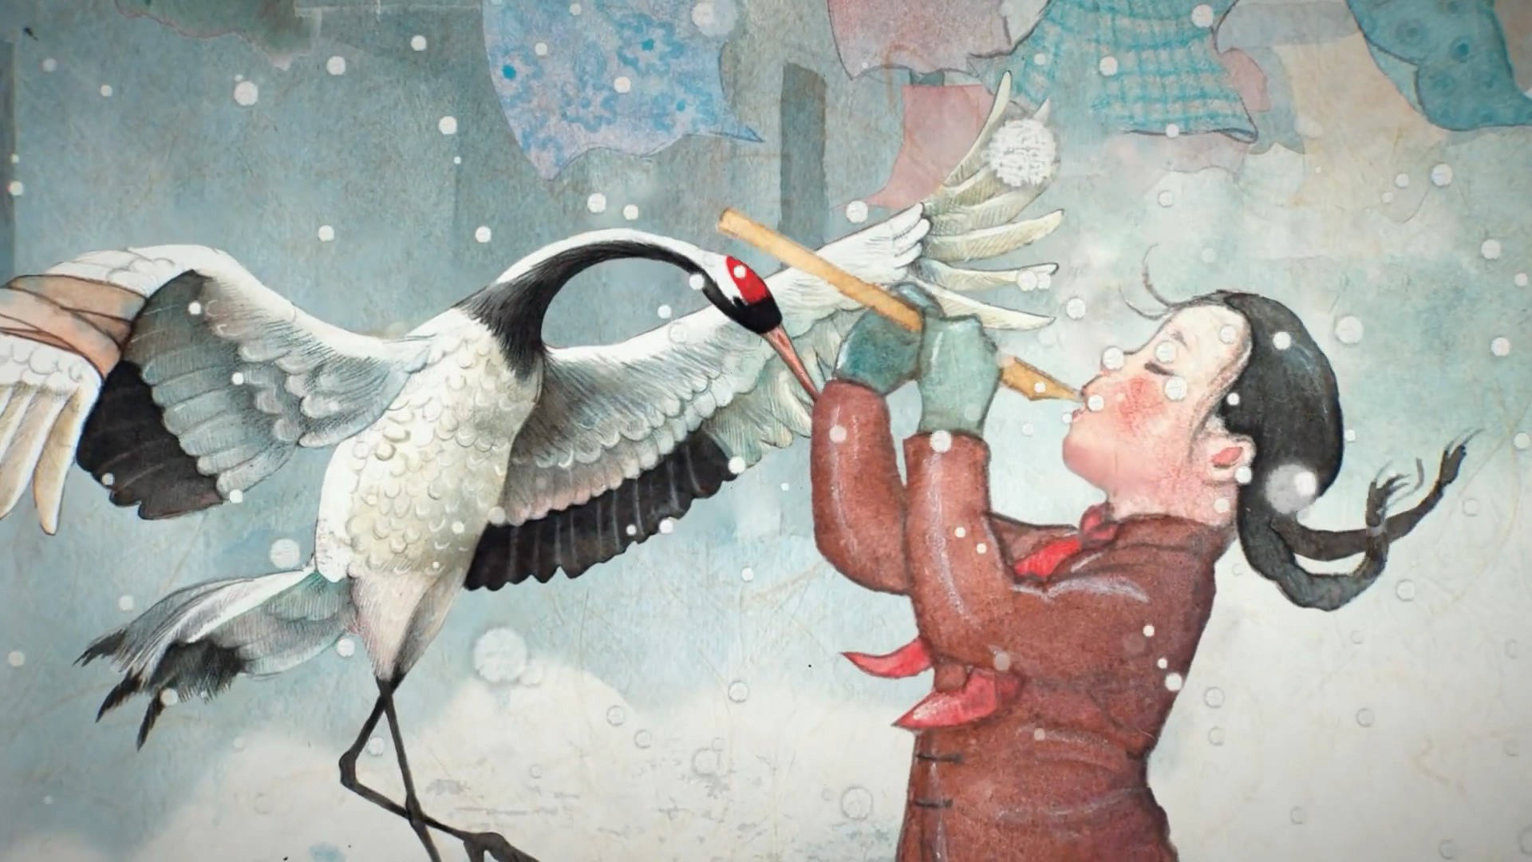
Soon Feather was following Lotus everywhere. Her reed whistle, like a magic wand, made him move up, down, slow and fast. He could not yet fly, but he could dance!

Slide 8

March arrived. Birds began appearing in the sky, migrating back north. Feather often watched the flocks until they disappeared.
“Will Feather leave us?” Lotus asked Grandpa. She was frightened by Feather’s longing stare. “That’s where his home is.” Grandpa said. Lotus looked down. She didn’t want her friend to leave but she knew she would never separate him from his home and family.

Slide 9
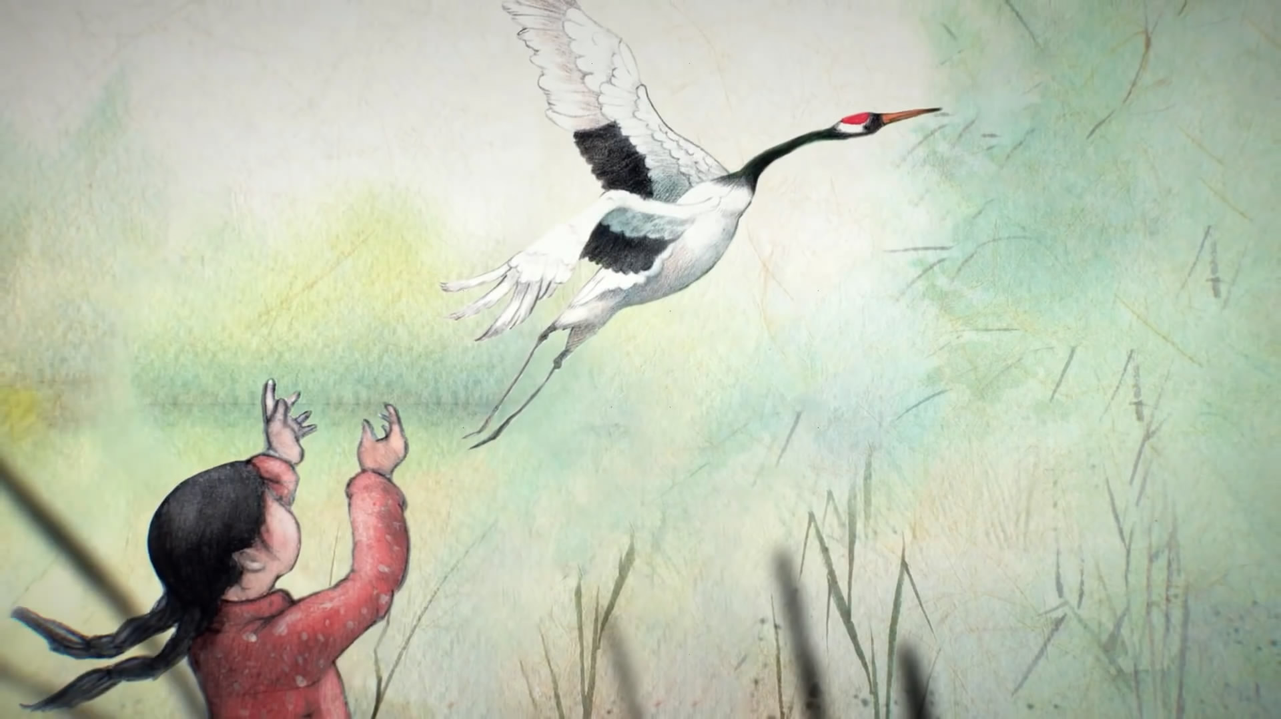
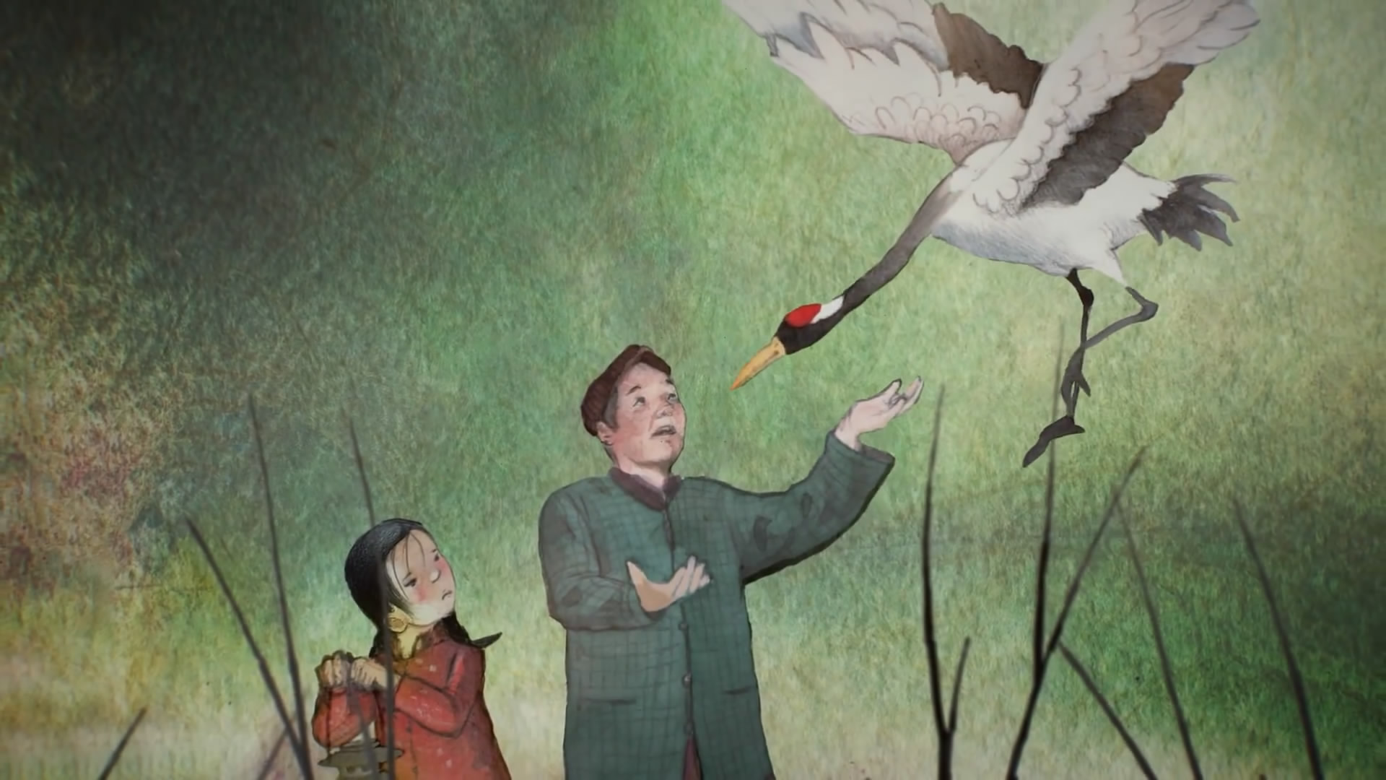
Feather spread his wings wide and leaped into the sky. He didn’t go far, but Lotus knew the time had come for him to leave.
Lotus walked slowly behind Grandpa as he carried Feather to the lake. He held Feather high and tossed him gently into the air. Feather flew up, circled a few times but landed back at Lotus’s feet. Grandpa tried again. Again Feather returned. “He is waiting for you.” Grandpa said, handing Feather to Lotus. Lotus buried her head in Feather’s warm body for a long time.

Slide 10
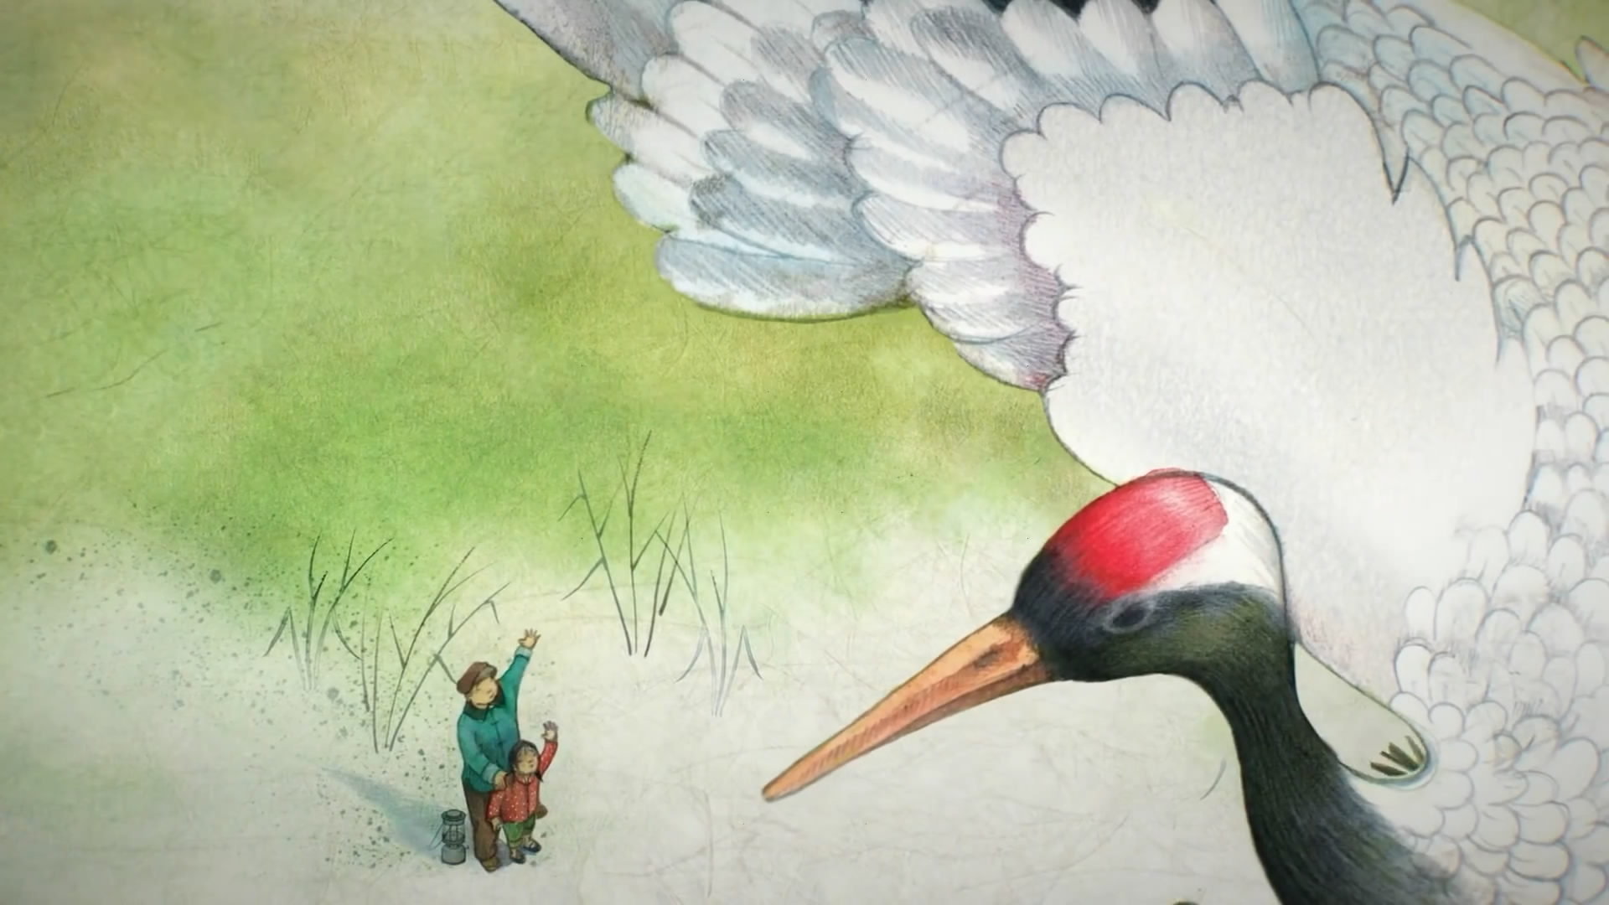
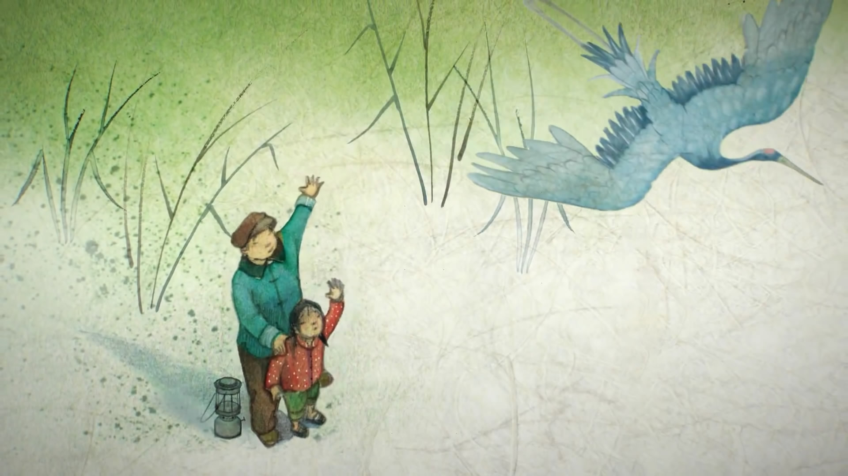
When she heard another flock of birds passing overhead, she hugged Feather one more time, and then threw him into the sky.
Feather hovered and circled, circled and hovered.
Lotus waved goodbye, holding her tears back. With a long crow, Feather flapped his big wings and soared north, disappearing into the horizon.

Slide 11
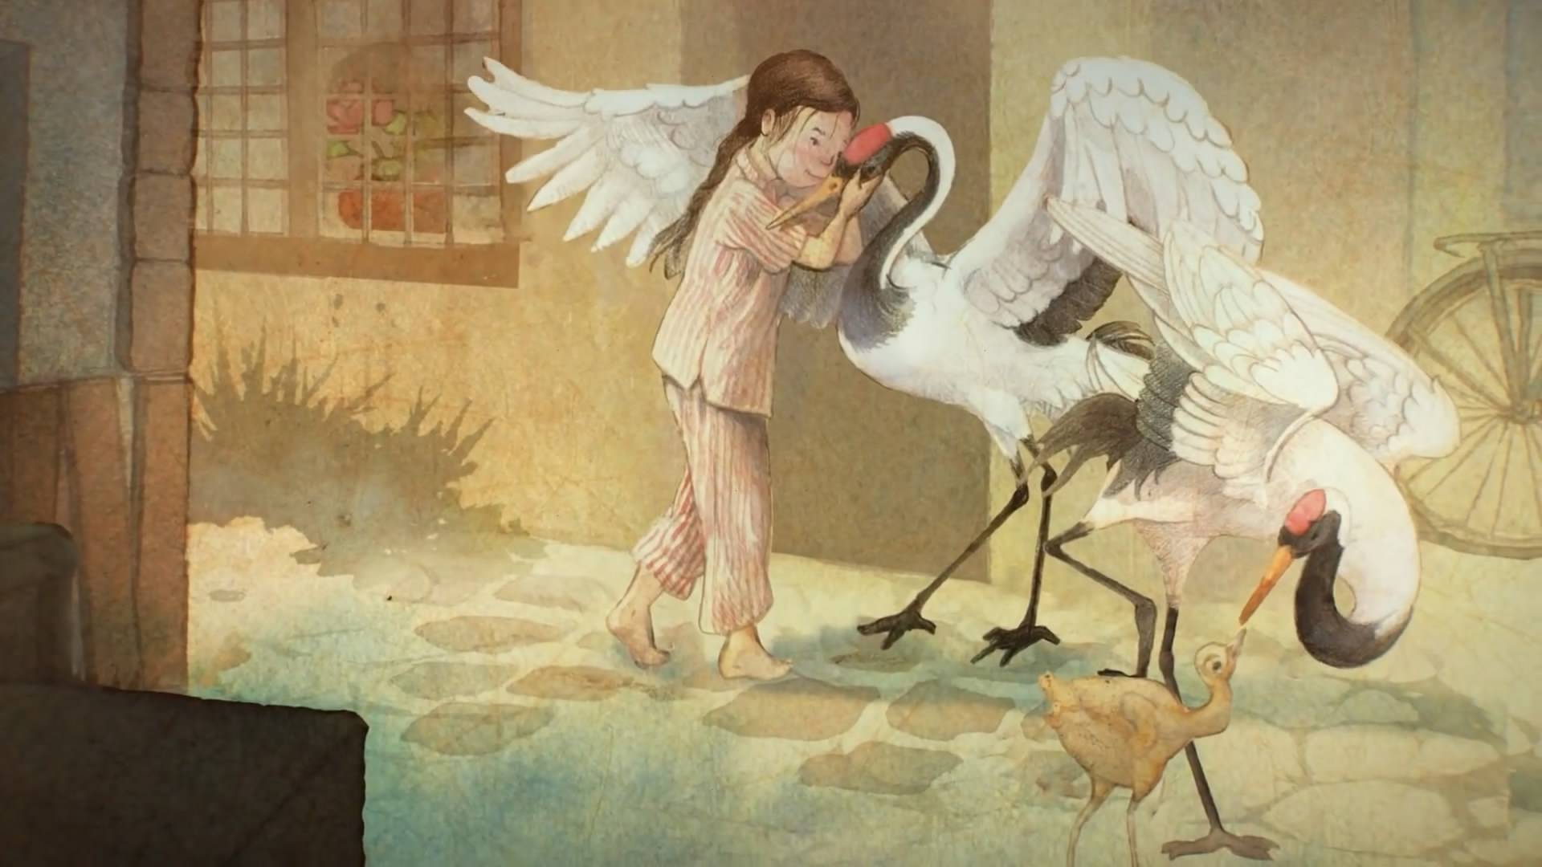
One early morning in autumn, Lotus heard a crow outside. She jumped off her bed, ran to the door, and pushed it open. Feather, as white as snow, stood on the doorstep.
Behind him was a beautiful red-beaked female and a chick. Feather’s family!
Moving slowly, so as not to frighted the birds, Lotus held out her hand. Feather stretched his neck over and rubbed her palm.

Slide 12
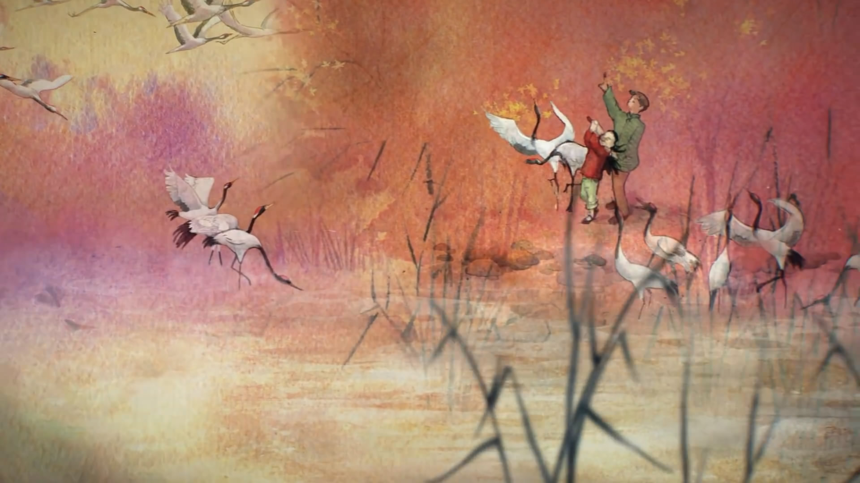
Then Lotus heard a commotion. She looked up and gasped. She tugged on Grandpa’s arm and they ran to the lake.
The sky turned white as it was filled by hundreds of cranes. They were circling and diving, singing and dancing around them.
“Feather has brought his entire flock! Another miracle!” Grandpa said, “ The lake will not be lonely this year.”
Lotus grinned. She twirled and pranced with Feather and his friends. Her whistle, accompanied by the birds’ singing, echoed far, far away in the golden sky.

Slide 13

故事小结
故事讲述了一个叫莲花的小女孩和一只仙鹤的故事。莲花在湖边捡到了一只受伤的仙鹤，并把它带回了家。莲花给仙鹤取名为“羽毛”，每天精心地照顾它，陪它玩耍。冬去春来，羽毛养好了伤，又能展翅飞翔了。尽管莲花万般不舍，最终还是选择了将它放归自然。
本故事体现了人与动物、与自然的和谐相处，同时也告诉人们一个道理：真正的爱并不是束缚，而是尊重和予以自由。

Slide 14
故事小结
在语言表达方面，《莲花与羽毛》的故事中多处使用了分词，既有现在分词，又有过去分词。它们在句中分别作定语、状语和补语等成分。
《英语语法》课程中第六讲为《非谓语动词》，其中重点讲解了现在分词和过去分词的异同、分词的句法功能（即分词在句中所充当的成分）等。因此，可将《莲花与羽毛》的故事作为阅读材料，引导学生重点分析其中包含分词的英文句子，并归纳总结其中分词的用法，从而让学生对相关知识点有更为深刻的理解和认知。

Slide 15
Thank you!

