Slide 1

CHINA STORY
中国故事
Tells the story of a real China
讲述一个真实的中国

Slide 2
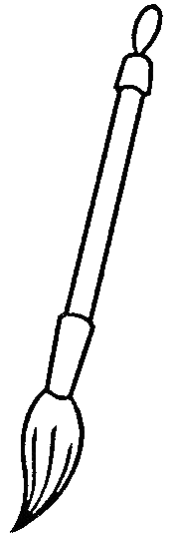


英语口译
译前准备

Slide 3

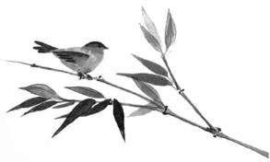
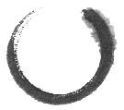
目录
一
Xi’an Facts
二
About Terracotta Army
三
FAQs

Slide 4

Part 1
Xi’an Facts

Slide 5


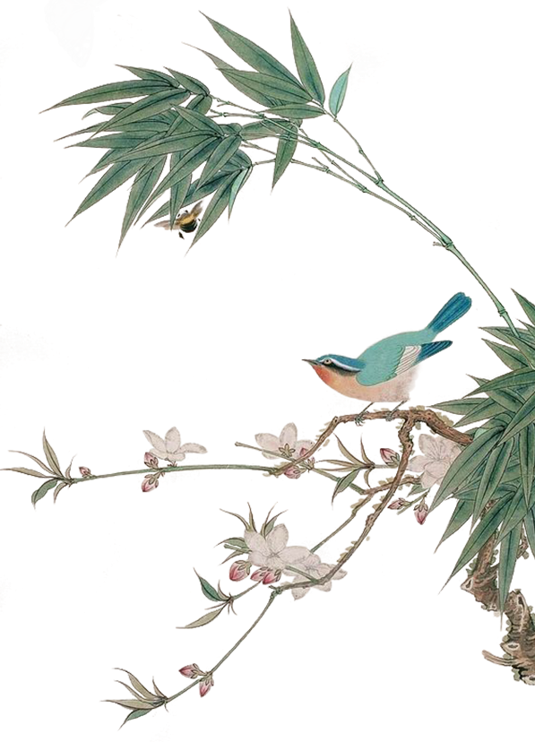
Part 1
Xi'an is the oldest of China's Four Great Ancient Capitals, serving as the capital city of 13 dynasties spreading intermittently across a 1,100-year period from 221 BC.
It is often called the birthplace of Chinese civilization.
Xi'an is characterized by and is proud of its ancient heritage, such as the world-renowned Terracotta Army. A visit to Xi'an is often at the top of a traveler's to-do list.

Slide 6
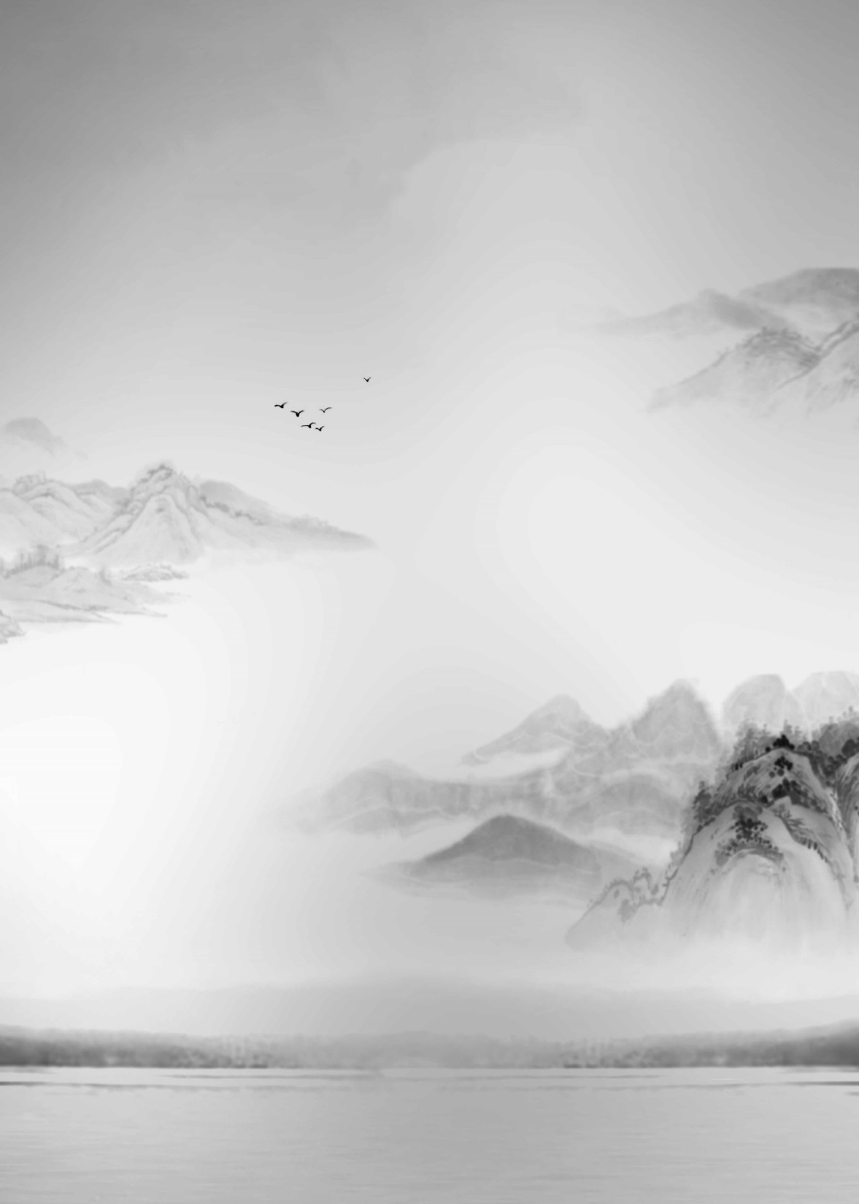
Part 2
About Terracotta Army

Slide 7
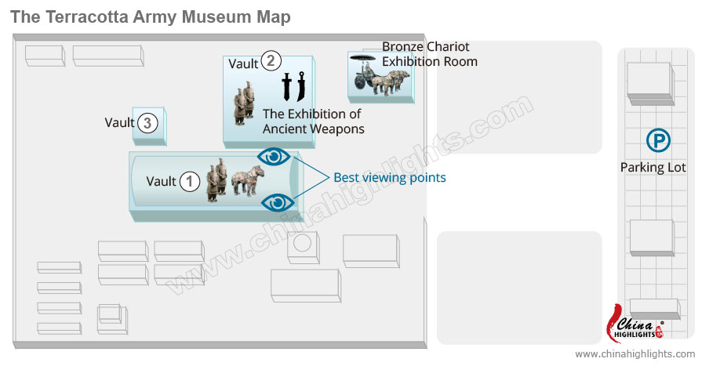
Part 2
兵马俑坑
vault
铜车马展厅 Exhibition Hall of the Bronze Chariots
Terracotta Army Museum mainly consists of three vaults and an exhibition hall: Vault One, Vault Two, Vault Three, and the Exhibition Hall of the Bronze Chariots.

Slide 8
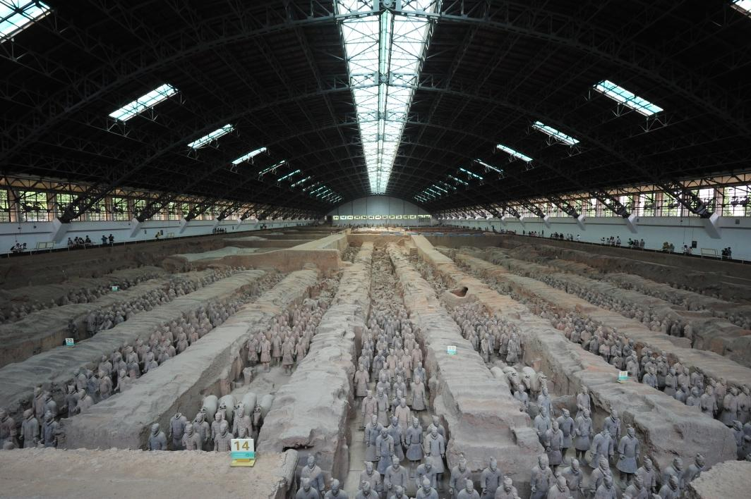
Part 2
Pit 1: 2000 warriors displayed
Vault 1: It is the largest and most impressive (about 230 x 60 m) - the size of an airplane hangar. There are over 6,000 terracotta figures of soldiers and horses, but less than 2,000 are on display.
Every figure differs in facial features and expression, clothing, hairstyle, and gestures, providing abundant and detailed artifacts for the study of the military, cultural, and economic history of that period.

Slide 9
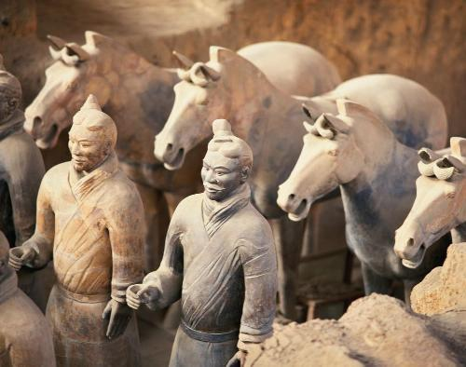
Pit 2: uncovers the mystery of the
Ancient Army Array
Part 2
Vault 2: It is the highlight of the vaults (about 96 x 84 m) and uncovers the mystery of the ancient army array.
It has the most army units with archers, chariots, mixed forces of infantry and trooper.
弓箭手 archers
战车 chariots
步兵 infantry
骑兵 trooper

Slide 10
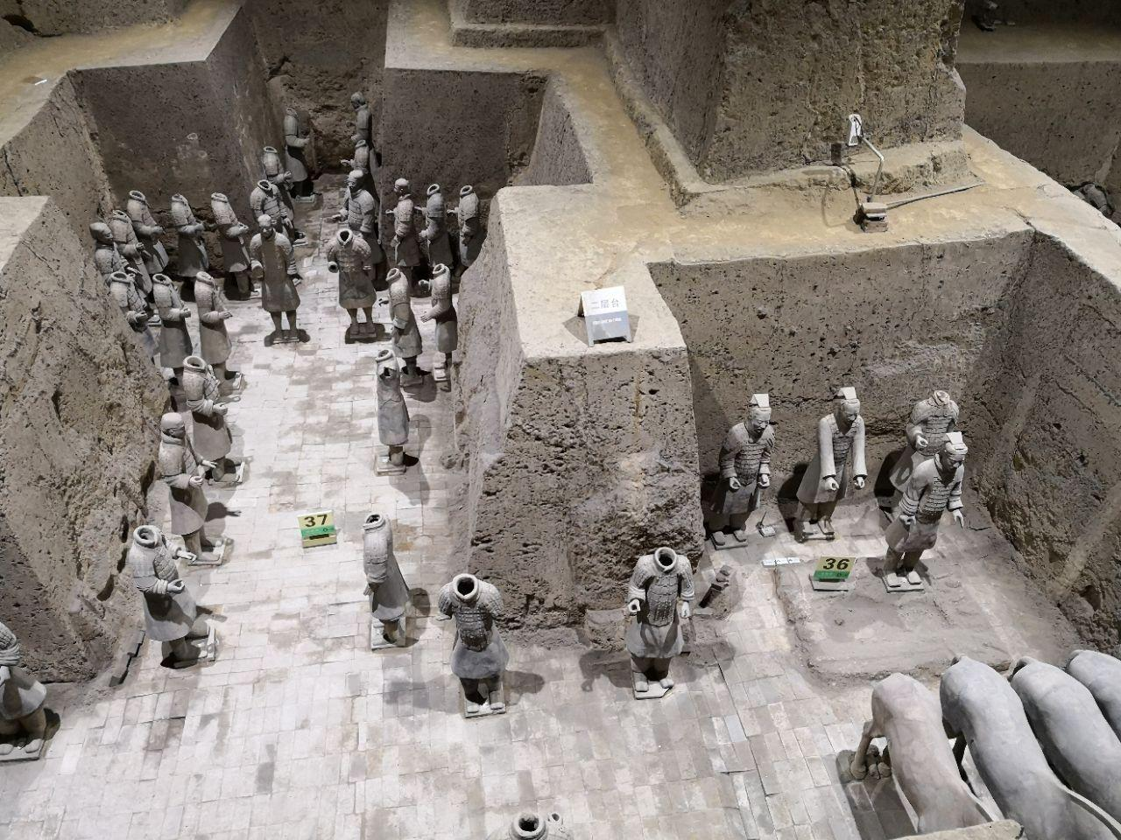
Part 2
Pit 3: represents the Command Post
Vault 3: It is smallest, but very important (21 x 17 m).
There are only 68 terracotta figures, many of which are without heads.
It's obvious that Vault 3 represents the command post, as all the figures are officials.

Slide 11
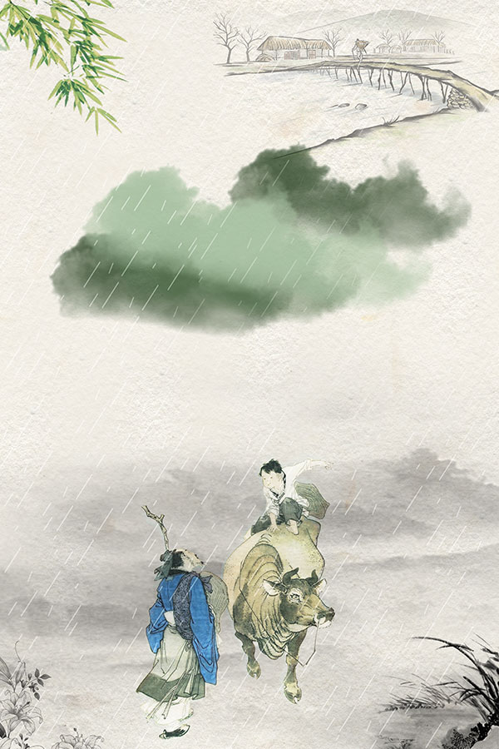
Part 3
FAQs

Slide 12

Part 3
Why and How were the terracotta warriors made?

Slide 13
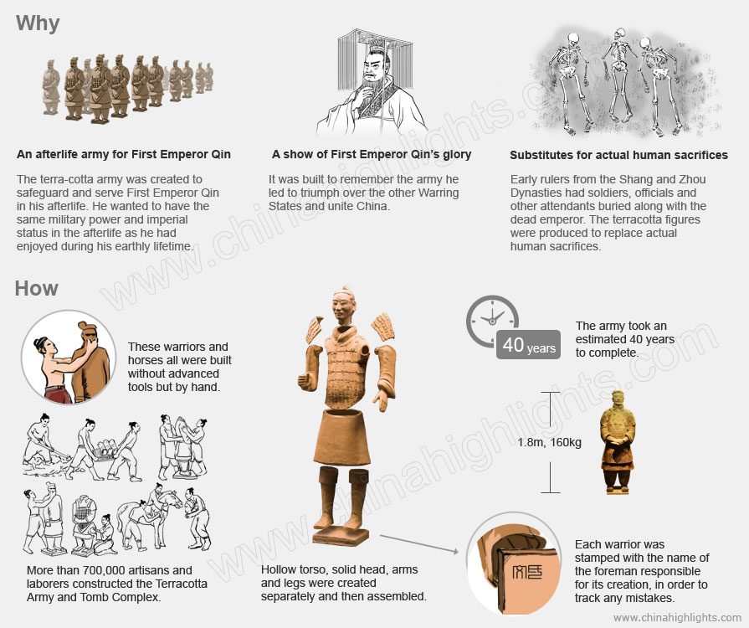
Part 3
An afterlife army 阴间军队
Actual human sacrifices 活人殉葬
Torso (身体的)躯干
Foreman 领班，工头

Slide 14
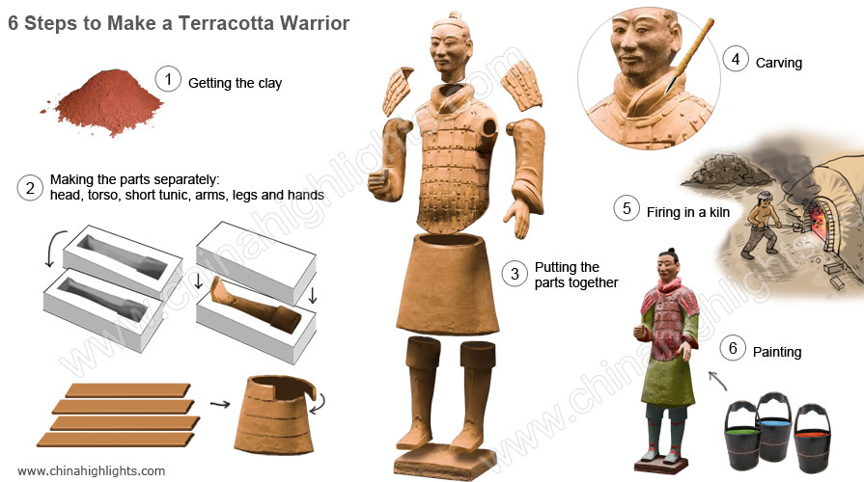
Part 3

Slide 15
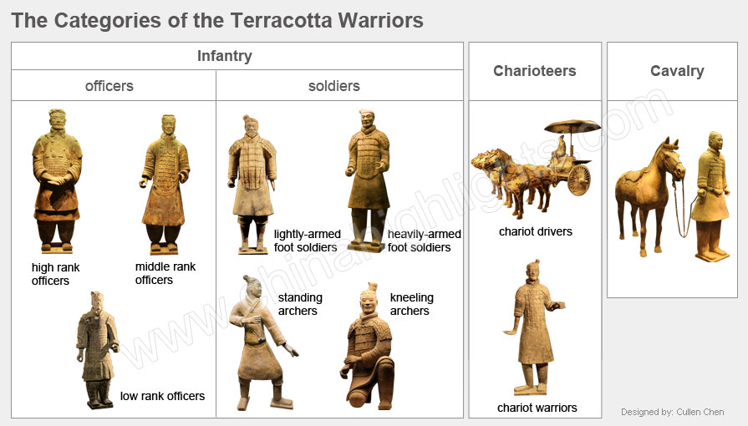
步兵 infantry
Part 3
骑兵 cavalry
武士俑
立射俑 跪射俑
车兵俑

Slide 16

故事小结
旅游是口译常见的话题，在进行相应的口译工作之前，需要对相关话题的背景知识有一定的了解，做好译前准备。
本次课为《英语口译》中专题口译，译前准备部分，以一次参观兵马俑的外事活动为切入点，学习兵马俑有关背景知识，做好译前准备工作。
通过本次课，希望学生不仅能掌握相关术语表达，做好译前准备，更重要的是，在学习中让学生感受到我国灿烂的传统文化，升华爱国之情。

Slide 17
Thank you!

