Slide 1

CHINA STORY
中国故事
Tells the story of a real China
讲述一个真实的中国

Slide 2


月
Moon
Notes:
The Chinese character 月 means moon with wax and wane. Mythical meanings are attributed to the moon in Chinese legends. Chang E flying to the moon is one of them.

Slide 3
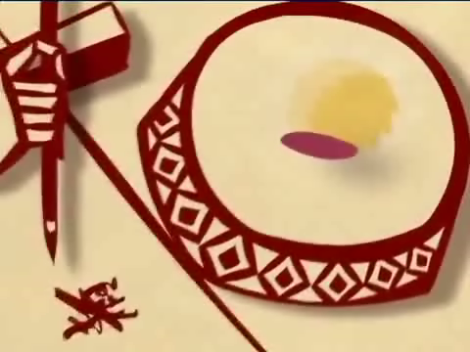
A Chinese Legend
Chang E Flying to the Moon
Notes:
Let’s watch a video clip about this old story. Chinese thoughts of moon are based on this.

Slide 4
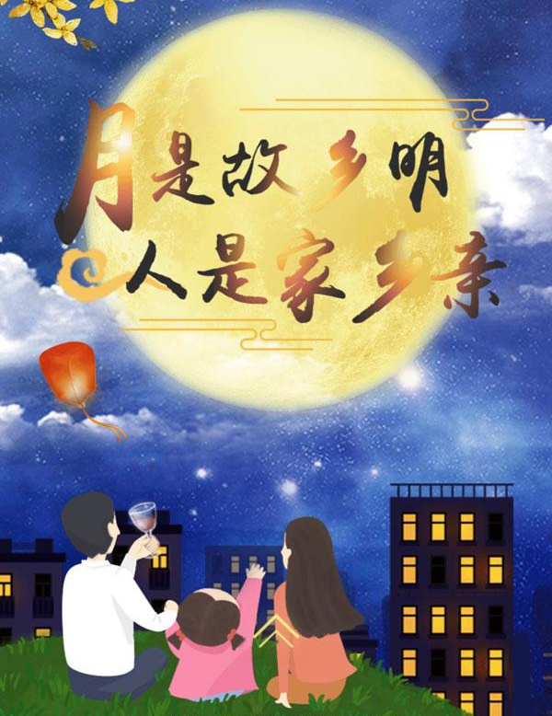
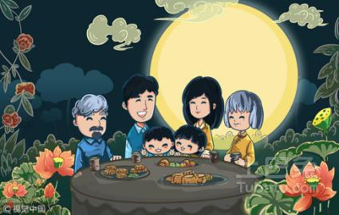
Thoughts of Moon in China
Raise my head to the bright moon;
Lower my head and think of my home.
A full moon represents family reunion.
Notes:
Chang E, as a family member of Hou Yi, has flown into the moon. For this reason, perhaps, Chinese people refer to the moon to express their missing for the distant family members, as can be seen from a famous Chinese poem “Raise my head to the bright moon; lower my head and think of my home.”A full moon represents family reunion.

Slide 5
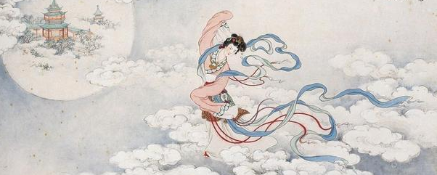
Thoughts of Moon in China
Moon is usually called a “Popo” (Gran), which is often compared to a female that is pure, kind and elegant.
Notes:
Generally speaking, moon is usually imagined as a female and is often called Yue Laolao (Granny Moon) by Chinese people. It is often believed to be pure, kind and elegant because of the image of Chang E.

Slide 6
故事小结
故事从月亮的象征意义角度讲述了中国文化中关于月亮的神话传说和月亮的在中国的文化内涵,体现了传统中国文化中“祭月”“赏月”的思想根源,能够很好的与西方文化中的月亮的象征意义的相关内容相结合。

Slide 7
故事小结
《高级英语1》第13课第5段：
The young moon lies on her back tonight as is her habit in the tropics, and as, I think, is suitable if not seemly for a virgin. Not a star but might not shoot down and accept the invitation to become her lover.今夜的一弯新月仰面斜躺在天空，这是月亮在热带地区常见姿势。在我看来，这种姿势对一个少女来说虽说有些不雅，但却还是适宜的。没有哪一颗星星不愿飞射下来接受邀请做她的情人。

Slide 8
故事小结
《高级英语1》第13课第5段：
文中将月亮拟成不拘小节的少女形象，虽与中国嫦娥的传统和优雅形象相差甚远，但也颇有自由自在的情趣。

Slide 9
Thank you!

