Slide 1

CHINA STORY
中国故事
程门立雪
Tells the story of a real China
讲述一个真实的中国

Slide 2


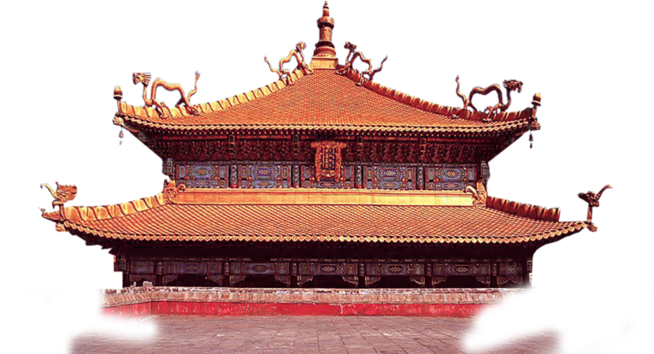

Respect for One’s Teacher: Standing in the Snow

Slide 3
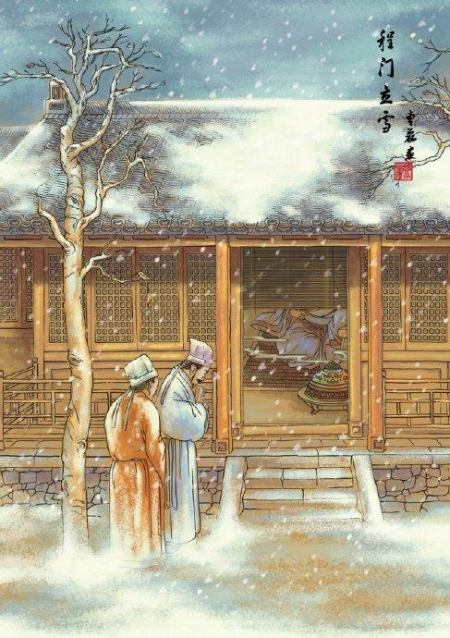
Key Elements for the story
Time: Song Dynasty
Place: Cheng Yi’s Home
Characters: Yangshi, You Zuo, Cheng Yi

Slide 4
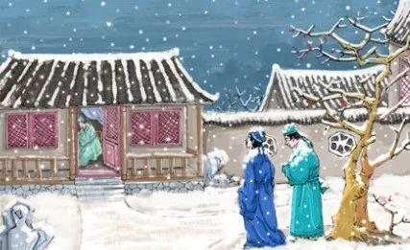
The Plots of the Story
In Song Dynasty, two young scholars Yang Shi and You Zuo went to visit a renowned scholar Cheng Yi on a snowy day . ..

Slide 5
The Plots of the Story
When they arrived at Cheng Yi’s house, they were told by the servant that Mr. Cheng was taking a nap at that time. Then they decided to wait outside until Mr. Cheng woke up.

Slide 6
The Plots of the Story
When Mr. Cheng got up, Yang and You had been standing in the heavy snow for a long time. Cheng Yi was quite moved, and enrolled them as his students.

Slide 7
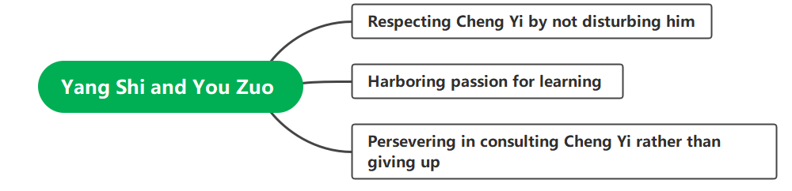
An Analysis of the Characters

Slide 8

故事小结
故事从尊师重道的角度讲述了北宋学者杨时和游酢拜谒著名学者程颐的故事, 体现了二人诚心专志，坚持不懈，好学求教的美好品格，能够很好的与《综合英语I》和《英语教学法》相结合。
《综合英语I》第3课 Whatever Happened to Manners? 谈到了日常生活中礼仪的重要性。礼仪可以让人与人之间的关系更为和谐，社会交往中充满更多温情。在分析该篇文章主旨的时候，可引入《程门立雪》的故事，来体现出礼仪的本质是尊重他人，其中蕴含的是诚意、亲善的美好品质。重视礼仪会得到善意的回报。

Slide 9
故事小结
《英语教学法》第1单元谈到了教师应该具备的素质。可引入《程门立雪》的故事，使学生更深切地意识到教师必须率先垂范，在学业和道德上成为模范，才能赢得学生的尊重。同时，教师的成长之路伴随着不断的学习和反思，亦课可导学生学习杨时和游酢坚持不懈，诚信求教的精神品质。

Slide 10
Thank you!

