Slide 1

CHINA STORY
中国故事
Tells the story of a real China
讲述一个真实的中国

Slide 2
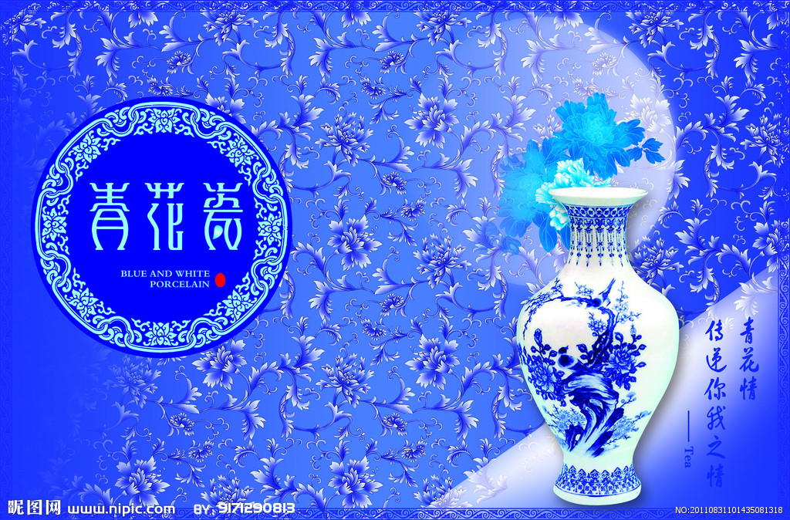
China
瓷器

Slide 3

CONTENTS
1.Foreword
2.The origin of porcelain
3.The history of development
4. The processing procedures

Slide 4
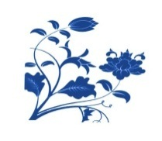



Foreword
In English,china means porcelain，therefore，it is obviously that China is the hometown of china .
It’s an important part of Chinese culture. Chinese achievements in science and technology in the pursuit of beauty and shape, are reflected through the ceramic production in many aspects.
china
Long before the European porcelain technology, China has been able to produce fine porcelain.
The invention of china is a great contribution to the world civilization.

Slide 5

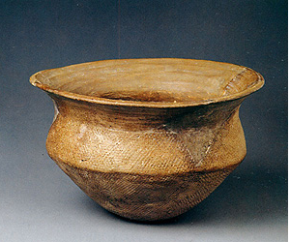
Origin
Around the 16th century BC in Shang Dynasty, the early Chinese porcelain appeared. As it was still rough on the firing process, it can be only called primitive-celadon.
primitive-celadon
原始青瓷

Slide 6



History of Development
  Primitive-celadon appeared in the Shang Dynasty, then from the Western Zhou Dynasty, the Warring States to the Eastern Han Dynasty, through the 1600 years’ change and development, porcelain firing technology had been improved gradually.

Slide 7
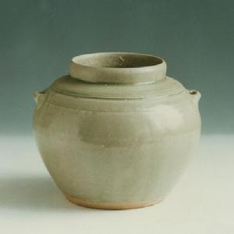
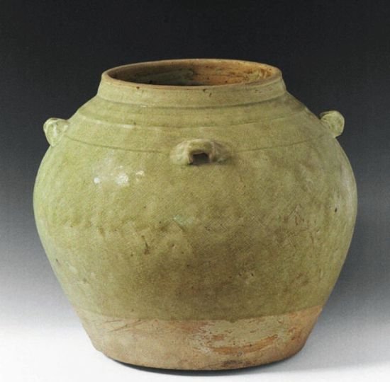
Han Dynasty
After long-term improvements, in the end of the Han Dynasty, the mature celadon was created, as an important milestonein the history of our country's pottery.

Slide 8
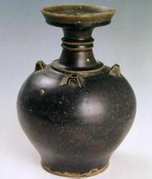
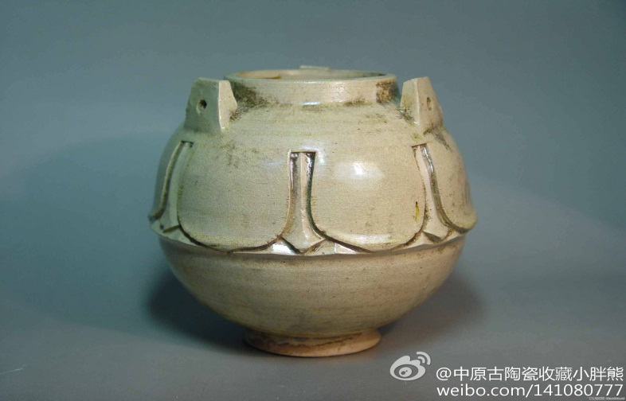
Jin and Southern and Northern Dynasties
In Jin Dynasty, original porcelain had been eliminated, at the same time color porcelain appeared.The period also appeared black porcelain .
Black porcelain
White porcelain

Slide 9

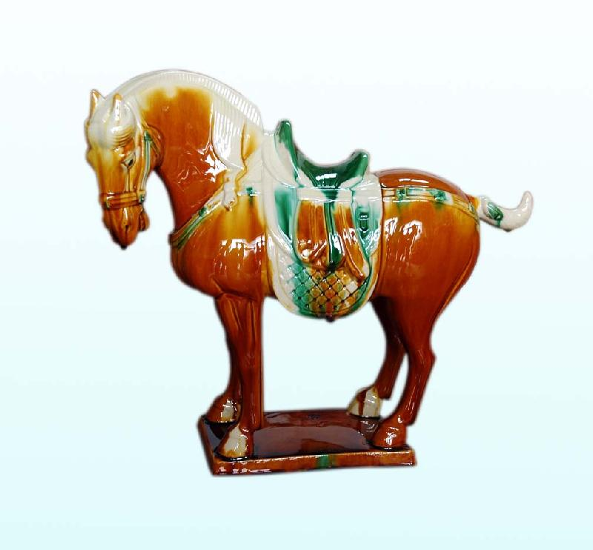

Sui and Tang Dynasty
During the Tang Dynasty, porcelain production entered a varied and colorful stage. Porcelain production has formed a green white North pattern.However,the tri-colored(三彩） glazed（釉的） pottery was the most civilized work.

Slide 10

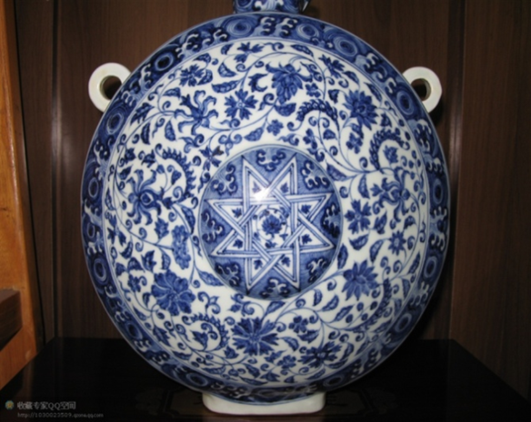
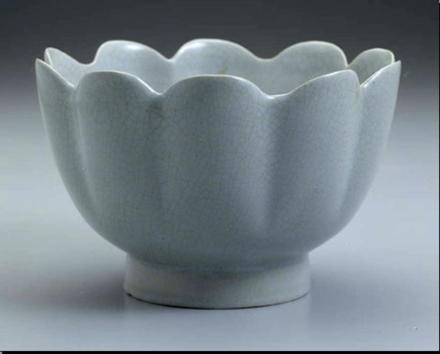
Song Dynasty
To the Song Dynasty, porcelain skills have been over half of Chinese, considered as the most prosperous period for porcelain. Then Jun kiln, Ge kiln,Ru kiln,Guan kiln and the Ding kiln are known as the five famous kilns in China.
From Ru kiln
From Guan kiln

Slide 11
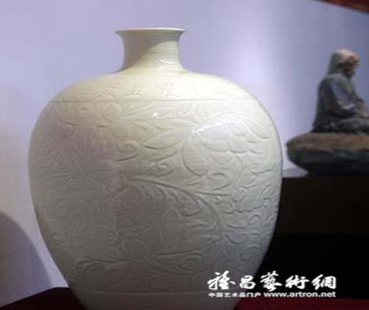
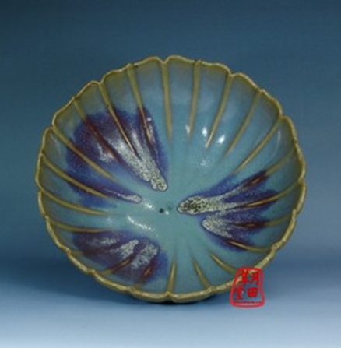

From Ding kiln
From Jun kiln
Song Dynasty is the highest aesthetic（美学的） era of porcelain.

Slide 12
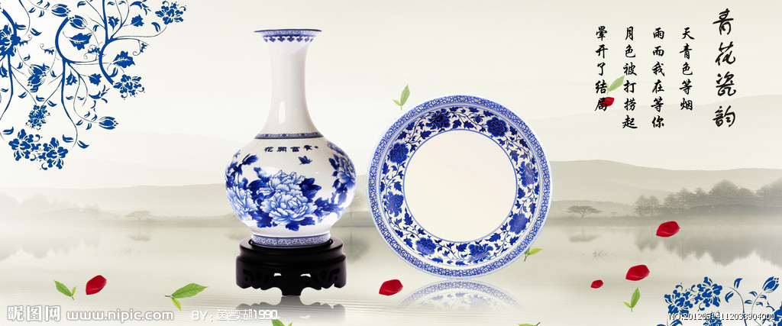
Yuan Dynasty
Yuan Dynasty is Chinese porcelain production turning period, innovation and development in many ways. The blue and white porcelain became the mainstream of Jingdezhen porcelain production.

Slide 13
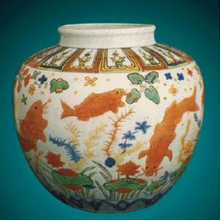
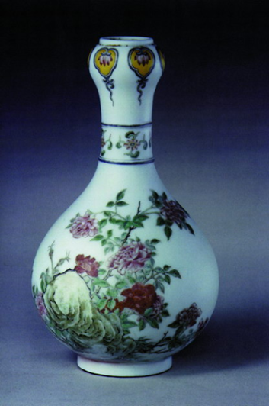
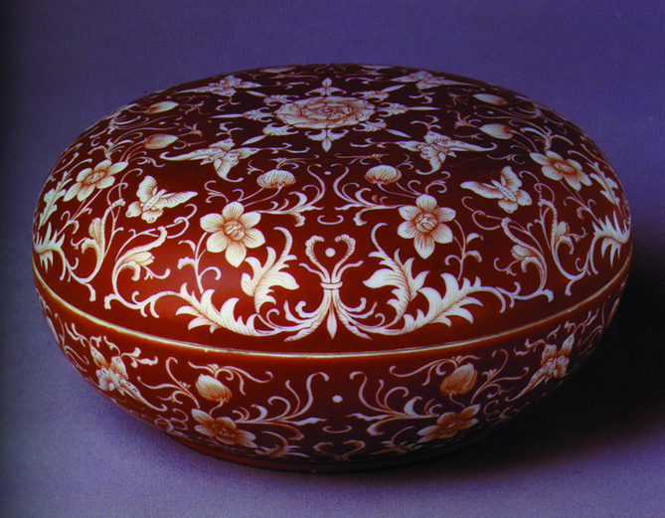
Ming Dynasty
Successfully firing, the exquisite（精致的） white glaze porcelain and the single-glaze porcelain with copper（铜） as the coloring agent（色剂）, made the Ming Dynasty porcelain colorful. The porcelain technology continued to improve.

Slide 14
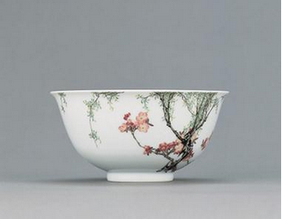
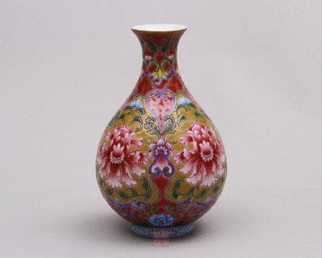

Qing Dynasty
Qing Dynasty is the most prosperous period China porcelain production, the quantity and quality of porcelain production reached a peak. A new kind of porcelain ,which called enamel (珐琅器), had appeared.

Slide 15




Processing procedures
Forming
①
Glazing
④
Firing
②
③
Decoration

Slide 16
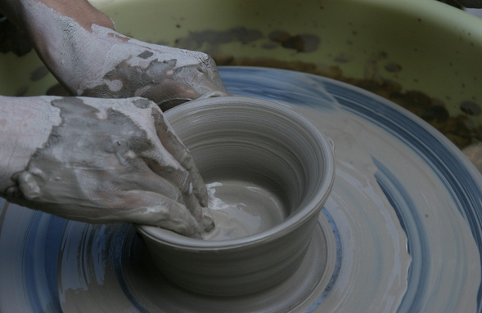
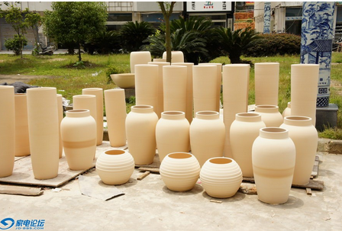

Slide 17
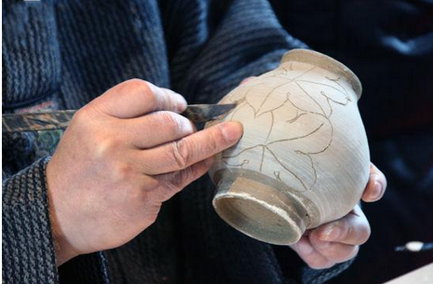
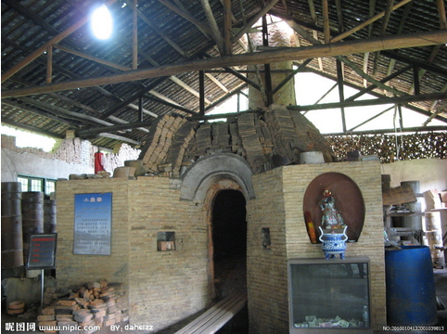
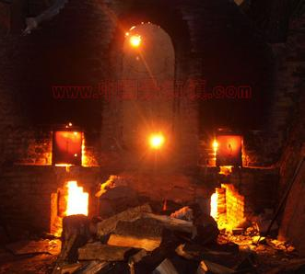

Slide 18
Summary
Special culture of porcelain reflects the broad social life, nature, customs, philosophy and concept. It is a kind of cultural carrier, or is a kind of static culture dance.

Slide 19

故事小结
四、六级翻译：
唐朝时期，人们就在昌南建造窑坊(kiln),烧制出一种青白瓷(bluish white porcelain)。青白瓷色彩晶莹，有“人造玉器”的美称，因而远近闻名，并大量出口欧洲。当时，欧洲人还不会制造瓷器，因此中国特别是昌南镇的瓷器很受欢迎。 在欧洲，昌南镇瓷器是备受珍爱的贵重物品，人们以能获得一件昌南镇瓷器为荣。因此，欧洲人就以“昌南”作为瓷器和生产瓷器的“中国”的代称。久而久之，欧洲人就把昌南的本意忘却了，只记得它是“瓷器”，即“中国”了。

Slide 20
故事小结
通过一段关于瓷器的四六级翻译练习将英语语言、文化、思维教学与思政教育无缝对接, 积极推进中国优秀传统文化与专业课程和思政课程相结合。以“陶瓷文化”为核心引领，引导学生牢牢树立起“工匠精神”的价值体系, 助推中国制造强国之梦, 实现知识传授与价值引领的有机统一。

Slide 21
故事小结
“瓷器起源”：结合“文明、和谐”价值观，学生介绍陶瓷的起源，人类文明的起源。中华民族的祖先创造了陶瓷，促进了世界文明的发展，表明中国自古以来对文明进步的孜孜追求。陶瓷文化诞生于水、土、火元素之间的碰撞，也象征了自然界物质的和谐统一，代表着万物和而不同，共存共生的思想，体现了中国的尚和之道。

Slide 22
故事小结
“汉唐瓷器”：结合“富强、民主”价值观，教学过程中通过讲授汉唐时期的陶瓷，让学生对这个历史发展时期的陶瓷发展有一个大致了解。兵马俑、青瓷、唐三彩等陶瓷艺术代表着汉唐时期我国的强盛国力，唐三彩是由一个健全强明的朝代所启毓而成，同时，它也具体而活跃地反映出健全强明的时代精神。

Slide 23
故事小结
“五大名窑”：“自由、平等”价值观。在中国古代，道家崇尚遵循自然规则前提下的精神自由，五大名窑中的许多名作都体现了古人追求自由的精神。我国瓷业之所以历经千年而不衰，其中一个重要原因是门户开放、兼收并蓄，这也是平等思想的体现。

Slide 24
Thank you!

