Slide 1

CHINA STORY
中国故事
Tells the story of a real China
讲述一个真实的中国

Slide 2
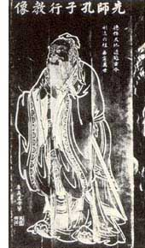
I. Confucianism
A. The life of Confucius
B. The teaching of Confucius
C. Impact on Chinese society

Slide 3
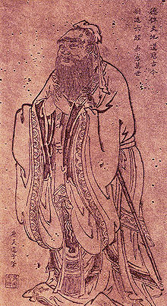
A. The life of Confucius
Full name Confucius 孔子
Born: 28 September 551 BC Qufu, Lu
Died: 479 BC (aged 71 or 72) Qufu, Lu
A portrait of Confucius by the Tang Dynasty artist Wu Daozi (680–740).

Slide 4
A. The life of Confucius
《论语·为政》 “吾十有五，而志于学。三十而立，四十而不惑，五十而知天命，六十而耳顺，七十而从心所欲，不逾矩”。
When I'm 15, I determined to learn; in my thirties, I'm independent; in my forties, I'm free of temptation; in my fifties, I know the fate; in my sixties, I'm satisfied with everything; in my seventies, I do whatever I want to do.

Slide 5
B. The teaching of Confucius
The “Five Classics” (of the past):
  The Book of Poems (Shih Ching)
  The Book of History (Shu Ching)
  The Book of Rituals (Li Chi)
  Yi-Ching
  The Spring and Autumn Annals (Ch’un Ch’iu)
The “Four Books” (Confucian)
  Analects (Lun Yu)
  Doctrine of the Mean
  The Great Learning
  The Book of Mencius (Meng-Tzu)

Slide 6
B. The teaching of Confucius
己所不欲，勿施於人。
"What you do not wish for yourself, do not do to others."
子貢問曰：“有一言而可以終身行之者乎”？子曰：“其恕乎！己所不欲、勿施於人。”
Zi Gong [a disciple] asked: "Is there any one word that could guide a person throughout life?"
The Master replied: "How about 'reciprocity'! Never impose on others what you would not choose for yourself."
—— Analects XV.24, tr. David Hinton

Slide 7
C. Impact on Chinese society
After his death, Confucius’ disciples wrote his sayings in “The Analects” → Sacred Text
During the Han dynasty, it became the basis of Chinese government bureaucracy (civil service exams were based on Confucian ideas and ancient Chinese books)
It influenced social life, government and education for over 2000 years.

Slide 8
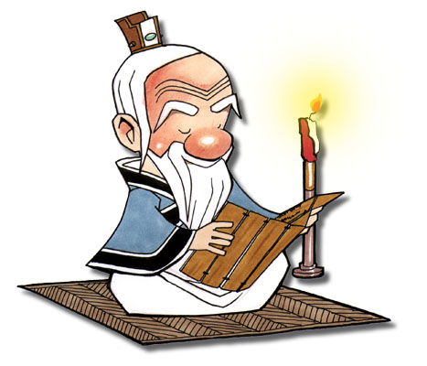
Confucius also said . . .

Slide 9
Confucius also said . . .
Confucius: In education there is no class distinction.
“A Son should not stray far from his parents while they are alive ."

Slide 10
Confucius also said . . .
“Shut your mouth 3 times before opening it”
“Work hard when you are young or regret it when you are old”
“Education is the only equalizer”

Slide 11

故事小结
在与学生子贡的问答中，孔子有一句名言——“己所不欲，勿施于人”，意即：自己所不愿意接受的，不要施加到别人身上。
《商务英语阅读1》第12单元是有关绿色经济、环保经济的。一些发达国家想转嫁污染给发展中国家、不发达地区，这种行为是不正确的。人类只有一个地球，各国共处一个世界，要倡导“人类命运共同体”（a Community of Shared Future for Mankind）意识。在追求本国利益时兼顾他国合理关切，在谋求本国发展中促进各国共同发展。

Slide 12
Thank you!

