Slide 1

CHINA STORY
中国故事
Tells the story of a real China
讲述一个真实的中国

Slide 2
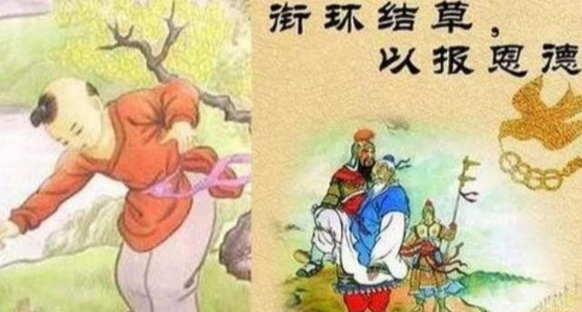
To Knot Grass and Carry a Ring

Slide 3
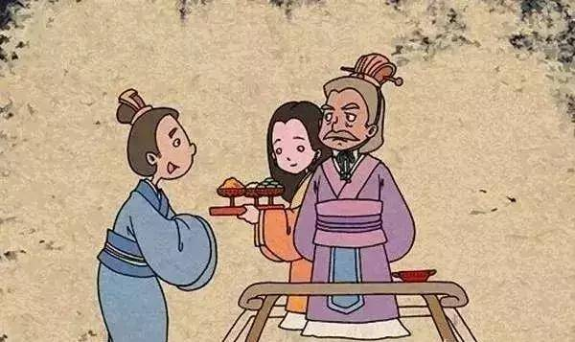
During the Spring and Autumn Period (chūn qiū 春秋时期,770-476 BC), there lived in the kingdom of Chin a man named Wei Ke (wèi kē 魏颗), whose father had a young and very beautiful concubine.

Slide 4
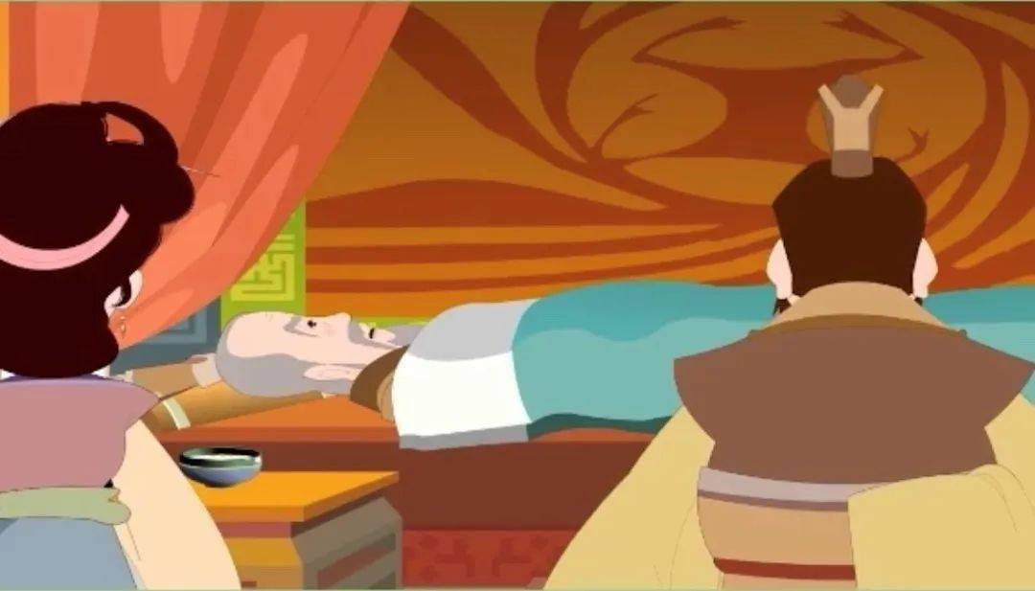
After his father grew old and fell ill, he told Wei Ke that after his death, his son was to marry the concubine into a suitable family. Later, when his illness had grown worse and he was in a state of delirium, he said that he wanted the girl to commit suicide and he buried with him. Wei Ke felt that he should obey what his father had said when he was fully conscious, and so he married the girl into a nice family.

Slide 5
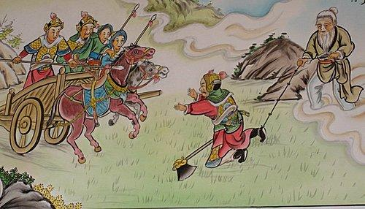
Later, Wei Ke was in a battle which he was about to lose, when suddenly he saw an old man come and tie a knot in the grass in front of his enemy, His enemy’s horse tripped over the knot, and Wei Ke won the battle.

Slide 6
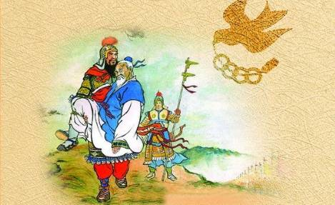
That night, Wei Ke had a dream that the old man came to him and said, “I am the father of the concubine, coming to repay you for not burying my daughter with your father.”

Slide 7
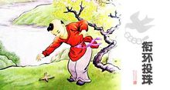
During the Han dynasty, there lived a man named Yand Bau, who was very kind and sympathetic. When he was a boy, Yang Bau once came across an injured sparrow. He saved the little bird, and treated its wounds. At that very night, a boy in yellow claiming himself as the messenger of Queen Mother of the west, came to thank him for him kindness and brought him three rings of jade, promising a prosperous future and moral goodness for his future generations.

Slide 8
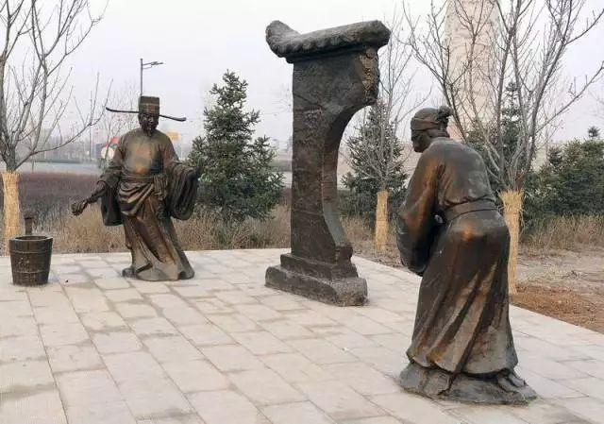
Just as the messenger promised, his son, grandson, great grandson and great great grandson all became the supreme government official in charge of military affairs, ranking the second in power, only inferior to the emperor.

Slide 9

故事小结
故事从受助者的角度讲述了受过别人恩惠或是帮助必当回报的故事,体现了中国俗语“滴水之恩当涌泉相报”的文化内涵,能够很好的与西方文化中的“帮助别人无需回报”相结合。
《综合英语2》第5单元第一篇讲述的是腿脚不方便的作者因健康状况原本对人情世故冷漠，后因冷雨夜受到盲人外公和外孙女无私帮助思想发生转变的故事。升华段作者引用圣经里的话表达“帮助别人无需回报”的新认知。此处引入“结草衔环”的典故，此为切入点，对比中国俗语“滴水之恩，当涌泉相报”，引导学生思考其中的中西文化差异。

Slide 10
Thank you!

