Slide 1

CHINA STORY
中国故事
Tells the story of a real China
讲述一个真实的中国

Slide 2

Chinese Chivalry: Characteristics and Typical Story “Major Lu Pummels the Lord of the West”
中国侠义精神：特征与典型故事《鲁提辖拳打镇关西》

Slide 3
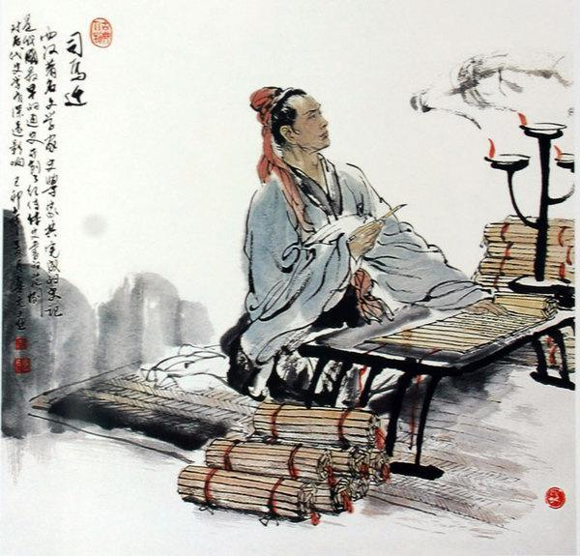
1. Origin
Sima Qian（司马迁）, author of Historical Records （《史记》）, is the first scholar who compiled the stories of roaming swordsmen.
Sima Qian

Slide 4
In collected biographies （列传）of roaming swordsmen, Sima Qian commented: “Although their behavior does not conform to the moral and legal rules, they keep their word, do things resolutely and honestly, care little about themselves and help others in despair. Having experienced the test of risk and death, they do not boast of their own ability, nor commend their own moral righteousness, which is something praiseworthy.” The deeds and spirit of these roaming swordsmen gradually evolve into Chinese Chivalrous spirit.

Slide 5
2. Definition
In general, Chinese chivalry includes the following characteristics:
Emphasizing cardinal principles of righteousness and making light of the life of self （重大义，轻生命）;
Emphasizing friendship and making light of personal interest（重友情，轻私利）;
Staying true to one’s words（信守诺言）;
Advocating freedom and universal love（崇尚自由和兼爱）.

Slide 6
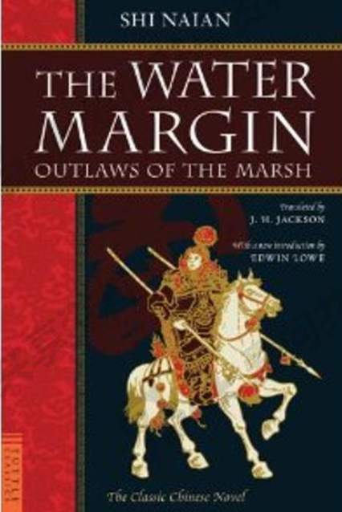
3. Typical Story from The Water Margin（《水浒传》）
Chapter Three: Major Lu Pummels the Lord of the West (《鲁提辖拳打镇关西》）
The so-called “Lord of the West”Zheng Tu（郑屠）likes a singing girl Jin Cuilian （金翠莲）and seizes and marries her by force. When “Major Lu”Lu Da（鲁达）hears about it, he is filled with righteous indignation and decides to do her justice.

Slide 7
One day, Lu Da, Li Zhong（李忠）and Shi Jin（史进） go to Pan’s restaurant for a drink. As they are talking about entering the port, they hear someone crying in the cabinet next door, so Lu Da asks the bartender to find out the reason. Hearing that Zheng Tu forcibly occupies Jin Cuilian as his concubine, finally drives her out and asks Jin family for money, Lu Da is infuriated.

Slide 8
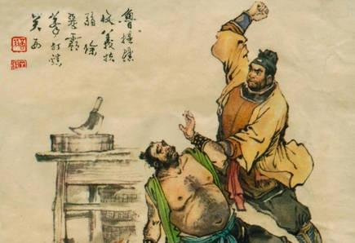
Lu Da immediately presents some silver for the Jin family and helps them to contrive a method to escape. Next day, in the early morning, Lu Da rushes to the inn where the Jin family live and escorts them to escape from the claws of Zheng Tu. Then Lu Da goes to the butcher’s shop of Zheng Tu, deliberately infuriates him, provokes a fight and beats Zheng Tu to death. Then he runs out of the south gate.

Slide 9
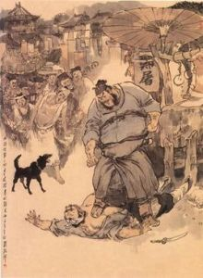
Questions:
What kind of Chinese chivalrous spirit does Lu Da demonstrate?
What are the similarities and differences between Chinese and Western chivalry?

Slide 10
故事小结
故事讲述了《水浒传》人物鲁达锄强扶弱的故事，展现了中国文学作品中侠义精神的一部分，能够较好地与英美文学课程相结合。
《英美文学概论（一）》第二课中谈到了骑士文学和骑士精神，借此引出该故事，引导学生探讨、分析西方文学作品中的骑士精神和中国文学作品中的侠义精神的异同。

Slide 11
Thank you!

