Slide 1

CHINA STORY
中国故事
Tells the story of a real China
讲述一个真实的中国

Slide 2
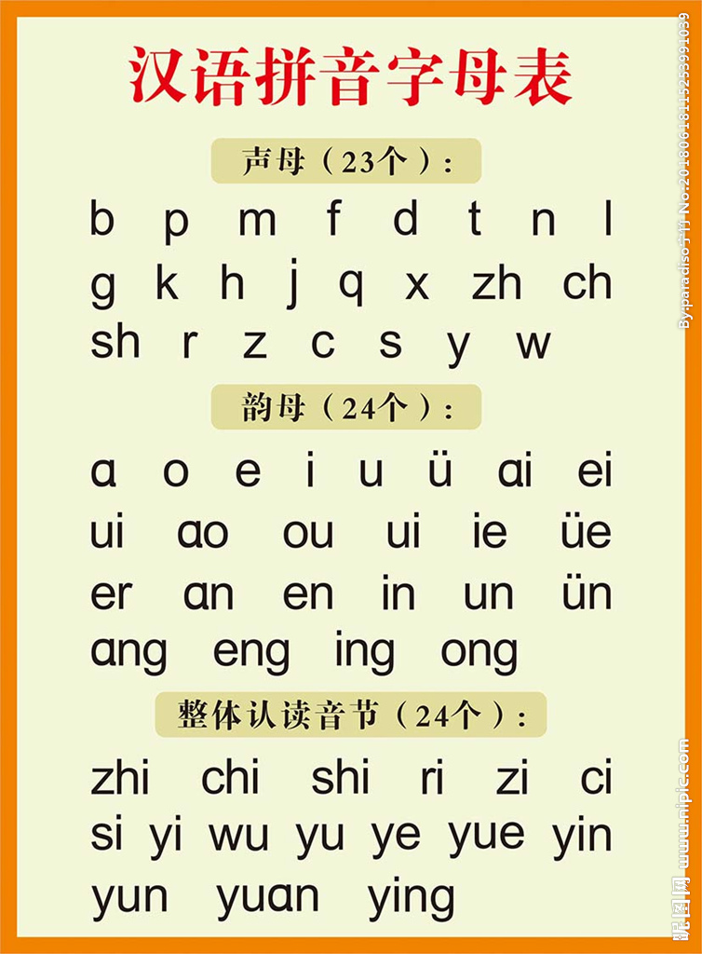
Introduction of the Story
Do You Know
What’s the function of Pinyin?
When was Pinyin created and who created it?

Slide 3

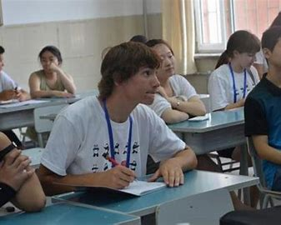
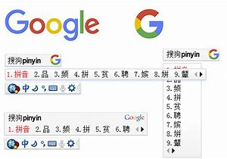
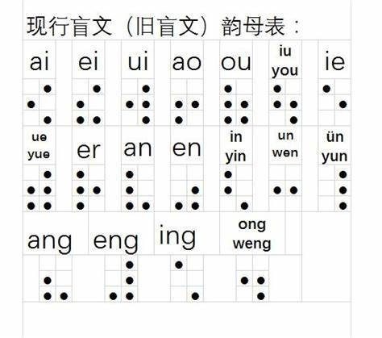
Function of Pinyin
Pinyin has vastly increased literacy throughout the country;
eased the classroom agonies of foreigners studying Chinese;
afforded the blind a way to read the language in Braille (盲文);
facilitated the rapid entry of Chinese on computer keyboards and cellphones.

Slide 4

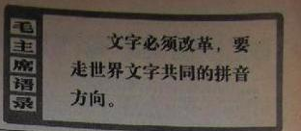
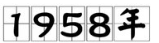
Google wrote on its blog:
It (Pinyin) bridged multiple Chinese dialects with its shared designations of sound.

Slide 5
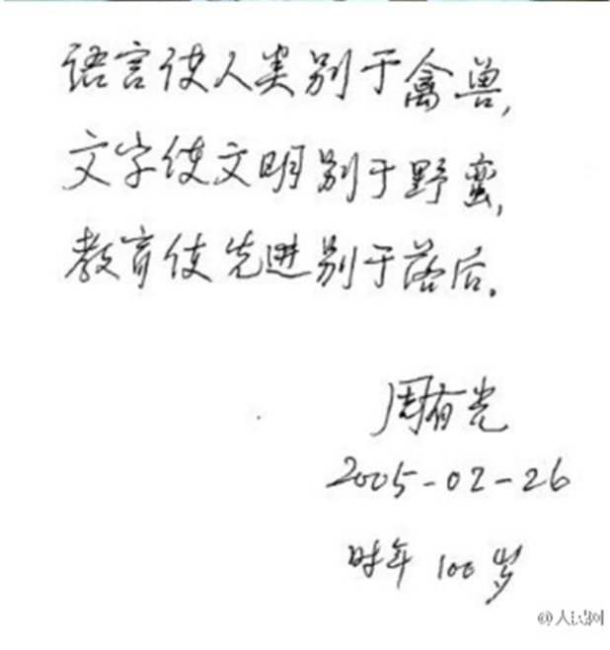
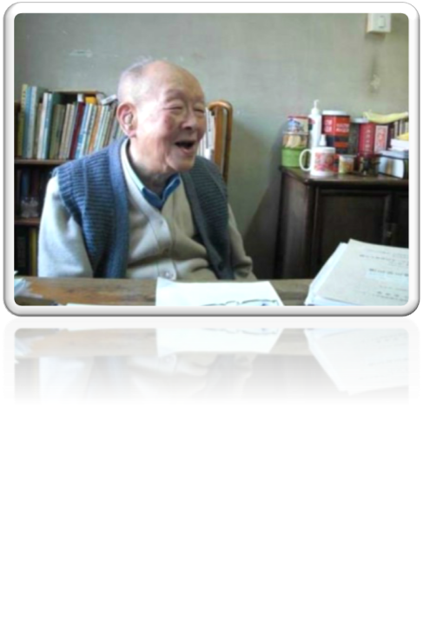
Father of Pinyin

Slide 6
Story of Zhou Youguang
Born in China on Jan. 13, 1906, Zhou Youguang developed an interest in linguistics when he was a teenager.
He studied economics and linguistics as a college student.
Throughout his career, he taught economics as a college professor until the Chinese government placed him at the head of a committee to reform the Chinese language to improve literacy in 1955.

Slide 7
Story of Zhou Youguang
For three years, he and members of the committee developed Pinyin, the system of Romanized Chinese writing that has become the international standard since its introduction in 1958.
Known as the “Father of Pinyin”, he went on to write 40 books, and he translated the Encyclopedia Britannica into Chinese.
Mr. Zhou articulated the philosophy that he said sustained him through his years in the labor camp.

Slide 8
“When you encounter difficulties, you need to be optimistic. The pessimists tend to die.”

Slide 9

故事小结及运用情景
故事从汉语拼音对中国人乃至世界人民的影响引入，从其创始人（周有光）生平的角度讲述了汉语拼音诞生的简要过程。通过周有光49岁开始由经济学转入语言学，服从国家大局，发挥个人潜质，经过3年时间取得了划时代的语言学领域的成果的案例，体现了学习能力迁移、个人理想抱负与国家利益的关系，能够与启发、激励学生注重学习能力提高、培养家国情怀。
故事作为《英语语言学》第2章语音学知识拓展，增加学生对母语知识的了解，明确拼音与国际音标的关系，增强文化自信；帮助认识专业学习与未来职业发展的关系。

Slide 10
Thank you!

