Slide 1

CHINA STORY
中国故事
Tells the story of a real China
讲述一个真实的中国

Slide 2


Double Seventh Festival

Slide 3


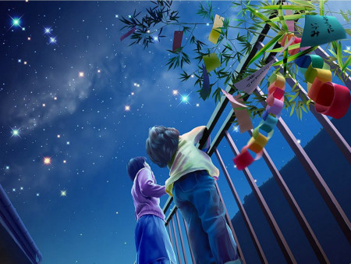
Pic 1 Aquila and Lyra
In summer when looking at the starry sky, Chinese people usually try to look for the two bright stars near the Milky Way. They are Aquila the Cowherd and Lyra the Girl Weaver. Chinese people believe it will bring them good luck and love if they can find them. The two stars are closely related with the Double Seventh Festival, known as the Chinese Valentine’s Day.
Pic 2 Looking at the Starry Sky

Slide 4
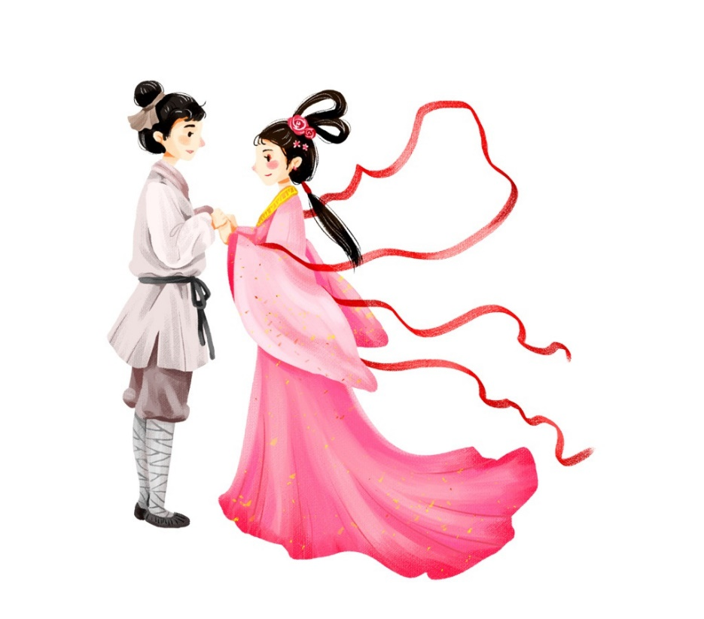
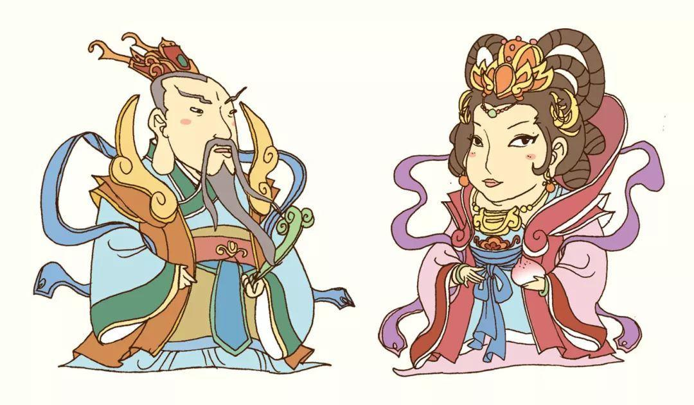
Pic 1 The Cowherd and the Girl Weaver
As its name implies, the Double Seventh Festival is the seventh day of the seventh lunar month.
The Cowherd Star and the Girl Weaver Star were believed to be the two lovers in folk legends. The cowherd was a young man on earth. He fell in love with the girl weaver, a daughter of the Jade Emperor in the Heaven. After the Queen Mother learned of their love, she created the Milky Way through her magic to separate the two lovers.
Pic 2 The Jade Emperor and the Queen Mother

Slide 5
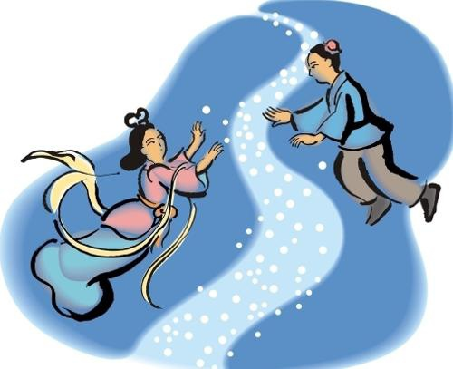
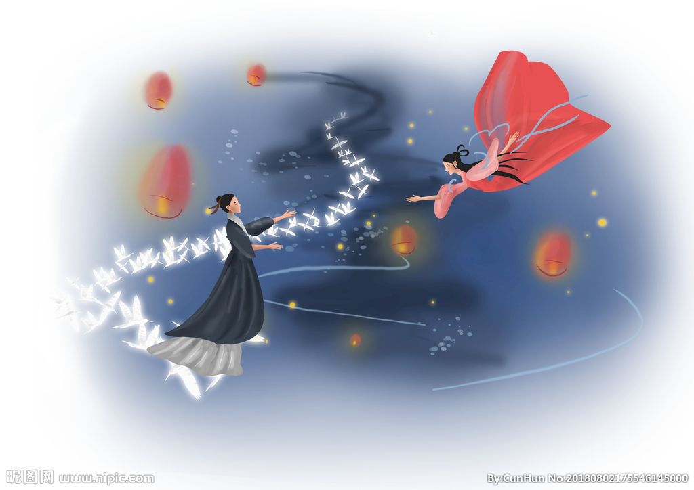
Such a seemingly love tragedy has a surprisingly happy ending. A group of considerate birds —magpies which are know as messengers of happiness in Chinese culture would fly together and build a magpie bridge across the Milky Way on the seventh of the seventh lunar month each year for the two lovers to meet.
Pic 1 The Milky Way
Pic 2 The Magpie Bridge

Slide 6

On the Double Seventh Festival, single girls especially those with close relationship would get together and pray to the Cowherd Star and the Girl Weaver Star for a Mr. Right.

Slide 7
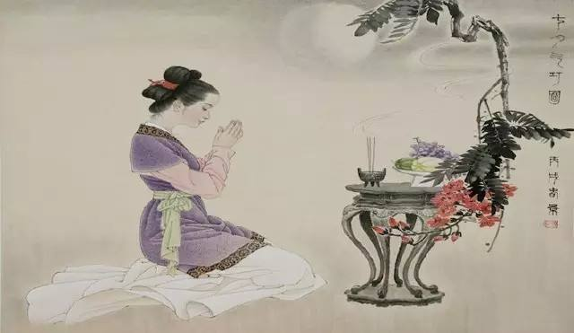
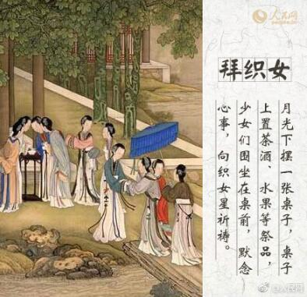
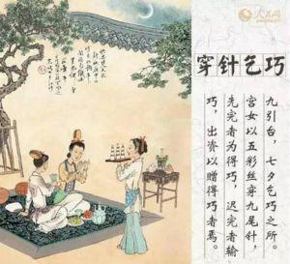
There is another custom called “Qi Qiao”, begging for the skills. The Girl Weaver Star is believed to be a fairy clever in mind and skillful in hand. On the Double Seventh Festival, girls in many places in China would offer steamed buns and fruit as sacrifices and hold contests of sewing, papercutting and embroidery. They do this and hope that the Girl Weaver Star can teach them more about girl skills.

Slide 8


Now the western Valentine’s Day is being accepted by more and more Chinese young people. Well, Chinese people are smarter enough to combine western and Chinese culture together. Thus, the Double Seventh Festival is called Chinese Valentine’s Day and becomes popular among both the traditional elder generation and the young people in love.
So now we’ve got a clear answer to the above question. In China people celebrate two Valentine’s Days. On the night of the Double Seventh Day, it is hard to book a table at a restaurant. The gift stores are full of people too. Many married and unmarried couples all long to have a delicious dinner together and receive flowers and presents. Most importantly, the Chinese Valentine’s Day is not only a chance to express your love to someone but also a good symbol of staying faithful to love in spite of all the possible difficulties.

Slide 9

故事小结
故事从由来、习俗和现代意义三个角度讲述了中国传统节日之一的七夕乞巧节,体现了中国丰富多彩的传统文化以及中国人从古至今对于爱的追逐与感悟,是非常好的口译练习素材。
《高级口译》第九单元话题为“文化交流”：外宾到中国访问，参观中国高校，学校师生热情接待，并向外宾介绍中国的风俗文化和价值观念。对于中国七夕这一传统节日的介绍便可作听力和口译素材之一融入到课堂当中，口译技巧中的听辨、复述和笔记法等技巧均可得到强化练习。

Slide 10
Thank you!

