Slide 1

CHINA STORY
中国故事－孙登孝母
Tells the story of a real China
讲述一个真实的中国

Slide 2
Introduction:
Sun Deng Filially Respected Stepmother
The King of Wu, Sun Quan, had an oldest song, Sun Deng, who was raised by his father's favorite wife, Lady Xu. Even though Sun Deng was not her own child, Lady Xu raised him as her son. And he was devoted to her as a song would be toward a mother.
三国时期 公元220-265年
Three Kingdoms Period 220-265 AD
孙登曾是吴国国主孙权的长子，他由孙权和宠妃徐夫人抚养长大。尽管孙登并不是徐夫人的儿子，徐夫人视如己出。而孙登也像她亲生儿子一样，对徐夫人孝顺有加。
Chapter 2 Communication Between Cultures: Verbal Communication

Slide 3
Introduction:
Sun Deng Filially Respected Stepmother
When the King then favored other wives and concubines, exiled Lady Xu, Sun Deng always remembered her. And when requested to succeed his father as king, he insisted as a condition that his stepmother be brought back.
后来孙权逐渐宠幸其他妻妾，并将徐夫人放逐，孙登一直挂念着他的养母。及至孙权称帝，欲立孙登为皇太子，而作为他受命成为皇太子的条件，孙登希望招养母徐夫人回宫。
Chapter 2 Communication Between Cultures: Verbal Communication

Slide 4
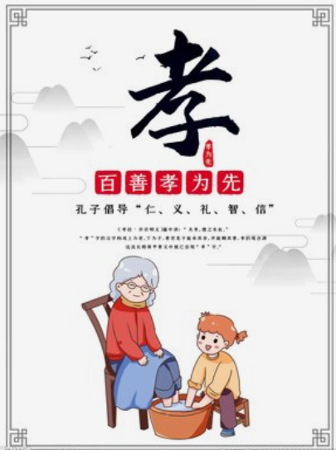
传统中国价值观－孝
Xiao, or piety, describes the state of having or showing a deep respect for your parents and elderly members in the family. Filial piety is rooted in children's love and respect for their parents. Confucians believe that filial piety is the foundation of a person's moral integrity and the basis for maintaining and strengthening the parent-child relationship, and even the sovereign-subject relationship.
孝，指孝顺、忠贞、敬重、奉献，强调对父母长辈甚至先祖的尊敬和无私奉献。在中国，“孝”植根于子女内心对父母的亲爱与尊敬。儒家认为，“孝”是个人德行养成的基础，并将其作为维系和强化父子关系乃至君臣关系的根本。
Chapter 2 Communication Between Cultures: Verbal Communication

Slide 5
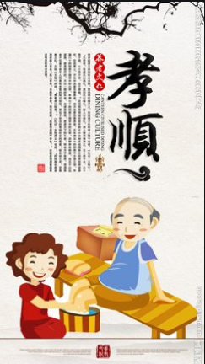
Piety Faithfulness Reverence Devotion
孝顺 忠贞 敬重 奉献
Xiao, is piety, reverence and faithfulness. And there is no such common usage in Western society.
Piety is composed of two parts. To find a position on top of a son, or somebody who's older on top of somebody who's younger supporting the older father.
And this is one of the most important concepts in Chinese culture. Where the young take care of the old. Son or daughter takes care of parents.
Chapter 2 Communication Between Cultures: Verbal Communication

Slide 6
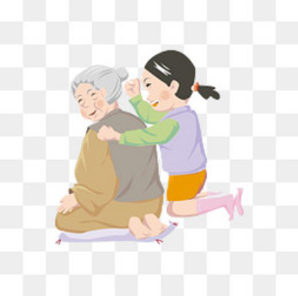
Piety Faithfulness Reverence Devotion
孝顺 忠贞 敬重 奉献
In companies of China, for instance, if somebody wants to take leave and take care of their parents. There is no other reason better to go and do to the errands on their own.
Because they are being a pious son of a pious daughter. And this is one of the most important character of a person in China.
Chapter 2 Communication Between Cultures: Verbal Communication

Slide 7
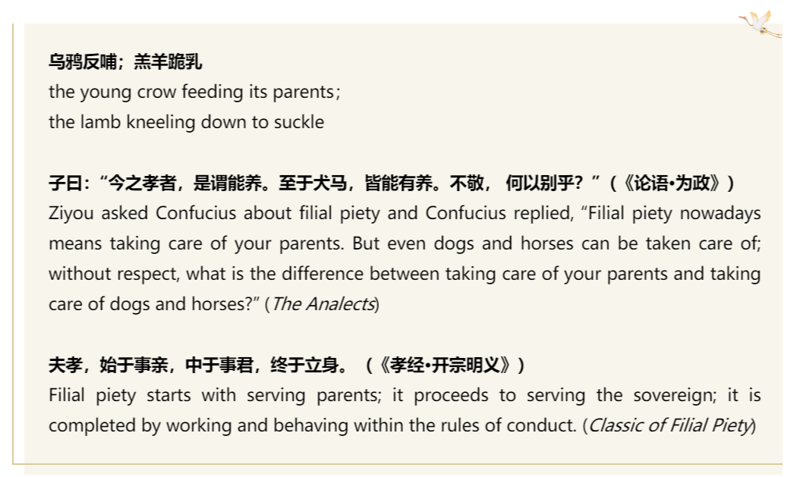

Slide 8
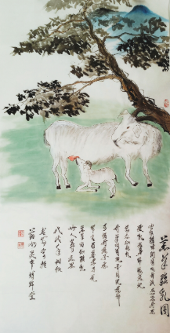
Conclusion:
Xiao is to honor your parents, respect old and love the young. And it is also a very good virtue. We must filially respect our parents and our eldership.
In this way, we will inherit this culture better just like many of our classics. Crow knows how to feed its parents; baby sheep knows how to knee down to get milk from mother sheep.
Chapter 2 Communication Between Cultures: Verbal Communication

Slide 9

故事小结
故事从传统中国价值观的角度讲述了三国时期孙权之子孙登孝顺其养母徐夫人的故事，体现了中国传统文化中对孝文化的重视，此类故事在中国历史上不胜枚举，口口相传，它能够很好地体现中西方文化的不同。
《跨文化商务交际导论》第1章中首先需要向学生们介绍“文化”这个基本概念，老师利用相关图片向大家对比中西方差异时，其中一张图片就涉及到中西方文化中对待老人的不同态度。

Slide 10
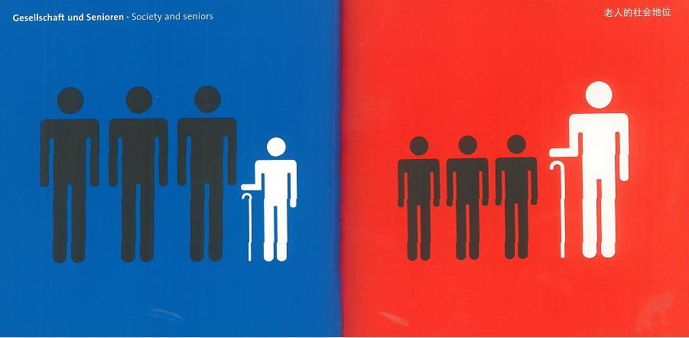
Chapter 1 Culture, Communication, Intercultural Communication
Introduction
Lead-in: East meets West
Chapter 1 Culture, Communication, Intercultural Communication

Slide 11
故事小结
通过图片和此故事的导入，较容易让学生们发现中西方文化中老人所处的不同社会地位：西方文化中，老人通常是衰弱、无能力的代名词，子女对父母没有法律上的赡养义务，所以在电影《刮痧》中主人公才会说“美国是儿童的天堂，老人的坟墓”，可见老人在西方社会中享受的不公正待遇；而在中国的传统文化中，老人有时会被称为智者，代表着经验丰富的过来人，从古至今还有“百善孝为先”的说法，可见老人在中国享有更受尊敬的社会地位。

Slide 12
Thank you!

