Slide 1

CHINA STORY
中国故事
Tells the story of a real China
讲述一个真实的中国

Slide 2
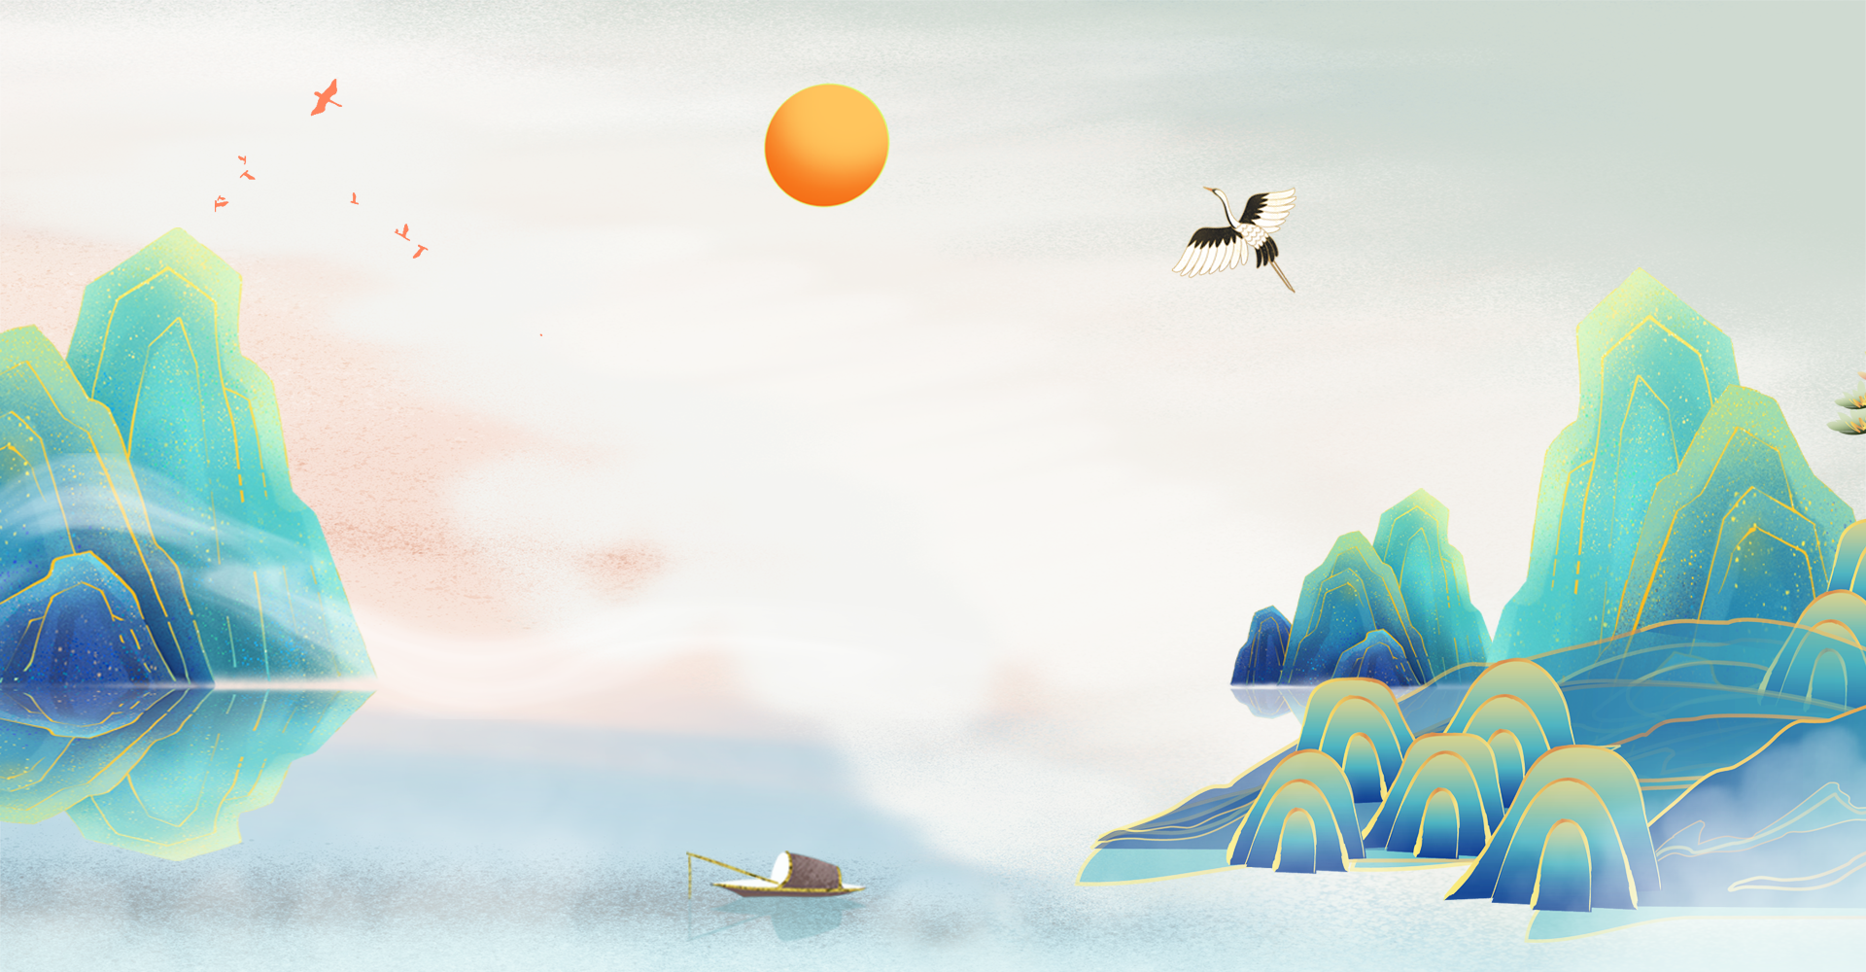


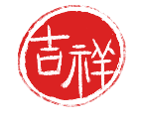
目录
壹
贰
《愚公移山》欣赏
记叙文写作教学设计

Slide 3
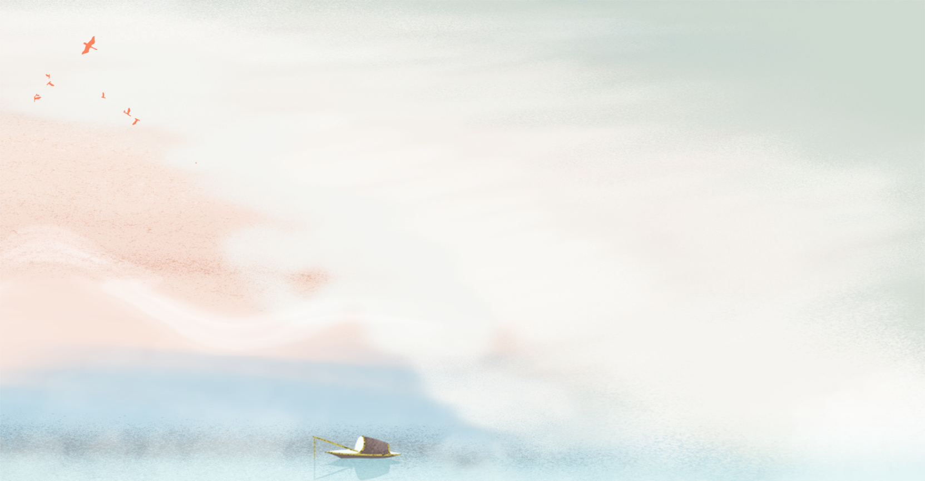




《愚公移山》欣赏
壹

Slide 4

The Foolish Old Man Who Moved the Mountains
The Foolish Old Man, over 90 years old as he was, was still in good health and enjoying his time in the big family with many children and grandchildren. With lovely kids and friendly neighbors, he led a simple happy life.
Only one thing annoyed him: two huge mountains lay directly in front of his house. One was the Mountain Taihang, the other the Mountain Wangwu. Everyone in the family had to take a long detour whenever they went out.
To get rid of this inconvenience, one day the Foolish Old Man said to the rest of the family. "I've been thinking for a long time. I will move the mountains. Are you going to join me?"
They all nodded, except his wife, who asked, "Where can we put the mountain rocks?"
He answered definitely, "We can dump them in the sea!"
Beginning--故事起因

Slide 5
The Foolish Old Man Who Moved the Mountains
He started to work the next day. Everyone in the family pitched in, men digging and carting while women delivering food and supplies.
The sea was so far away from their home that it would take a whole year to cart the rocks to the sea and come back on foot.
A neighbor's boy, about six or seven years old, also joined the team. Young as he was, he was eager to help and worked hard with the Foolish Old Man's grandchildren to cart the rocks.
Another old man in the village, the Wise Old Man, thought the Foolish Old Man was making a rod for his own back and laughed at him.
The Wise Old Man said to the Foolish Old Man, "You're really too foolish! With the few years and little strength that you still have, you wouldn't even be able to fell a tree on the mountain. How can you possibly move all the soil and rocks?"
Developing--故事经过

Slide 6
The Foolish Old Man Who Moved the Mountains
The Foolish Old Man, with a quick and meaningful look, pointed to the working scene and said firmly, "You are so pigheaded! Even widows and orphans know better. It is true that I will die, but my sons will survive and they will have sons. Then their sons will have sons, and those sons will also have sons, and I will have endless sons and grandsons, but these two mountains will grow no higher. Why can't they be leveled?"
Surprised by and disappointed at the stubborn man, the Wise Old Man shook his head and went away.
The Foolish Old Man and his family continued their work despite jeers of the Wise Old Man. Their fatigue was relieved by clean drinking water brought by their loved ones and the pathway stretching further ahead with each passing day.
Developing--故事经过

Slide 7
The Foolish Old Man Who Moved the Mountains
The gods of the two mountains got to know the Foolish Old Man's endeavor and reported it to Emperor Jade, "The stubborn old guy is indeed persistent. What a spirit! Well, let us give me a hand!"
Emperor Jade agreed and sent two titans to help the hard-working family. They each carried a mountain and moved them.
With no mountains in their way anymore, the Foolish Old Man and his family as well as their fellow villagers lived happily thereafter.
Ending--故事结局

Slide 8

记叙文写作教学环节设计
贰

Slide 9

故事小结
故事从第三人称的角度讲述了近九十岁的愚公，不论严寒和酷暑，带领家人靠双手移走了挡在家门口的两座大山,体现了锲而不舍、知难而上的精神,能够很好的与英语记叙文写作相结合。
《英语写作II》第6章记叙文写作，可以通过中国神话故事--《愚公移山》，引导学生了解记叙文的六大要素以及人物的创设。

Slide 10
1. 通过《愚公移山》的故事，教师引导学生分析故事六要素
要素 | 关键信息
时间 | once upon a time, over 90 years old
地点 | between the Mountain Taihang and the Mountain Wangwu
人物 | the Foolish Old Man, his family, the Wise Old Man
起因 | two big mountains sat right in front of his house and everyone in the family had to take a long detour whenever they went out
经过 | his family worked hard to move the mountains
结果 | two mountains moved by two titans

Slide 11
2. 学生讨论如何通过语言、动词、副词（短语）创造人物特点
 | 举例 | 人物特点
人物对话 | “Are you going to join me?” “We can dump them in the sea!” “ Why can't they be leveled?” “It is true that I will die, but my sons will survive and they will have sons. ” | determined
动词 | dump, pitch，dig，cart，deliver | hard-working down-to-earth
副词 (短语) | definitely, firmly, with a quick and meaningful look | strong-willed

Slide 12
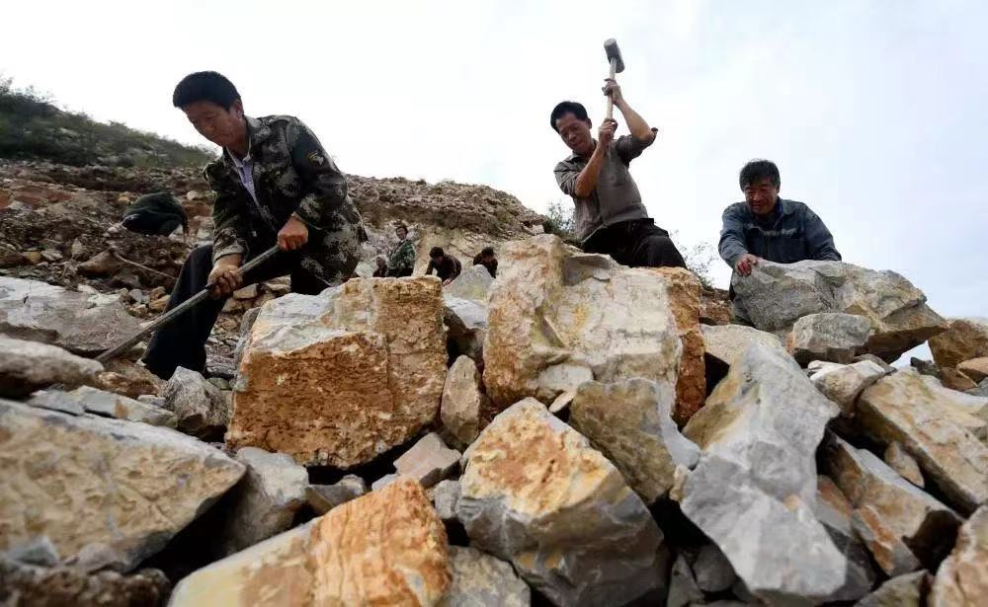
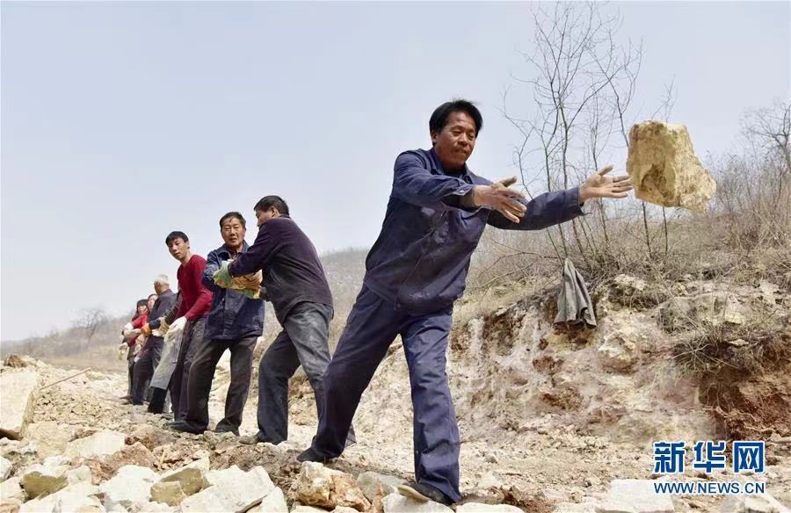
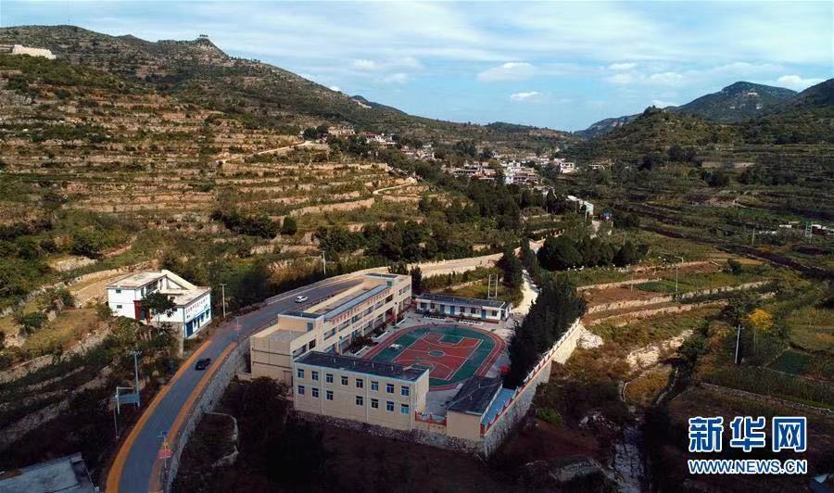
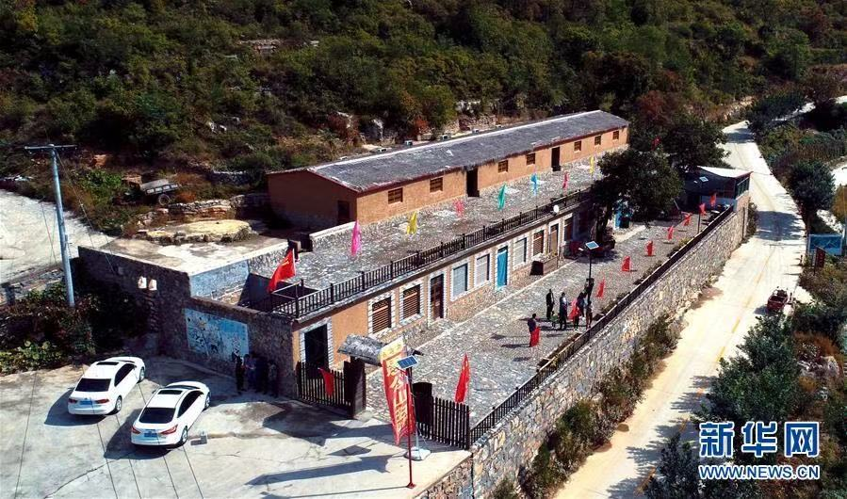
3. 学生观看图片或视频，讨论当前中国脱贫攻坚战中的 “愚公移山”精神
4. 学生讨论“愚公移山”精神对自己的启示
Perseverance, determination and meagerness to surmount difficulty

Slide 13
Thank you!

