Slide 1

CHINA STORY
中国故事
Tells the story of a real China
讲述一个真实的中国

Slide 2


Chinese Tea Culture
In spring, from drunkenness rose late oft me.
O'er poems we argued, spilling the sweet tea, But then I thought little of them.

Slide 3

Chinese Tea
Originated in the East, Tea has long been central to the lives of millions of people. It is said that Tea can aid meditation and self-reflection and even stimulate imagination.

Slide 4

Legend of Chinese Tea
One day, after walking for a long time, Shennong felt tired and thirsty. So, he rested under a tree and made a fire and boil water in a pot. Suddenly some leaves fell into the pot from a nearby tree.
Shennong drank the water and found it not only sweet and tasty, but also refreshing. Feeling less tired, he continued to drink up all the water in the pot.

Slide 5
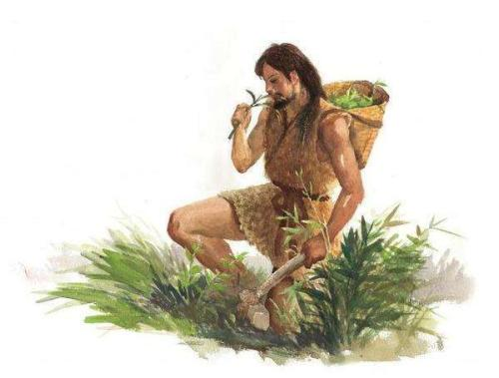
The Origin of Chinese Tea
Appeared in 2737~2697 B.C.
The Classic of Tea
茶经
Tea, as a beverage, originated with Shennong
茶为之饮，发乎神农也
Sheng Nong's herbal classic
神农本草经
Shennong tasted hundreds of herbs;
he encountered seventy two poisons daily and used tea as an antidote.
神农尝百草，日遇七十二喜，得茶而解之

Slide 6
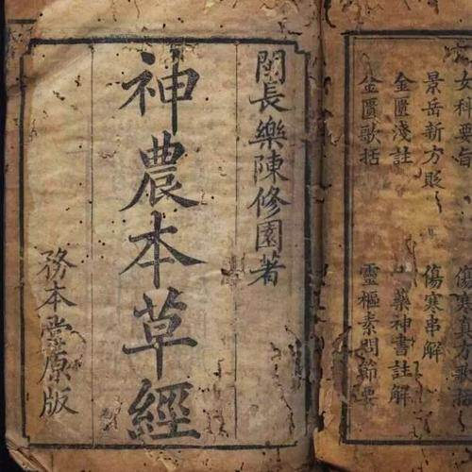
The earliest record
Tea tastes bitter.
Drinking it, one can think quicker, sleep less, move more nimbly, and see more clearly.

Slide 7
History of Chinese Tea Culture
There was a record dating back to Zhou Dynasty (1046-256 BC) about the usage of tea in a Chinese dictionary The Erya.
China was the first country to discover the tea in the world.
Tea was used as a medicine to make people stay awake at the beginning.
Tea was used as a plant of medicine function in Han Dynasty (206B.C.-220A.D.)

Slide 8
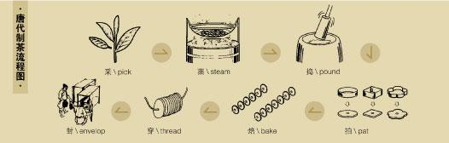
History of Chinese Tea Culture
Drinking tea started to become popular in the Tang (618-907) and Song (960-1279) Dynasties.
The flavor of tea, which may be drunk weak or strong, contains both bitter and sweet elements.
With its unique appeal, tea has
been transported to most parts
of the world.

Slide 9
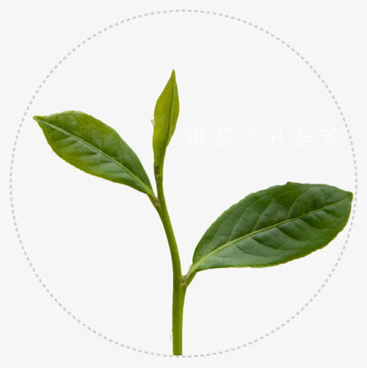
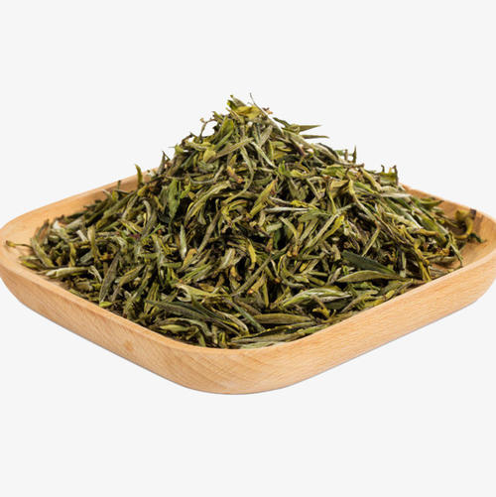
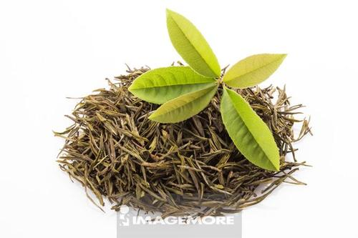
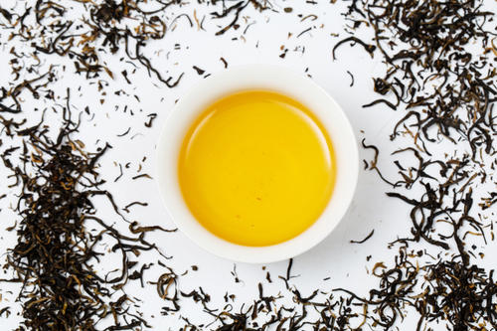
Development of Chinese Tea
1
2
3
4
Oblation
Medicine
Food
Drink
West Zhou
Spring and Autumn period
Warring States period
Han Dynasty

Slide 10
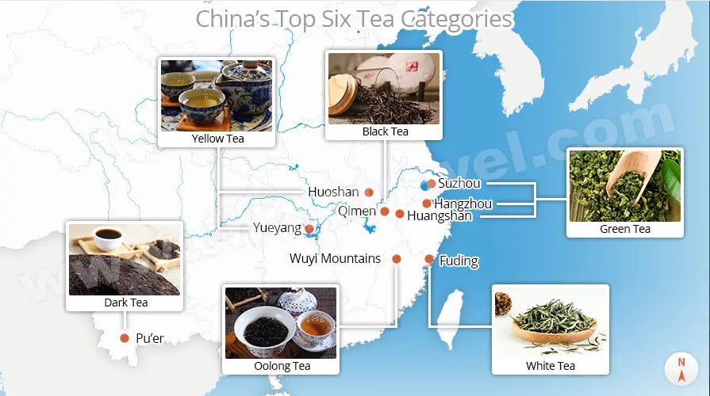
Categories of Chinese Tea

Slide 11
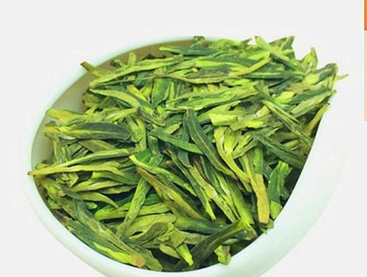
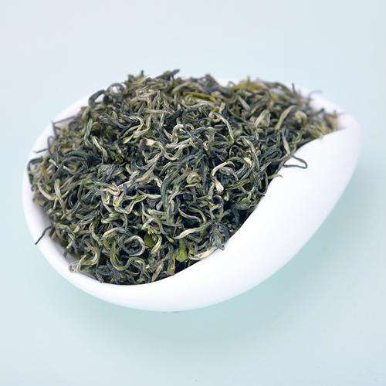
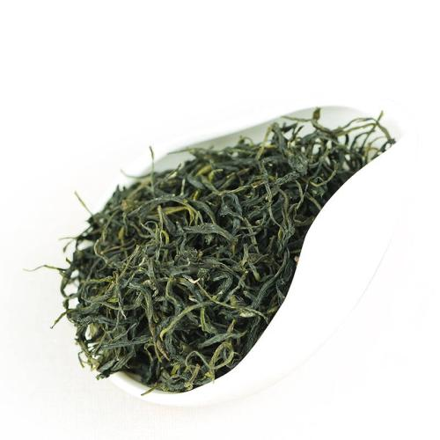
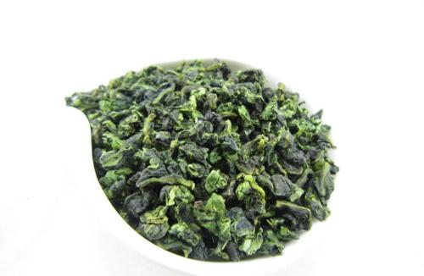
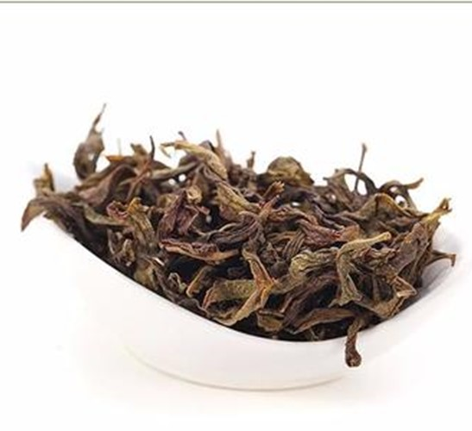
Top 10 Chinese Teas
Type: green tea
Location: West Lake, Hangzhou, Zhejiang Province
Type: green tea
Location: Dongting Mountain near Lake Tai, Jiangsu Province
Type: green tea
Location: Huangshan,
Anhui Province
Longjing
Biluochun
Huangshan Maofeng
Type: oolong tea
Location: Anxi county,
Fujian Province
Type: oolong tea
Location: Wuyi Mountain region of Fujian Province
Tieguanyin
Wuyi Yancha

Slide 12
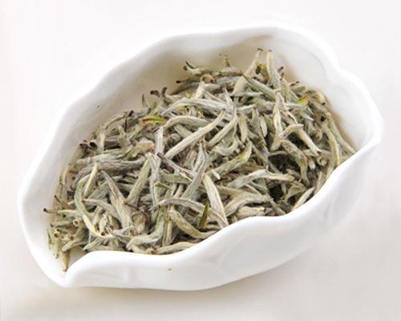
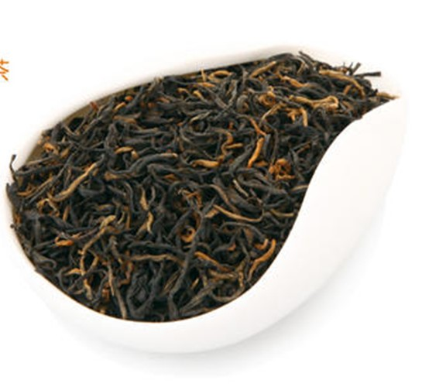
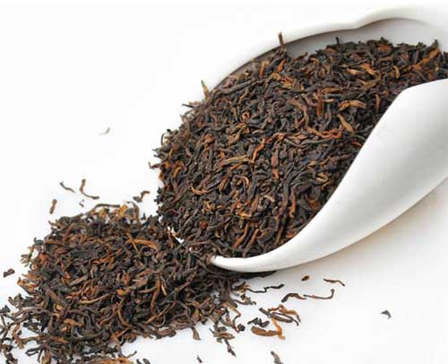
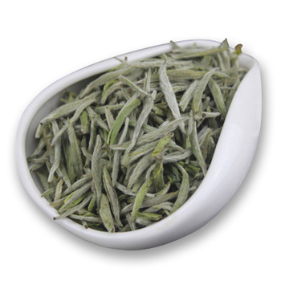
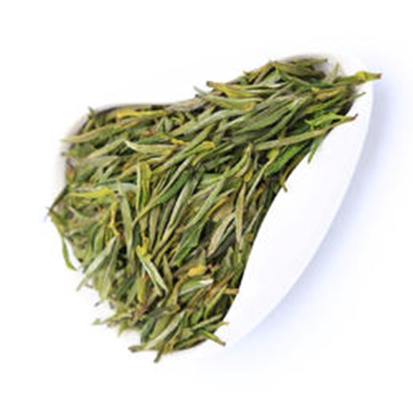
Top 10 Chinese Teas
Type: yellow tea
Location: Junshan Island in Dongting Lake, Yueyang city, Hunan Province
Type: black tea
Location: Qimen county, Huangshan city,
Anhui Province
Type: dark tea
Location: Pu'er county,
Yunnan Province
Junshan Yinzhen
Qimen Hongcha
Yunnan Pu'er
Type: white tea
Location: Fuding county, Zhenghe county of Fujian Province
Type: green tea
Location: Lu'an city,
Anhui Province
Baihao Yinzhen
Lu'an Guapian

Slide 13
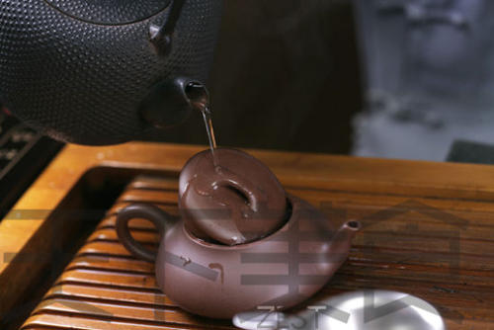
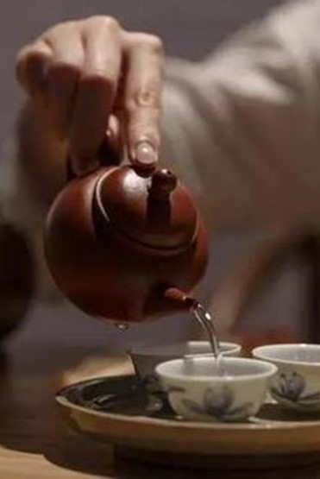
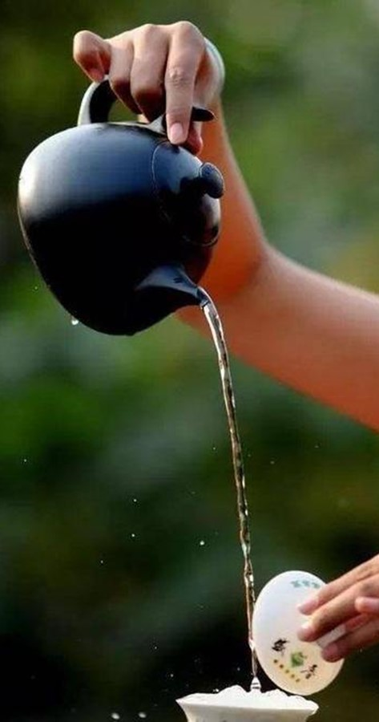
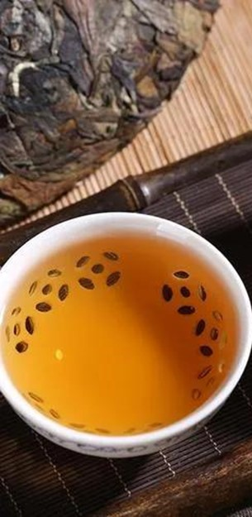
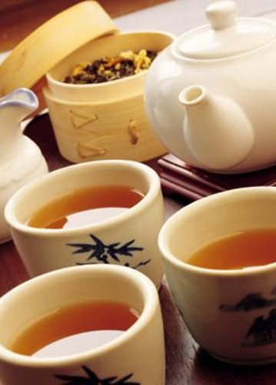
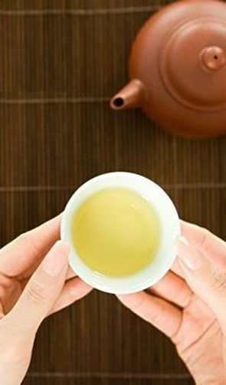
Steps of making Tea
Heat Tea Pot
Warm Cups
Wash the tea on high
Make tea in the low spot
Divide tea
Serve
tea
烫壶
温杯
悬壶高冲
低泡
分茶
敬茶

Slide 14
Translation（CET-4）
茶拥有5000年的历史。传说，神农氏(ShenNong)喝开水时，几片野树叶子落进壶里开水顿时散发出宜人的香味。他喝了几口，觉得很提神。茶就这样发现了。
自此，茶在中国开始流行。茶园遍布全国，茶商变得富有。昂贵、雅致的茶具成了地位的象征。
今天，茶不仅是一种健康的饮品，而且是中国文化的一个组成部分。越来越多的国际游客一边品茶，一边了解中国文化。

Slide 15

故事小结
通过一段关于茶文化的四级翻译练习将英语语言、文化、与思政教育无缝对接, 积极推进中国优秀传统文化与专业课程相结合。茶文化的内涵其实就是中国文化的一种具体表现。茶文化的精神内涵即是通过沏茶、赏茶、闻茶、饮茶、品茶等习惯与中国的文化内涵和礼仪相结合形成的一种具有鲜明中国文化特征的一种文化现象。中国不仅是茶叶的原产地之一，而且，在中国不同的民族，不同的地区，至今仍有着丰富多样的饮茶习惯和风俗。茶为一种植物，可食用、解百毒、长品易健康、长寿，茶品顺为最佳、还可作药用。

Slide 16
故事小结
茶文化对现代社会的作用主要有五个方面：
一 茶文化以茶德为中心，重视人的群体价值，倡导无私奉献。重视修生养德，有利于人的心态平衡，提高人的文化素质。
二 茶文化是应对人生挑战的益友。在激烈的社会竞争下，参与茶文化，可以放松精神和身心，以应对人生的挑战。
三 有利于社区文明建设。改革开放后茶文化的传播表明，茶文化能促进社会进步。
四 提高人们生活质量，丰富文化生活。茶文化具有知识性、趣味性和康乐性，品尝名茶、茶具、茶点，观看茶俗茶艺 ，都给人一种美的享受。
五 促进开放，推进国际文化交流。

Slide 17
Thank you!

