Slide 1

CHINA STORY
中国故事
Tells the story of a real China
讲述一个真实的中国

Slide 2
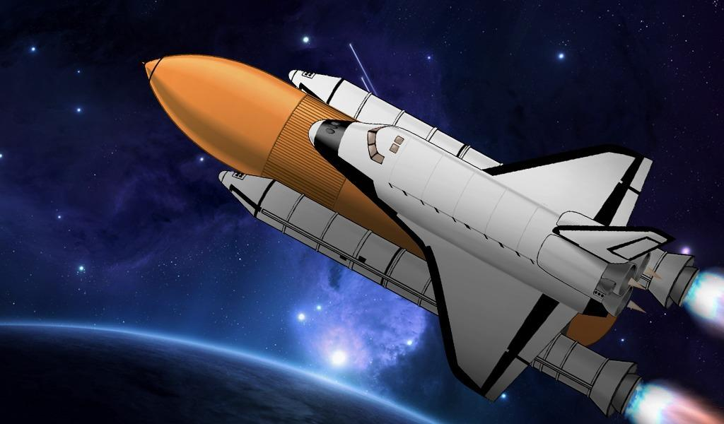
History of China Aerospace

Slide 3
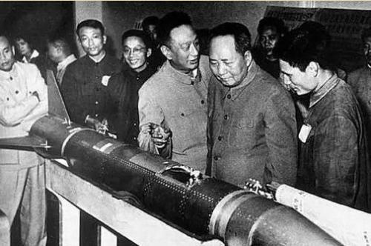
Time:1956.10.8
Issue: The establishment of the 5th research institute of Chinese Ministry of National Defense
This was the first institute related to the guided missile.
It was considered as the foreshadowing of China Aerospace Corporation

Slide 4
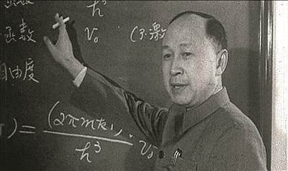
Time:1960.2
Issue:China took the first step in rocket technology
The first experimental rocket designed and made in China was a huge success
At that moment, Xuesen Qian was the dean of the research institute

Slide 5
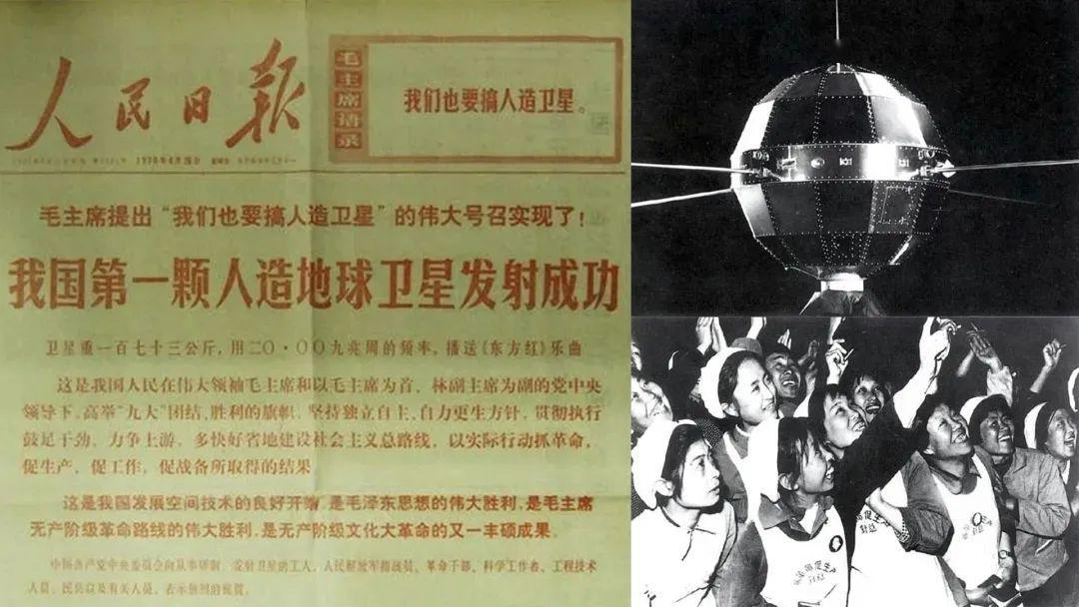
Time:1970.4.24
Issue: China has successfully launched its first artificial satellite:Dongfanghong-1
China has become the fifth country in the world to launch a satellite
The main mission was to paly the music The East is Red in the space

Slide 6
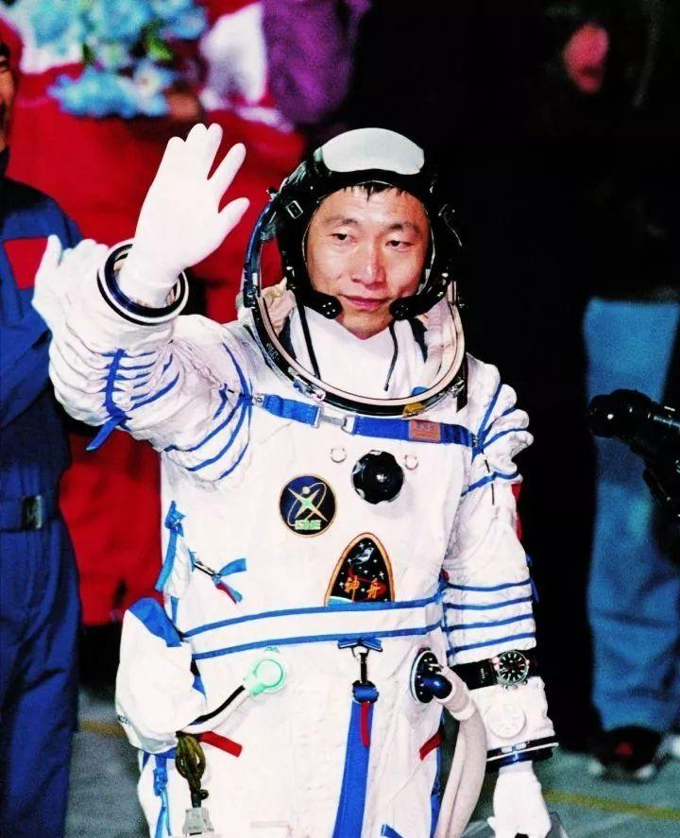
Time:2003.10.15
Issue: China successfully carried out its first manned space fight
Liwei Yang became the first Chinese man to travel in the space
Shenzhou V spacecraft successfully carried him to the space and returned safely after nearly 21hours

Slide 7
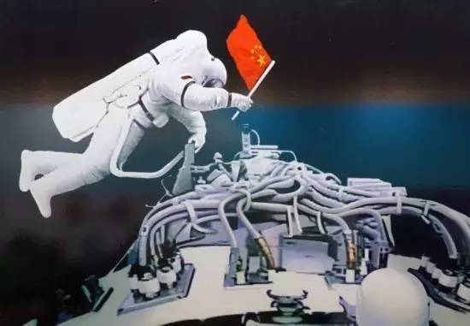
Time:2008.9.25-28
Issue:Chinese astronauts have stepped outside their space capsule for the first time
Three astronauts have joined the flight
China became the third country to develop this technology

Slide 8
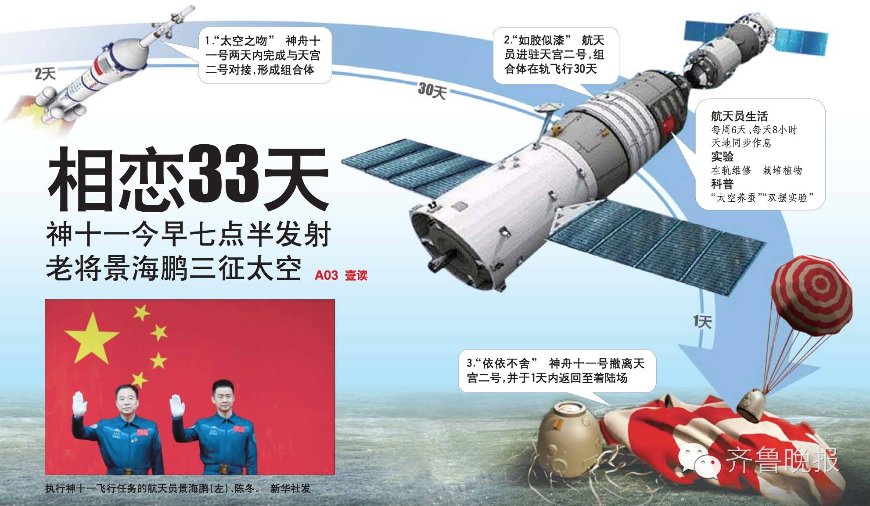
Time:2016.11.18
Issue:Shenzhou-11 was successfully launched
Haipeng Jing became the only Chinese man to go into the space for three times

Slide 9
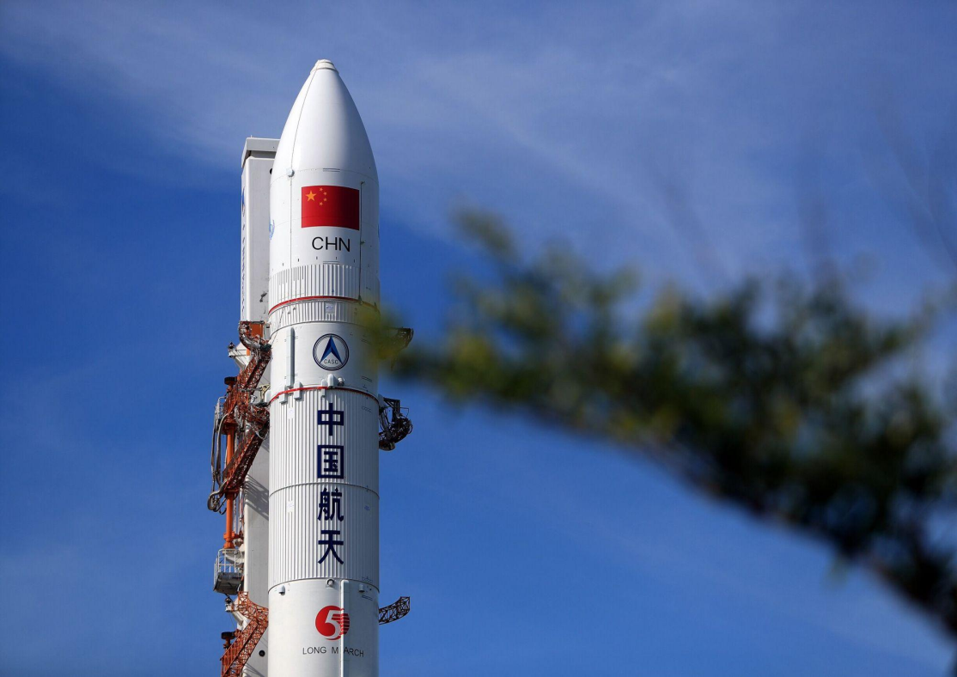
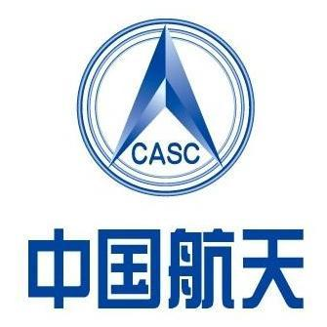
According to China’s space program, China is targeting no earlier than 2025 for manned lunar landing
In the future, we will see more of the universe

Slide 10

故事小结
故事从历史角度讲述了中国航天业的发展史,体现了科技发展的曲折历程,能够很好的与西方国家的科技发展相结合。
《高级英语I》第4课“震惊世界的审判”当中介绍了外国的科学观念“进化论”的曲折的发展过程。古今中外，所有对于科学的追求都需要付出和勇气。
科技进入我们的生活从来都不是一帆风顺的，但中国科学家有敢闯敢拼的精神，不畏艰难险阻，迎难而上，才造就了今天伟大的中华民族。

Slide 11
Thank you!

