Slide 1
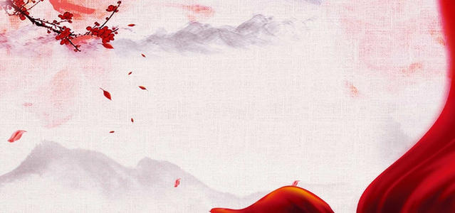
CHINA STORY
中国故事
Tells the story of a real China
讲述一个真实的中国

Slide 2


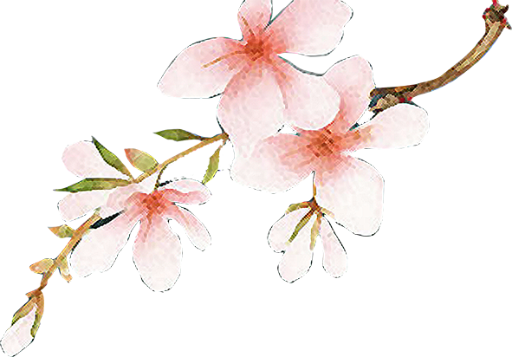
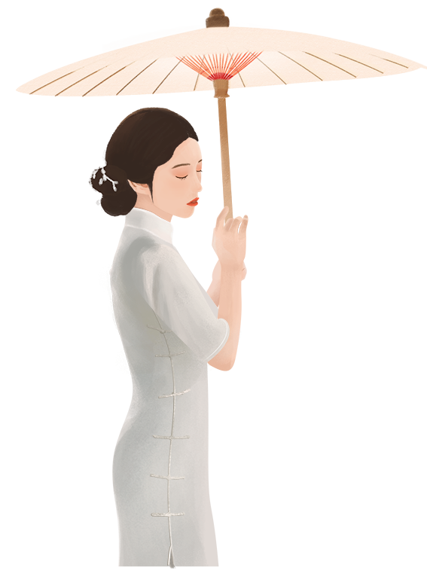


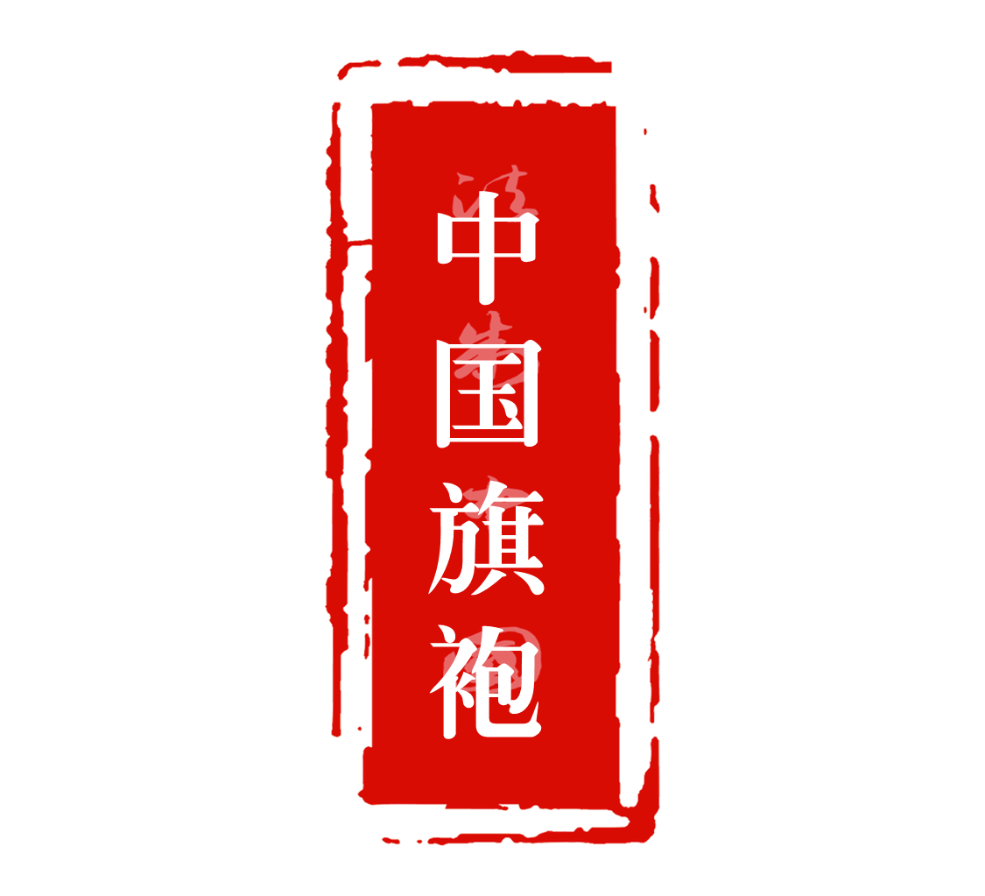
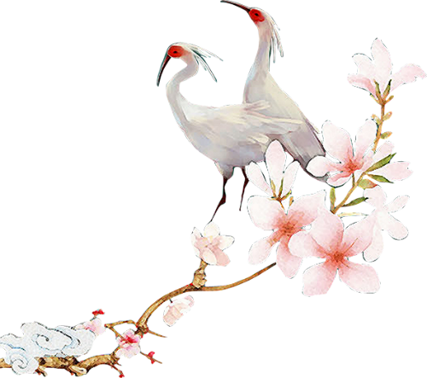
The History of
Chinese Cheongsam

Slide 3
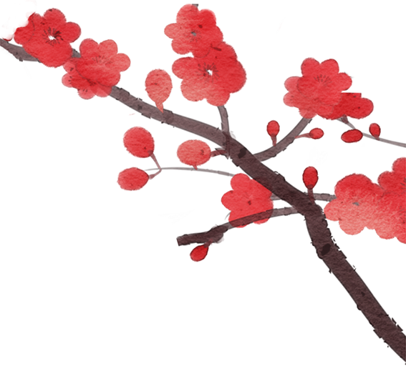
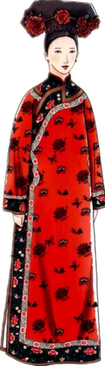
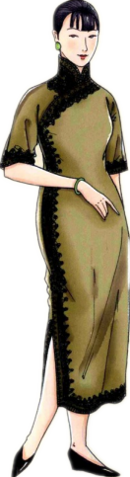
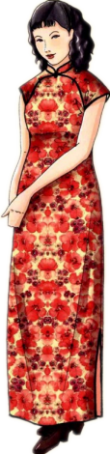
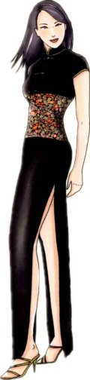
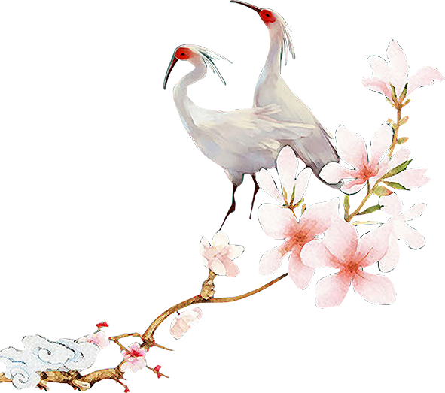
Cheongsam (literally, long shirt/dress), also known as Qipao or Mandarin Gown, was a type of feminine body-hugging dress with Manchu and Western elements.

Slide 4
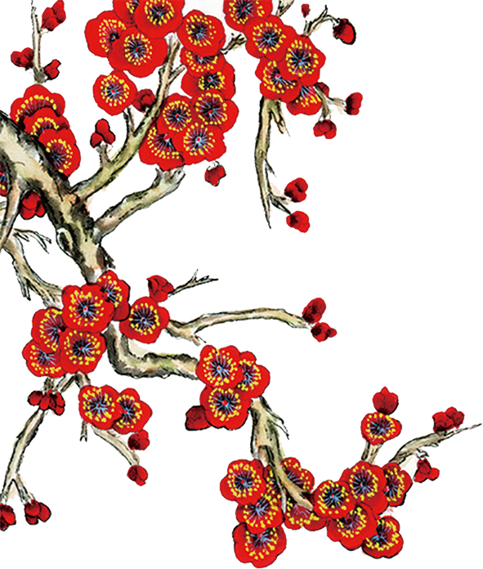
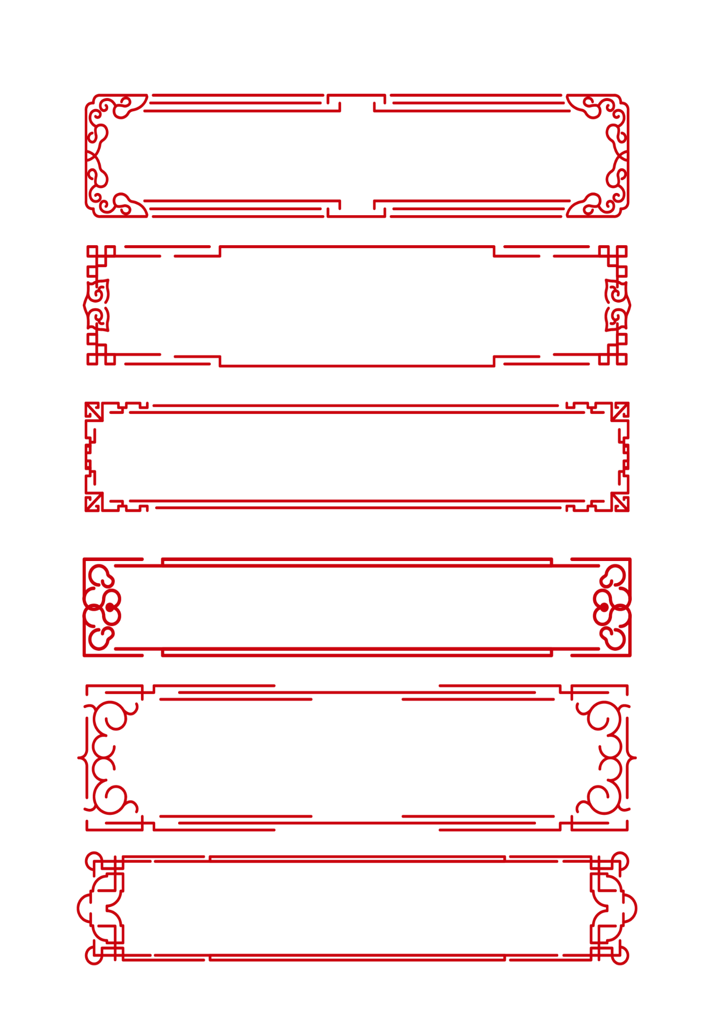
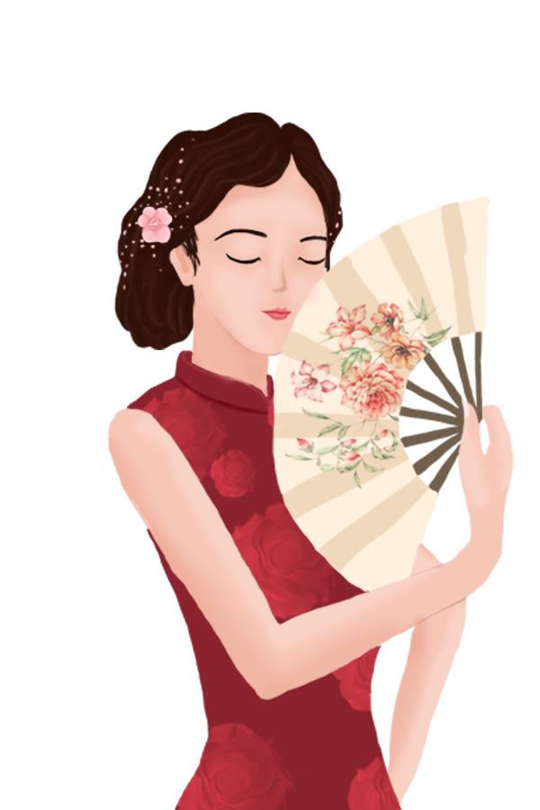
旗 袍
Eight Banners
the gown that Banner people wear

Slide 5
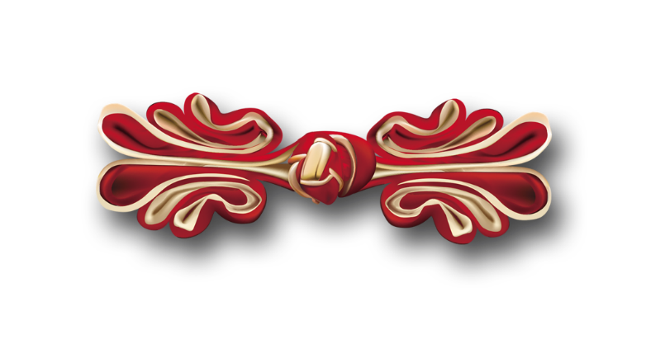
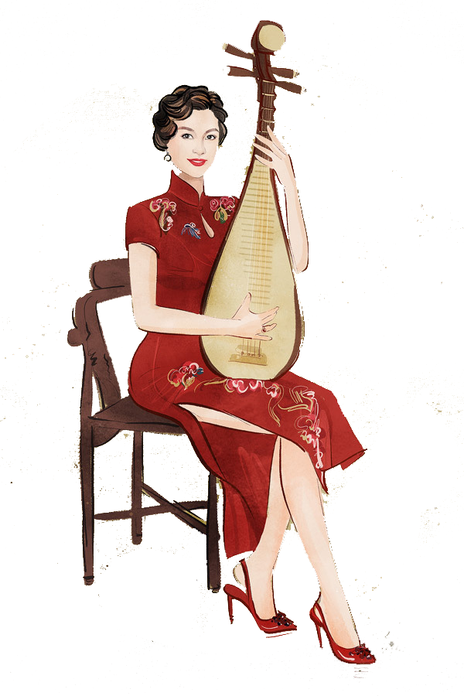
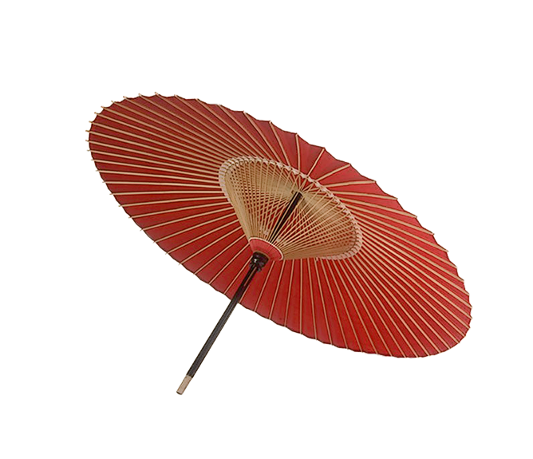
The History of Chinese Cheongsam
1. Before Crossing Shanhaiguan
2. During the Qing Dynasty
3. During the Republic of China period
4. Since the 1980s

Slide 6
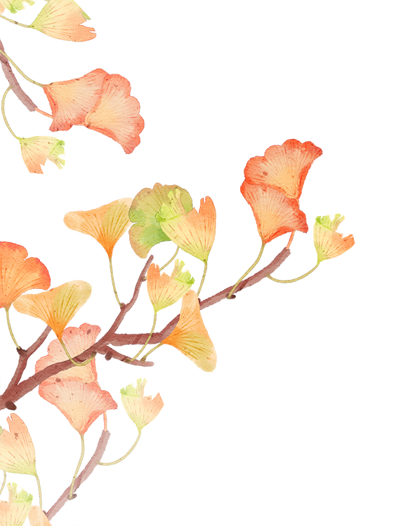
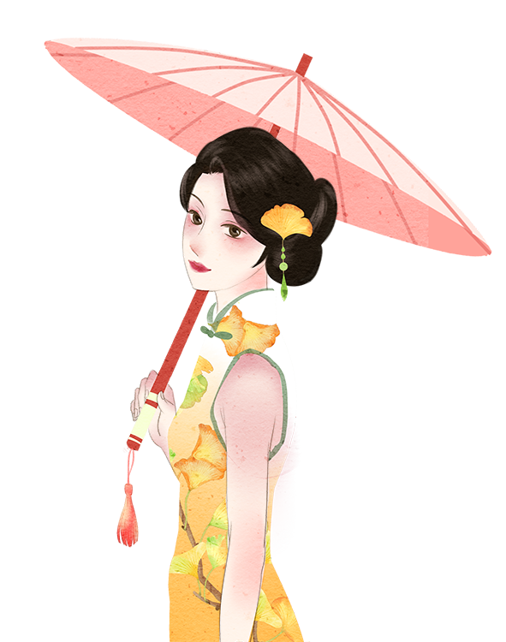

壹

Slide 7
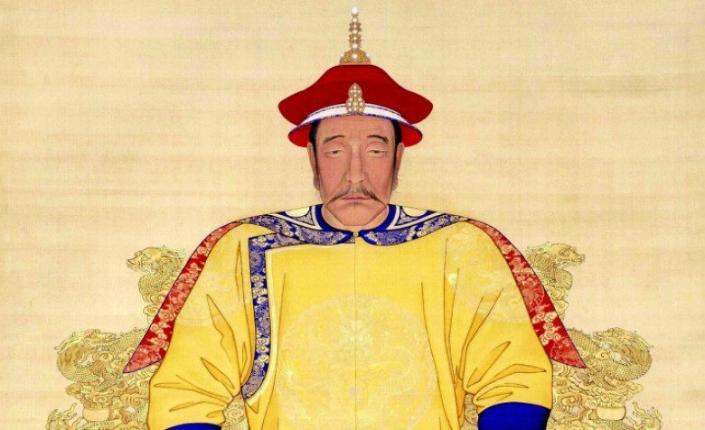
Stage 1:
Before Crossing Shanhaiguan
In the 1600s, following a series of campaigns led by a brave and ambitious chieftain named Nurhaci (努尔哈赤）the Manchus established the new Qing dynasty (清朝). The Manchu emperors were to conquer all of China and far beyond, and ruled for almost 300 years until the fall of imperial China(1644-1911).

Slide 8
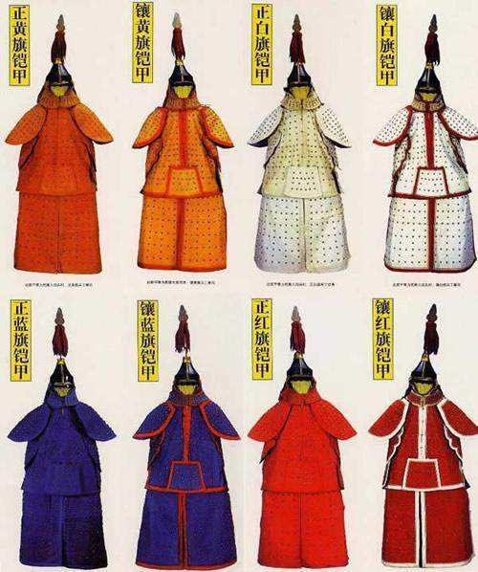
Stage 1:
Before Crossing Shanhaiguan
Although Nurhaci died before the formal establishment of Qing, he left behind a powerful legacy. He had united and expanded the Manchu army under the Eight-Banner (八旗) system, which eventually came to be the administrative foundations of the entire Qing society.

Slide 9
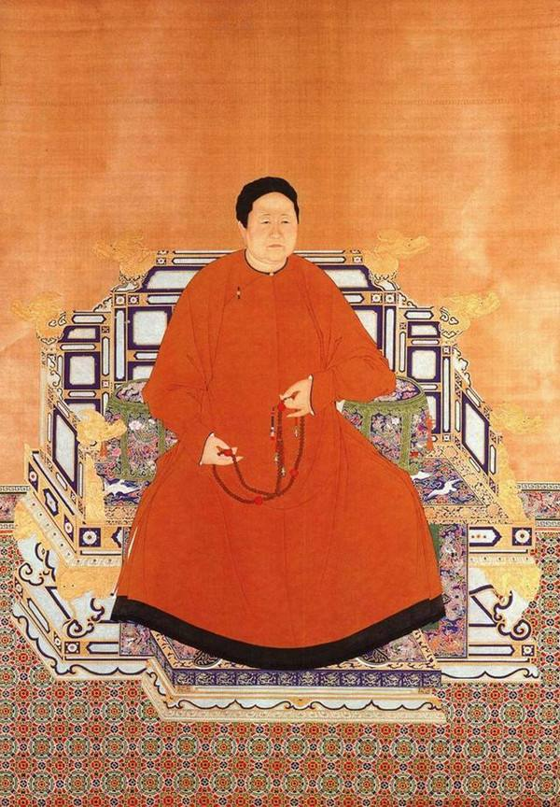
Stage 1:
Before Crossing Shanhaiguan
This is how the Manchus came to be known as the Banner people, and the long robes that they wore, came to be known as the Banner robes, or in Chinese Qipao. The Manchu Qipao was not body-hugging but was indeed baggy specifically to conceal the wearer’s figure.

Slide 10
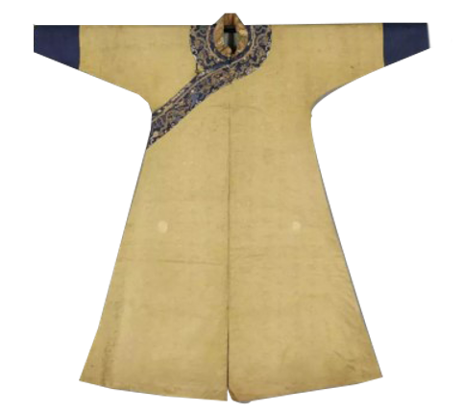
Stage 1:
Before Crossing Shanhaiguan
Influenced by the Mongol Pao, the Qipao consisted of a single long robe with a more fitted cut, narrow sleeves, known as hoof cuffs (马蹄袖)，four slits for ease of movement, and were fastened on the right side with buttons. Noticeably, in these early days the robes had small, round collars, suitable for hunting, riding, shooting, battling and the cold mountainous life.

Slide 11
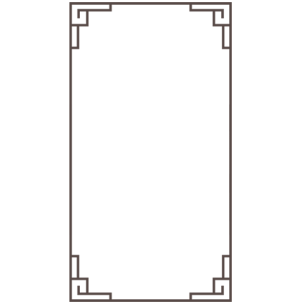
Stage 1:
Before Crossing Shanhaiguan
Round collar
Horse hoof
cuff
Loose and straight piece
Slits of four sides

Slide 12
贰

Slide 13
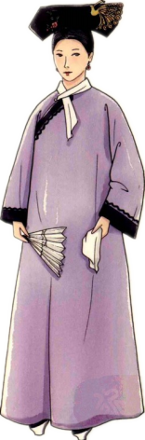
Stage 2:
During the Qing Dynasty
After the Manchus went across Shanhaiguan and established the Qing dynasty, their living environment, production mode and lifestyle changed dramatically. Along with the change, the evolution of cheongsam also came to the second stage.

Slide 14
Stage 2:
During the Qing Dynasty
With the Eight Banner system, all Han Chinese men had to wear the male version of the qipao, called Changshan (长衫), by which we got its English name Cheongsam. Despite strict enforcement to convert to Qipao, many Han people continued to wear hanfu throughout the Qing dynasty. But by mid to late Qing, the two styles of clothing had intermixed and influenced each other so much that they became very similar.

Slide 15
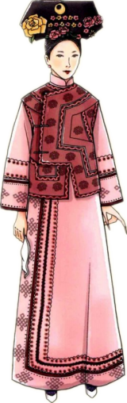
Stage 2:
During the Qing Dynasty
Qipao’s hoof cuffs widened, the collar became high, great ornamentation was employed through embroidery and piping, and fashionable vests (坎肩) of various styles were added. Large floral headpieces (大拉翅), stilted flower-vase shoes (花盆底) and red-centred lips completed the look.

Slide 16
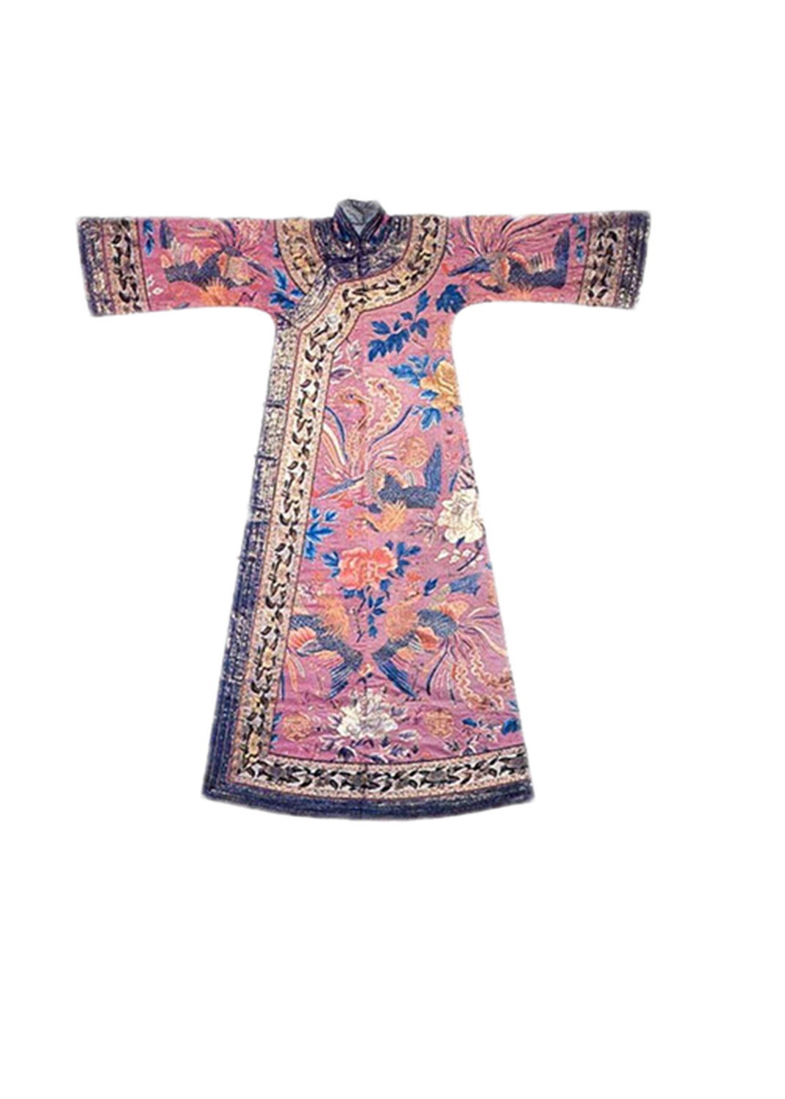
Stage 2:
During the Qing Dynasty
Higher collar
Reversed large sleeves(倒大袖）
Slits of two sides
Beautiful embroidery and various auspicious patterns

Slide 17
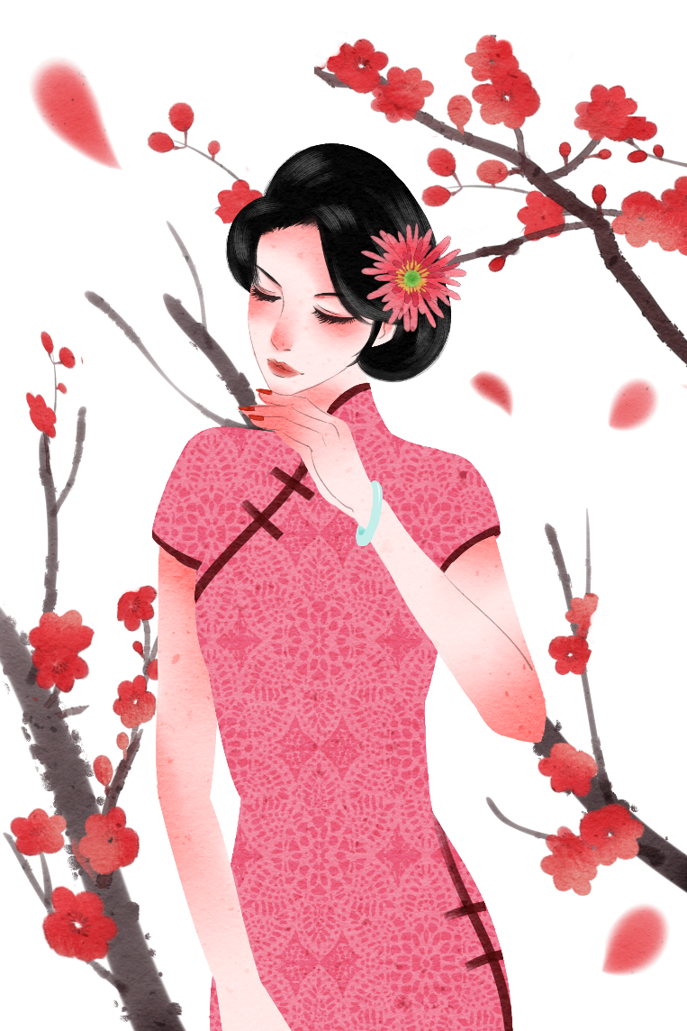
叁

Slide 18
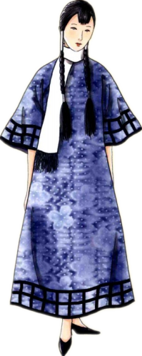
Stage 3:
During the Republic of China Period
The history of the Cheongsam took a sudden turn in 1911-12, along with the rest of China. With the revolution that overthrew imperial China, Chinese culture underwent seismic changes, and the Cheongsam was not exempt. The large fancy hair pieces (大拉翅) and stilted flower-vase shoes (花盆底) characteristic of the Qing dynasty disappeared entirely, and even the qipao itself became confined to only wealthy Manchu families.

Slide 19
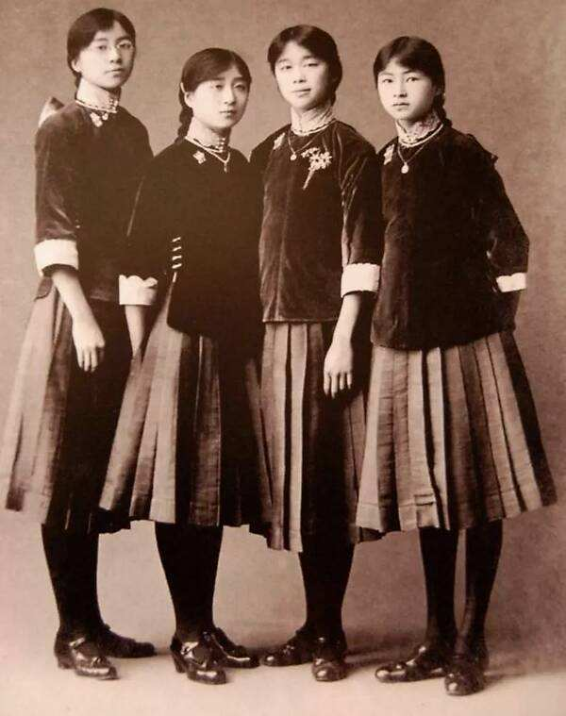
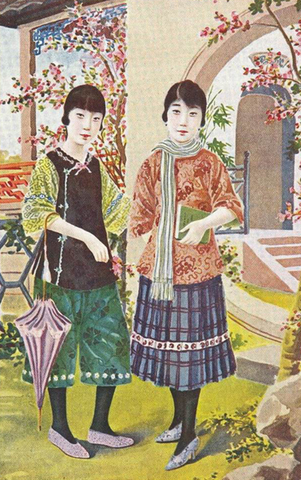
Stage 3:
During the Republic of China Period
Most Chinese women began to wear a two-piece outfit consisting of a top (very similar in style to a qipao, but shorter) and a long skirt. For the educated, liberal minded and fashion forward, trousers were worn for the first time.

Slide 20
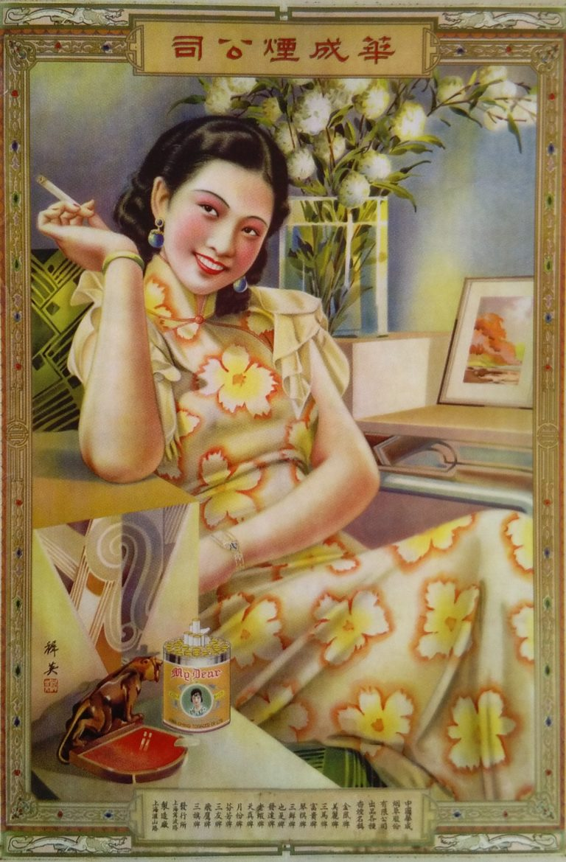
Stage 3:
During the Republic of China Period
By the 1930s, Shanghai had well and truly developed into the center of East Asia. And it was during the 1930s that the development of qipao became inextricably linked to the development of Shanghai.

Slide 21
Stage 3:
During the Republic of China Period
As high-waisted, figure-hugging dresses with long hemlines came into vogue in the west, the qipao followed suit. Gone were the bell sleeves and loose shapes of the 20s, the qipao of the 1930s had shorter, narrow sleeves (if any at all), extremely fitted waistlines, and by the mid 30s, hemlines that covered the back of the foot – and without high heels, long enough to literally sweep the floor.

Slide 22
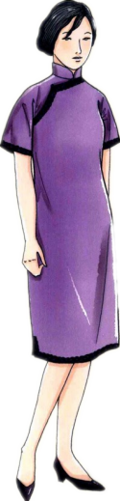
Stage 3:
During the Republic of China Period
By the mid 30s, many women had slits up to the thighs, revealing tantalizing flashes of leg and edges of their lace slips as they walked. This was contrasted with the long hemlines, and a high, stiff collar which reached the chin and kept the upper body straight and poised. Demure and proper on first sight, but with a hint of naughtiness – this was the allure of 1930’s qipao.

Slide 23
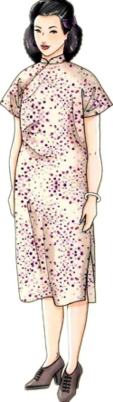
Stage 3:
During the Republic of China Period
By the early 1940s, the flamboyant qipaos of the 30s were no longer considered appropriate or affordable by many (prices of fabric had risen significantly due to war).And accordingly, the early 1940s qipao became extremely restrained. Sweeping hemlines of the 1930s were reduced to mid-calf or knee length, high collars were lowered, sleeves became non-existent in the summer. Materials, trimmings, pankous (knotted buttons used on qipaos) also all became very simplistic.

Slide 24
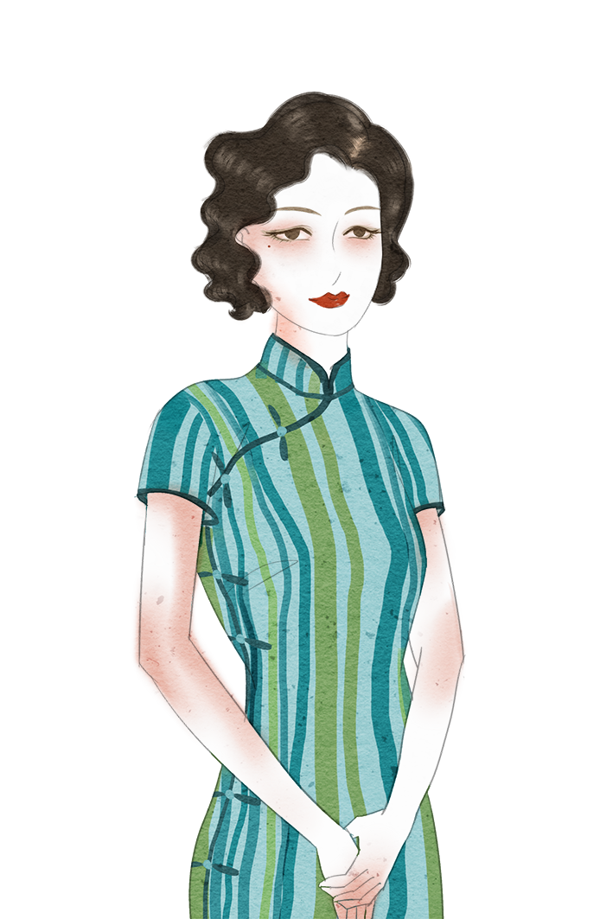
肆

Slide 25
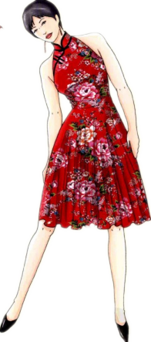
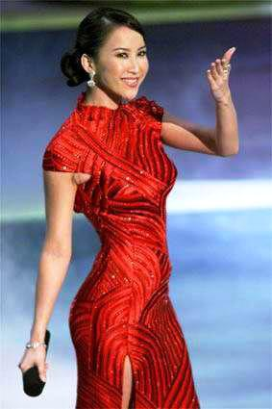
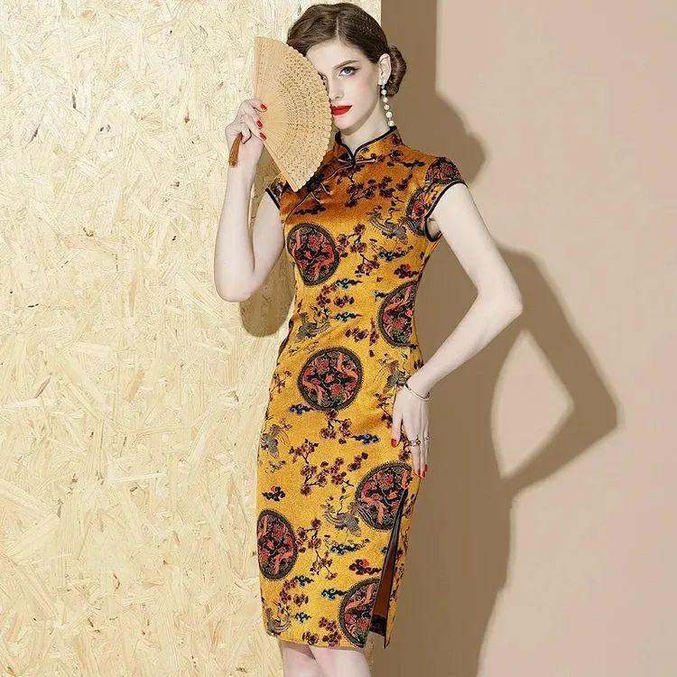
Stage 4:
Since the 1980s
After disappearing for nearly 30 years, cheongsam came into people’s sight and entered the fourth stage. The reform and opening-up policy, which not only greatly promoted the development of social economy but also sent the cheongsam to the world stage.

Slide 26
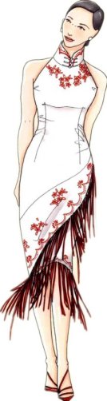
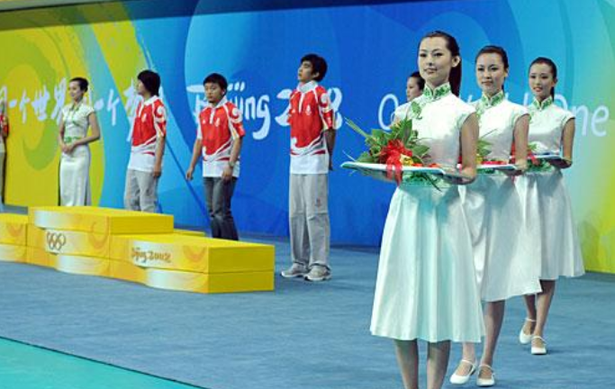
Stage 4:
Since the 1980s
Cheongsam has become an indispensable Chinese element in both the 2008 Olympic games and the national leaders’ meetings. Cheongsam has become the best representative of Chinese women’s clothing.

Slide 27
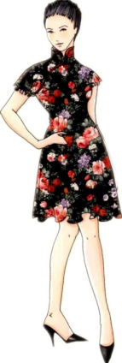
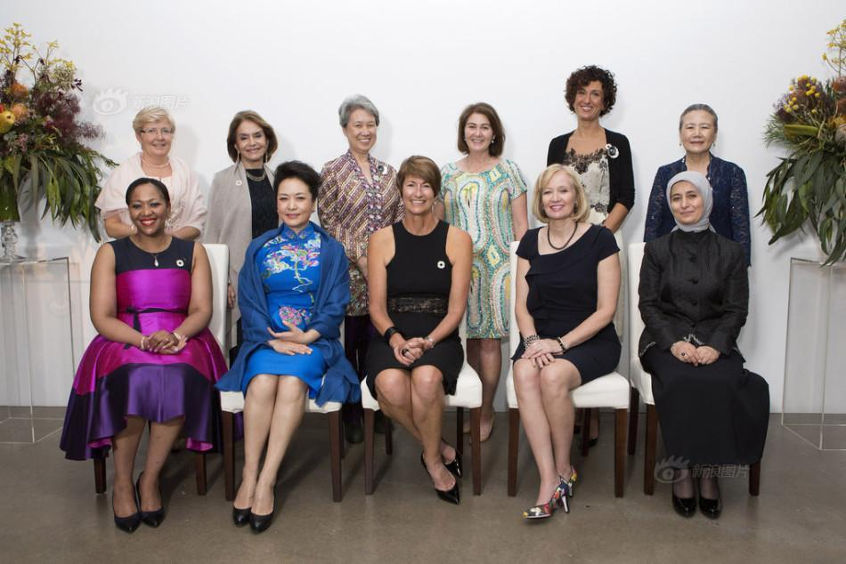
Stage 4:
Since the 1980s
Cheongsam, especially the modern one, is a very classic product to represent the beauty of Chinese’s traditional clothing. It reveals not only the history of the Han Chinese, but also the footprints of other ethics and cultures on the land.

Slide 28

该故事讲述了中国旗袍的发展史，其承载的文化意蕴和历史内涵对认知和传承中华民族优秀传统文化具有重要的意义。
《综合商务英语》III Unit 1 Text 3的题目为 Traditional Chinese Clothing, 该课文的主要内容为中国传统服饰的发展史，其中第七段重点讲到了中国旗袍。此故事既可以用作课文的导入，也可以作为对课文内容的补充拓展，帮助学生更好的了解中国传统文化。

Slide 29
Thank you!

