Slide 1

CHINA STORY
中国故事
Tells the story of a real China
讲述一个真实的中国

Slide 2

Beauty of Chinese Poetry

Slide 3

Contents
1
Brief Introduction to Translator Xu Yuanchong and His Theory of “Three Beauties”
2
Appreciation of Poem Translation by Xu Yuanchong

Slide 4

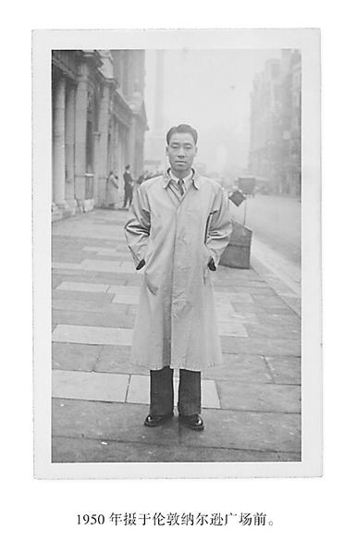
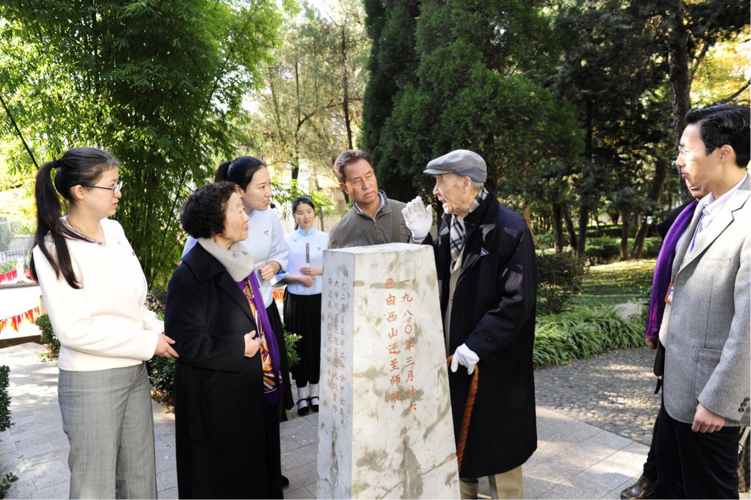

Slide 5
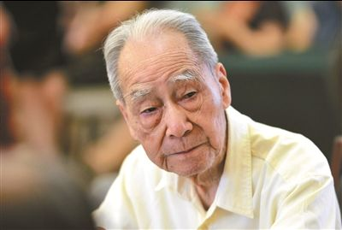
Profile
1921, born in Jiangxi Province of China
1943, graduated from department of foreign languages National Southwestern Associated University
1944, studying in Tsinghua University for foreign language
Since 1983 he has taught as a professor for international culture course at Peking University.
In 1991, he retired. He published twenty works before his retirement, and after that he continue to publish forty works.

Slide 6
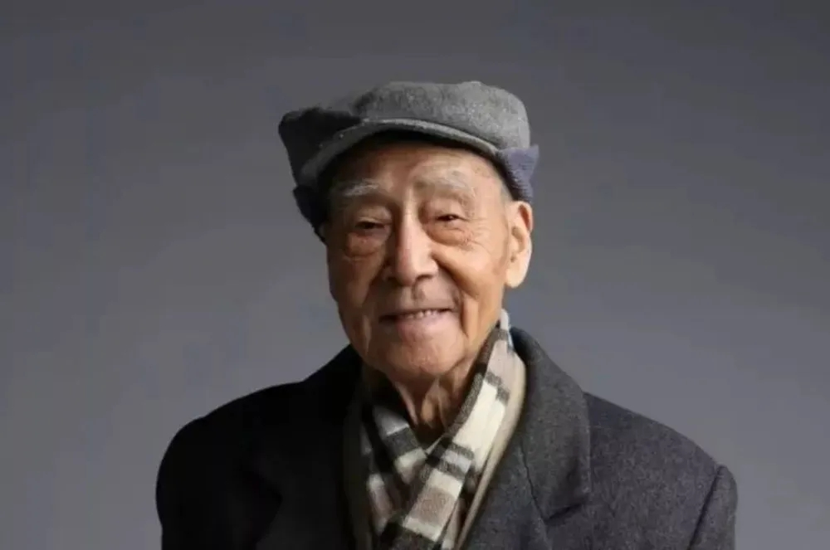
Achievement
In 1999, Xu Yuanchong was nominated for the Nobel Prize winner in literature
In 2010, he was awarded "translation culture lifetime achievement award“
In 2014, he was awarded "Aurora Borealis" outstanding literary translation award
He has been proclaimed as the only expert in the world who can translate Chinese poetry into English and French rhyme.

Slide 7
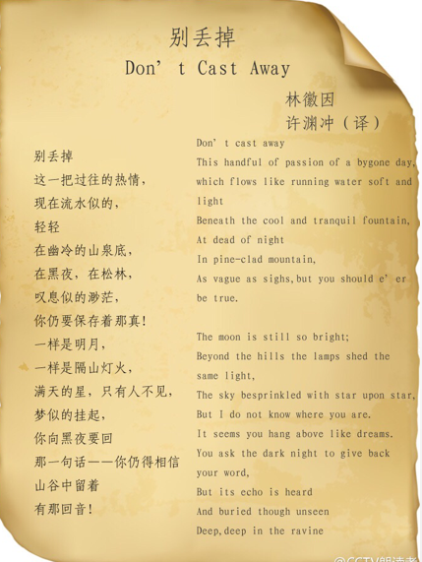
Translation Works
Book of Poetry
The Songs of the South
300 Tang Poems
300 Song Lyrics
Selected Poems of Li Bai
Poems and Lyrics of Su Dongpo
The Romance of the Western Bower
Selected Poems of Mao Zedong，ect.

Slide 8

Translation Theory of Three Beauties
Beauty in Three Aspects:
Beauty in Sense
意美，即思想内容美，能够感动人心
Beauty in Sound
音美，即音韵节奏美，读起来朗朗上口
Beauty in Form
形美，即形式上的美，字形结构、句式让人悦目

Slide 9
Appreciation of The Willow Tree
咏柳 贺知章 碧玉妆成一树高， 万条垂下绿丝绦。 不知细叶谁裁出， 二月春风似剪刀。 | The Willow Tree He Zhizhang The slender tree is dressed in emerald all about; Thousands of branches droop like fringes made of jade; But do you know by whom these slim leaves are cut out? The wind of early spring is sharp as scissor blade.

Slide 10
Beauty of Sound
咏柳 贺知章 碧玉妆成一树高， 万条垂下绿丝绦。 不知细叶谁裁出， 二月春风似剪刀。 | The Willow Tree He Zhizhang The slen der tree is dressed in eme rald all about; Thousands of branches droop like fringes made of jade; But do you know by whom these slim leaves are cut out? The wind of ear ly spring is sharp as scissor blade.
a
b
a
b
6-foot iambus

Slide 11
Beauty of Meaning
咏柳 贺知章 碧玉妆成一树高， 万条垂下绿丝绦。 不知细叶谁裁出， 二月春风似剪刀。 | The Willow Tree He Zhizhang The slender tree is dressed in emerald all about; Thousands of branches droop like fringes made of jade; But do you know by whom these slim leaves are cut out? The wind of early spring is sharp as scissor blade. (slend, emerald, droop, fringe, jade等词充分再现了古诗词中碧绿的柳枝在和煦的春风中摇摆的场景)

Slide 12

故事小结
故事介绍了翻译大家许渊冲先生的生平故事与翻译理论，并赏析了许渊冲英译唐诗《咏柳》。故事体现了著名翻译家的爱国精神与学术追求,能够很好地与翻译课程相结合。
《翻译理论与实践1》课程第四章为诗歌翻译，许渊冲先生的生平故事可以让学生很好地感受一代翻译大家对于中国文化的热爱和对于学术追求的执着。许渊冲先生的“三美理论”也可以帮同学们更好地理解诗歌翻译的基本要领，提升翻译鉴赏能力。

Slide 13
Thank you!

