Slide 1


Slide 2


The Double Ninth Festival

Slide 3





When is the festival?
What is the origin(起源) of the festival?
The Double Ninth Festival
What activities do people usually do on this day?
What is the meaning of the festival?

Slide 4

Time
(The 9th day of the 9th lunar month )

Slide 5
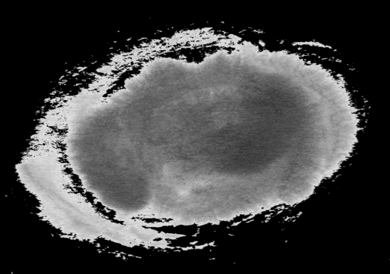
Origin
It was said that during the Eastern Han Dynasty, there was a young man named Huan Jing. He learned magic from a famous man who could predict the future.
The man asked Huan Jing to go home because the monster was going to appear on the 9th day of the 9th lunar month. Also, the man told him to take the people to the top of the mountain and give each person a leaf and a cup of wine . The advice and Huan Jing’s brave fighting saved all the people.

Slide 6
Poem
Thinking of My Brother On Mountain-Climbing
九月九日忆山东兄弟
Alone, a lonely stranger in a foreign land,
独在异乡为异客，
I doubly pine(渴望) for my kinsfolk（亲人） on holiday.
每逢佳节倍思亲。
I know my brothers would, with the dogwood（山茱萸）spray in hand.
遥知兄弟登高处，
Climb up the mountain and miss me so far away.
遍插茱萸少一人。

Slide 7
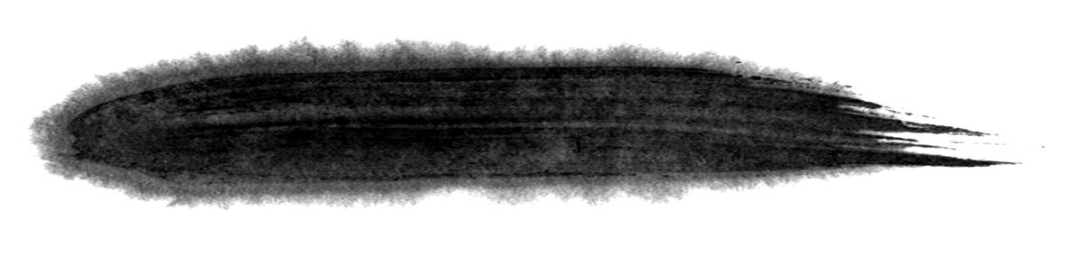

Activities
Eating Chongyang cake
Enjoying the chrysanthemum
Climbing high mountains

Slide 8
该故事介绍了重阳节的来历，时间以及意义。
在综英2 unit2 The virtues of growing older这篇课文中，结合重阳节的故事同学们理解the meaning of growing older and our respect for growing older.

Slide 9


